Slide 1
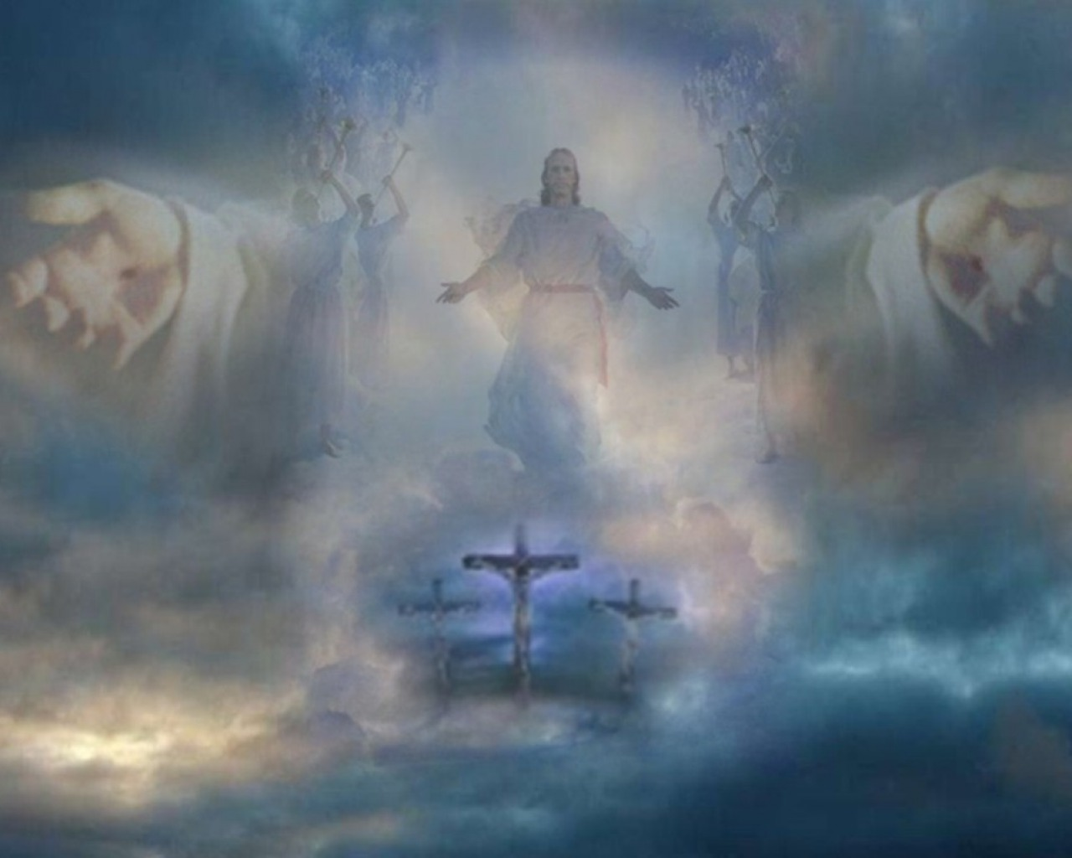
匿佇主的翅股下
Hidden in Under the Wings of the Lord
北區査經班 獻詩

Slide 2
1-6
你若對水中經過,我的確及你佇啲,
你若經過江河,水的確袂淹密你.
When you pass through the waters, I will be with you; and when you pass through the rivers, they will not sweep over you.

Slide 3
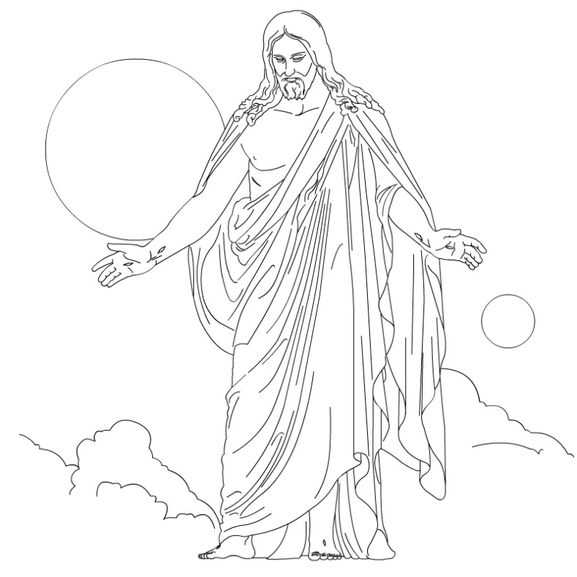
2-6
匿佇主的翅股下
互你堅固擱勇壯
驚惶及失望的人
就會找著平安
Hidden in under the wings of the Lord
Make you strong and sturdy
Dismayed and disappointed people,
Will find it safe

Slide 4
3-6
你若對火中經過
火的確袂燒著你
你若經過火焰中
亦袂燒著你的身上
匿佇主的翅股下
就會找著平安
When you walk through the fire, you will not be burned;
When you walk through the fire, the flames will not set you ablaze.
Hidden in under the wings of the Lord
Will find it safe

Slide 5
4-6
你若對水中經過,我的確及你佇啲,
你若經過江河,水的確袂淹密你.
When you pass through the waters, I will be with you; and when you pass through the rivers, they will not sweep over you.

Slide 6
5-6
匿佇主的翅股下
互你堅固擱勇壯
驚惶及失望的人
就會找著平安
Hidden in under the wings of the Lord
Make you strong and sturdy
Dismayed and disappointed people,
Will find it safe

Slide 7
6-6
你若對火中經過
火的確袂燒著你
你若經過火焰中
亦袂燒著你的身上
匿佇主的翅股下
就會找著平安
When you walk through the fire, you will not be burned;
When you walk through the fire, the flames will not set you ablaze.
Hidden in under the wings of the Lord
Will find it safe

