Slide 1
Amazing Grace,
how sweet the sound, That saved a wretch like me. I once was lost but now am found, Was blind, but now I see.
奇異恩典甘甜和諧，
救我脫離罪坑
前我失迷今我倒來，
睛瞑今得看見

Slide 2
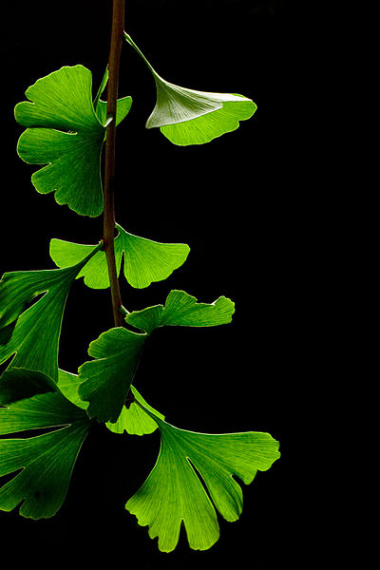
Amazing grace! Amazing grace!
So vast and yet so free!
The son of God, the righteous One,
is crucified for me.
奇異恩典!奇異恩典!
極大無比恩賜!
上帝聖子,公義的子
為我受釘十架.

Slide 3
T‘was Grace that taught my heart to fear. And Grace, my fears relieved. How precious did that Grace appear The hour I first believed.
主大恩典使我敬畏，
驚惶變作安慰
真心信靠就得恩惠，
主恩真正寶貴

Slide 4
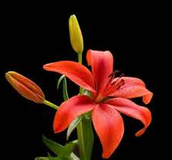
Amazing grace! Amazing grace!
So vast and yet so free!
The Son of God, the righteous One,
is crucified for me.
奇異恩典!奇異恩典!
極大無比恩賜!
上帝聖子,公義的子
為我受釘十架.

Slide 5
Through many dangers,
toils and snares I have already come; 'Tis Grace that brought me safe thus far and Grace will lead me home.
Led me home, led me home.
經過多多試鍊羅網，危險饑餓苦痛；
得主恩典引導保護，導我回歸故鄉。
歸故鄉,歸故鄉,歸故鄉.

Slide 6
When we've been here ten thousand years Bright shining as the sun. We've no less days to sing God's praise Than when we've first begun.
聖徒相見佇主身邊，
若日光照滿天；
歡喜吟詩主恩齊備，
讚美到萬萬年。

Slide 7
Amazing grace! Amazing grace!
So vast and yet so free!
The Son of God, the righteous One,
is crucified for me.
奇異恩典!奇異恩典!
極大無比恩賜!
上帝聖子,公義的子
為我受釘十架.

