Slide 1
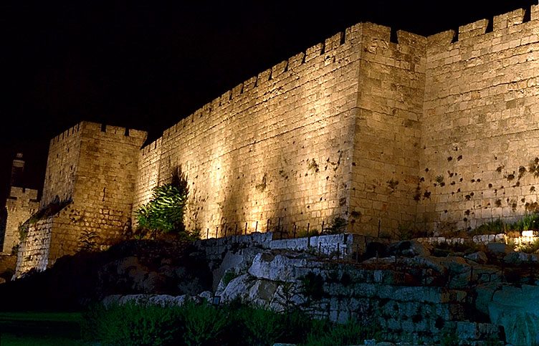
Narration: The final days of Christ’s earthly ministry were marked by powerful miracles and inspired teachings.
敘述：基督佇地上最後的日子，
祂的聖工有權能、神蹟與啟示。

Slide 2
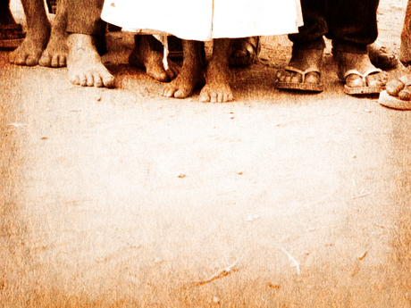
跟隨耶穌的人攏肯定祂真正是
上帝的子，是久久所等待的彌賽亞，是先知預言的成全。
For Jesus’ closest followers they were confirmation that He was indeed God’s Son, the long-awaited messiah;
the fulfillment of prophecies of old.

Slide 3

As Jesus and His followers prepared to
enter Jerusalem for the Passover, the most
holy of holidays, the words of the prophet
Zechariah were fulfilled in yet another
display of god’s plan for Jesus:
這時耶穌與跟隨祂的人欲入耶路撒冷準備踰越節，是最神聖的日，是照先知撒迦利亞所講欲成全上帝佇耶穌的計劃.

Slide 4
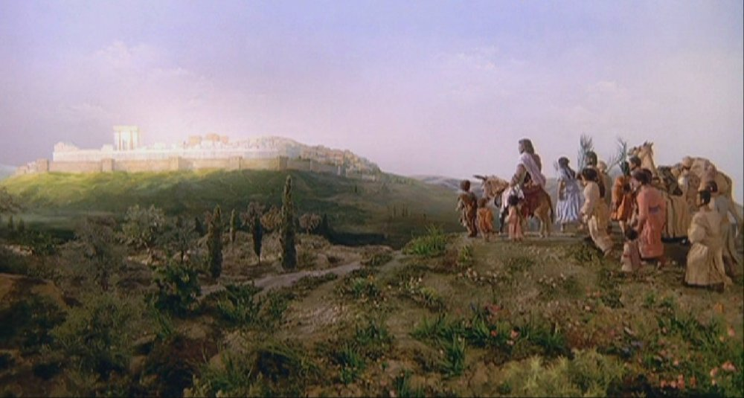
Say to the Daughter of Zion, “see, your King comes to you, gentle and riding on a donkey, on a colt, the foal of a donkey.,”
對錫安的女子說“看啊，妳的王來就近妳，溫柔又騎驢，與驢所生的驢仔子”。 (撒迦利亞書9:9)

Slide 5

Great is the Lord,
He is worthy of praise.
Hosanna to the King! Sing to the Lord,
let your voices be raised.
He is the King of glory! 至大的主,值得咱的謳咾.
和散那咱的王!
謳咾我主咱著大聲謳咾.
祂是榮光的君王!

Slide 6

Rejoice, O daughter of Zion,
your King is coming today!
With open arms, receive Him now.
With palms prepare Him the way!
歡喜，郇城的眾女子，
你的王今日臨到!
展開雙手，迎接咱王.
用棕樹枝迎接祂.

Slide 7

Great is the Lord,
He is worthy of praise.
Hosanna to the King! Sing to the Lord,
let your voices be raised.
He is the King of glory! 至大的主,值得咱的謳咾.
和散那咱的王!
謳咾我主咱著大聲謳咾.
祂是榮光的君王!

Slide 8

Blessed is He, the King of kings,
who comes in the name of the Lord.
Lift up your heads, O royal gates,
be lifted up, ancient doors.
祂要賜福，萬王的王，
祂是佇主的名來的.
舉起你頭，榮光的門， 義的門著受舉起.

Slide 9

Sing “Hosanna, Hosanna to the King!”
Sing “Hosanna!”
He is the King of glory!
唱和散那，和散那咱的王!
唱和散那，
祂是榮光的君王!

Slide 10

Great is the Lord,
He is worthy of praise.
Hosanna to the King! Sing to the Lord,
let your voices be raised.
He is the King of glory! 至大的主,值得咱的謳咾.
和散那咱的王!
謳咾我主咱著大聲謳咾.
祂是榮光的君王!

Slide 11
Great is the Lord,
He is worthy of praise.
Hosanna to the King! Sing to the Lord,
let your voices be raised.
He is the King of glory! 至大的主,值得咱的謳咾.
和散那咱的王!
謳咾我主咱著大聲謳咾.
祂是榮光的君王!(2X)

Slide 12
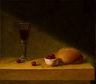
In the Garden He Prayed 在園內祈禱 Narrator: On the day of the Passover Feast, Jesus gathered His disciples together to share this holy time. 敘述者﹕逾越節彼日，耶穌與門徒做伙坐桌，來慶祝這個神聖的節日。

Slide 13
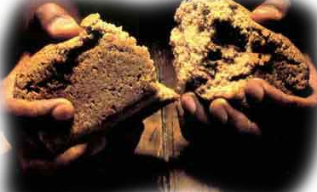
Following the meal, Jesus told them of difficult hours which were soon to come. 食的時，耶穌給門徒講﹕ 苦難日子欲到﹔

Slide 14
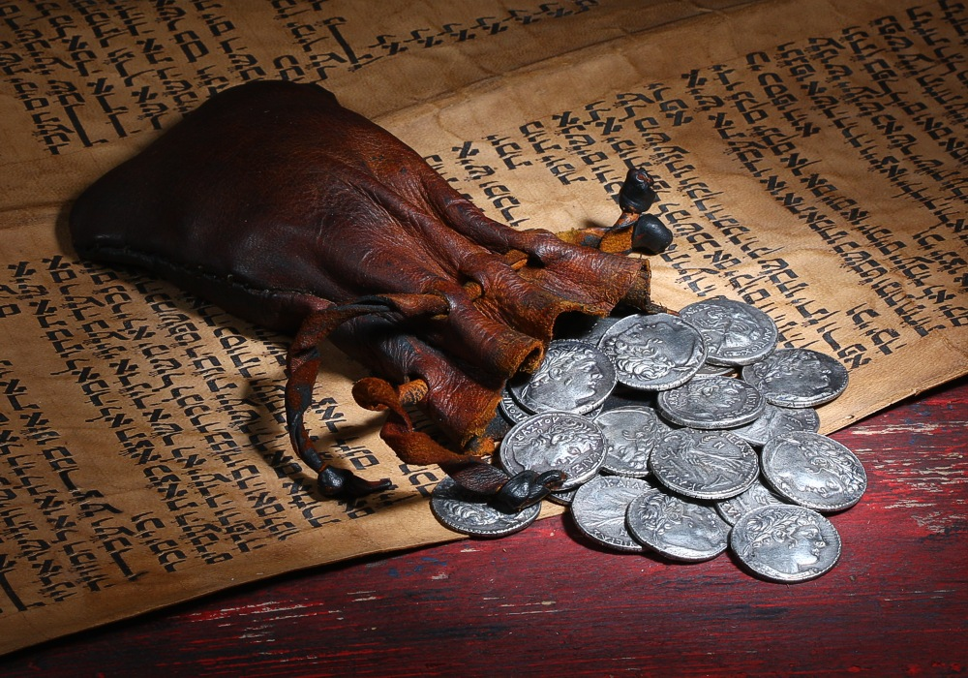
He shared of betrayal and rejection
which would emerge even within this
intimate circle of friends.
祂會受背叛、
受拒絕，甚至
受家己內部的
人陷害。

Slide 15
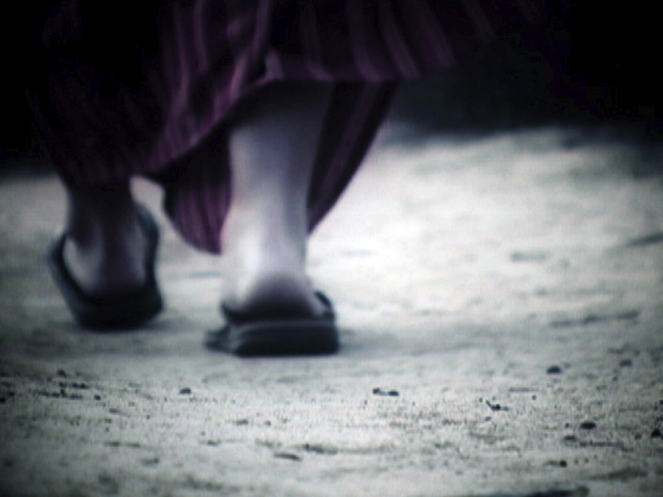
Confused, yet determined to affirm their commitment, the disciples followed Jesus to a place called Gethsemane.
門徒無了解，總是攏表示欲跟隨祂。門徒跟隨祂來到一個所在名叫客西馬尼園。

Slide 16
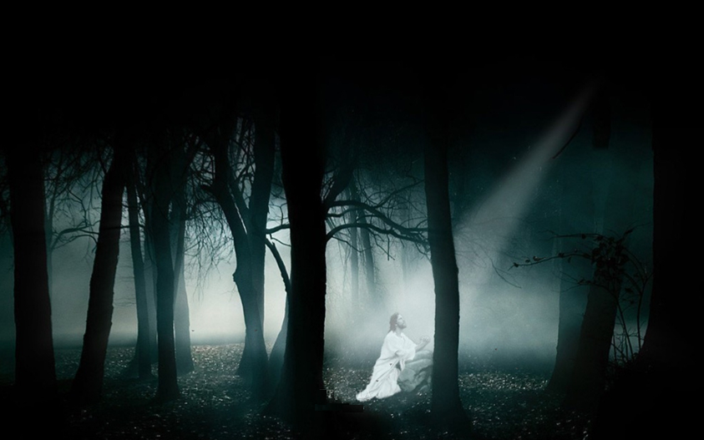
Going a bit further in order to be alone, Jesus fell to the ground in anguish and prayed. 祂家己一個人行到卡頭前，俯佇地上 迫切啲祈禱。

Slide 17
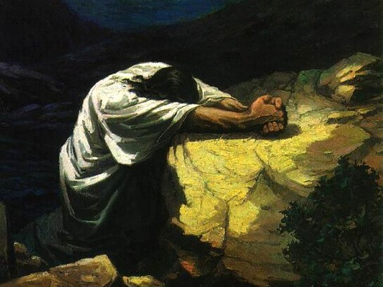
Jesus, alone in the garden, fell to the ground where He prayed, “Father, O Holy Father, my soul is dark and dismayed. 耶穌真孤單在園內， 仆落祈禱的所在， “天父，至聖的天父， 我靈暗淡又慘悽.

Slide 18
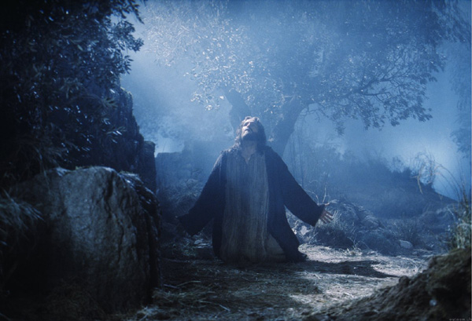
Please take this bitter cup from me. My spirit longs to be free. “Yet not my will”, cried the Savior as there in the garden He prayed. 徙開苦杯離開我去， 我靈欣慕得放離. 但是祈求不從自己”， 祂在園內祈求指示.

Slide 19
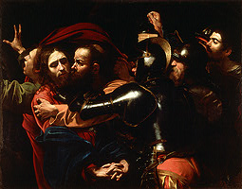
Soldiers with clubs came to seize Him as there in the garden He prayed; led by a fallen disciple, by a kiss Jesus was betrayed. 兵丁攑傢俬來捉祂，是當祂在祈禱的時. 猶大導路付出代價，用親嘴耶穌受出賣.

Slide 20
Abandoned by those who most loved Him, deserted and all alone. Taken to face His accusers from the garden where He had prayed. 祂所愛的人也放拺祂，我主孤單受拋棄. 受提面對控告陷害，是祂在祈禱的所在.

Slide 21
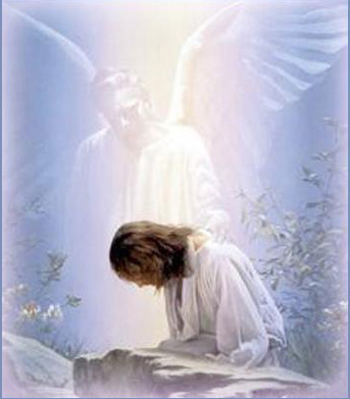
Jesus, the chosen One of God, Son of the great I Am! Sent to redeem the world in love, Jesus, God’s holy Lamb! It was there in the garden He prayed. 耶穌是上帝所揀選， 是大聖子完全! 為著疼,祂來救世間 聖羊羔賜平安! 祂在園內祈禱求幫助.

Slide 22

Jesus, whose life had been characterized by love, had now been handed over to a mob motivated by hate. 耶穌，一生充滿愛的人， 受抓交給一群充滿怨恨的人群。

Slide 23
He was taken to a place where he stood before high priest, the chief priests, elders, and teachers of Law.
他受縛交給眾祭司頭，
百姓的長老以及
經學士的面前。

Slide 24
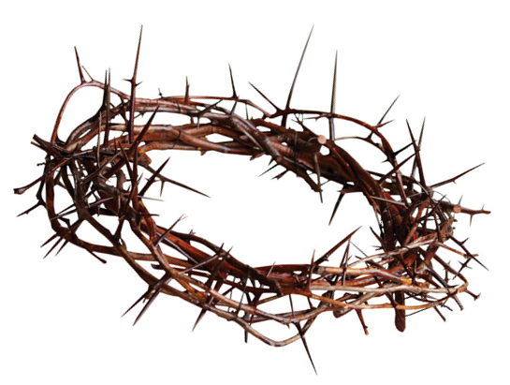
In a trail filled with mockery and deception, Jesus was sentenced to a criminal's death: crucifixion on a cross.
在充滿譏刺及欺騙的審判過程之後
耶穌受定罪判死刑：釘十字架。

Slide 25
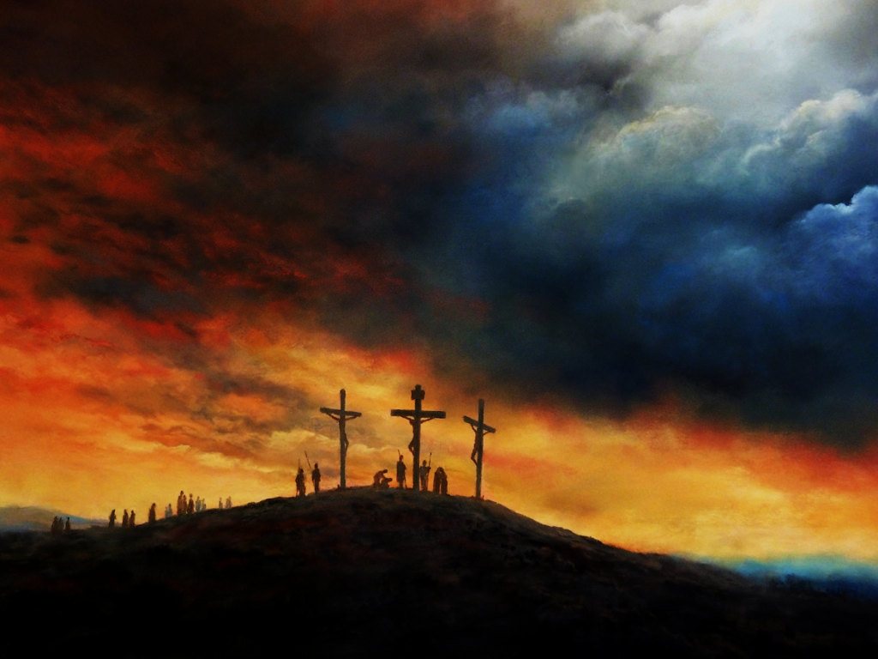
Mocked, beaten, and rejected,
He was led to a place called
The Skull to be crucified. 受恥笑，拒絕，身軀受鞭打，
耶穌行經過那條受苦的路，
到抵各各他，受釘死。

Slide 26

Down the Via Dolorosa，
in Jerusalem that day. The soldiers tried to clear
the narrow street. But the crowd pressed in to see
The Man condemned to die on Calvary. 行過多勒羅沙道路，彼日在耶路撒冷.
兵丁想欲撥開一條小路.
若是眾人想要看，
啲要死在各各他的一人.

Slide 27
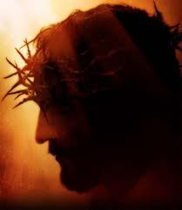
He was bleeding from a beating.
There were stripes upon His back,
And He wore a crown of thorns
upon His head,
And He bore with every step.
The scorn of those
who cried out for His death. 祂受鞭打血流不止，身驅滿滿受傷痕
祂的頭殼頂戴荊仔的冕旒.
每一步攏得承受，
要釘死祂的人在譏刺.

Slide 28
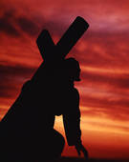
Down the Via Dolorosa
called “the Way of Suffering." Like a lamb came the Messiah,
Christ the King. But He chose to walk that road
out of his love for you and me.
行過多勒羅沙道路，
稱作受難的道路.
基督君王彌賽亞上帝羊羔.
祂選擇行這條路，
是為著疼你和我.

Slide 29
Down the Via Dolorosa，
all the way to Calvary. 行過多勒羅沙道路，
一路到抵各各他.

Slide 30
He was bleeding from a beating.
There were stripes upon His back,
And He wore a crown
of thorns upon His head,
And He bore with every step.
The scorn of those
who cried out for His death. 祂受鞭打血流不止
身驅滿滿受傷痕
祂的頭殼頂戴荊仔的冕旒
每一步攏得承受
要釘死祂的人在譏刺

Slide 31

Down the Via Dolorosa
called “the Way of Suffering." Like a lamb came the Messiah, Christ the King. But He chose to walk that road
out of his love for you and me.
行過多勒羅沙道路，稱作受難的道路.
基督君王彌賽亞上帝羊羔.
祂選擇行這條路，是為著疼你和我.

Slide 32
The blood that would cleanse the souls
of all men made its way through
the heart of Jerusalem. Down the Via Dolorosa
called “the Way of Suffering." Like a lamb came the Messiah,
Christ the King. 祂寶血洗清所有的靈魂.
使祂甘心行過到耶路撒冷
行過多勒羅沙道路，
稱作受難的道路.
基督君王彌賽亞上帝羊羔.

Slide 33
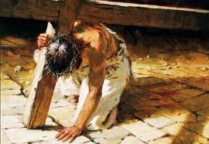
But He chose to walk that road
out of his love for you and me.
Down the Via Dolorosa，
all the way to Calvary. 祂選擇行這條路，是為著疼你和我.
行過多勒羅沙道路，一路到抵各各他.

Slide 34
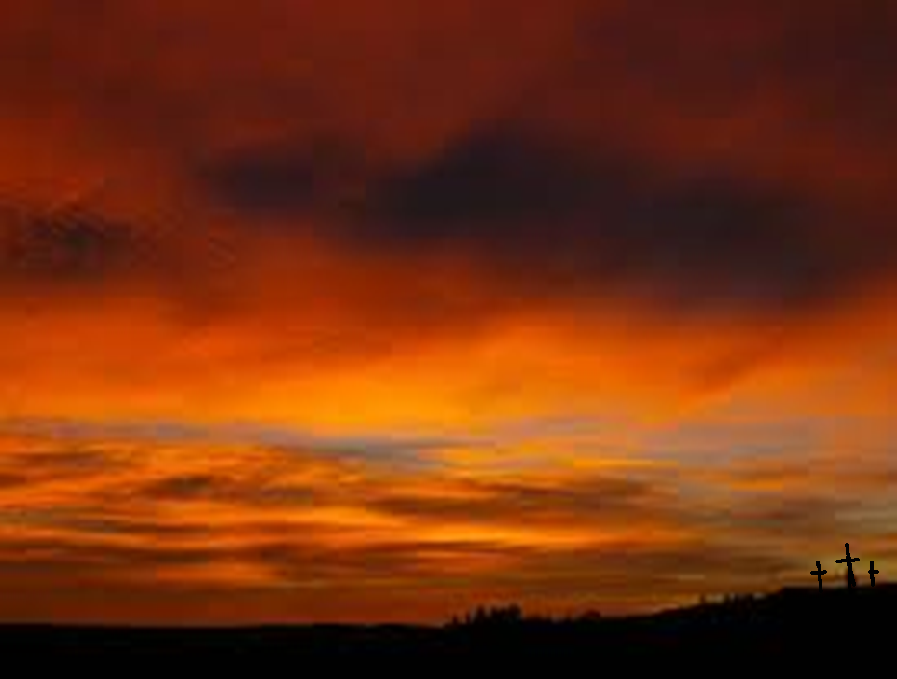
Instead of it being a place of great tragedy, Calvary became the place where we discover how deeply God loves us and what He was willing to sacrifice to redeem us.
無成做一個大悲劇的所在,各各他反轉成為一個給咱了解上帝疼咱極深的所在，也明白祂願意犧牲這樣(chia-ni)大來拯救咱。

Slide 35

All we have to do
is respond to His love with trust and gratitude.
This is the depth and breadth of Calvary's Love!
咱今所要做的是要用信靠及感恩來回應衪的愛-
上帝各各他深深的愛。

Slide 36

(1/5)
各各他的疼真燦爛,賜咱自由到永遠
如親像安穏的大船,行佇人生的海洋
Calvary's love will sail forever;
Bright and shinning, strong and free.
Like an ark of peace and safety
on the sea of human need.

Slide 37
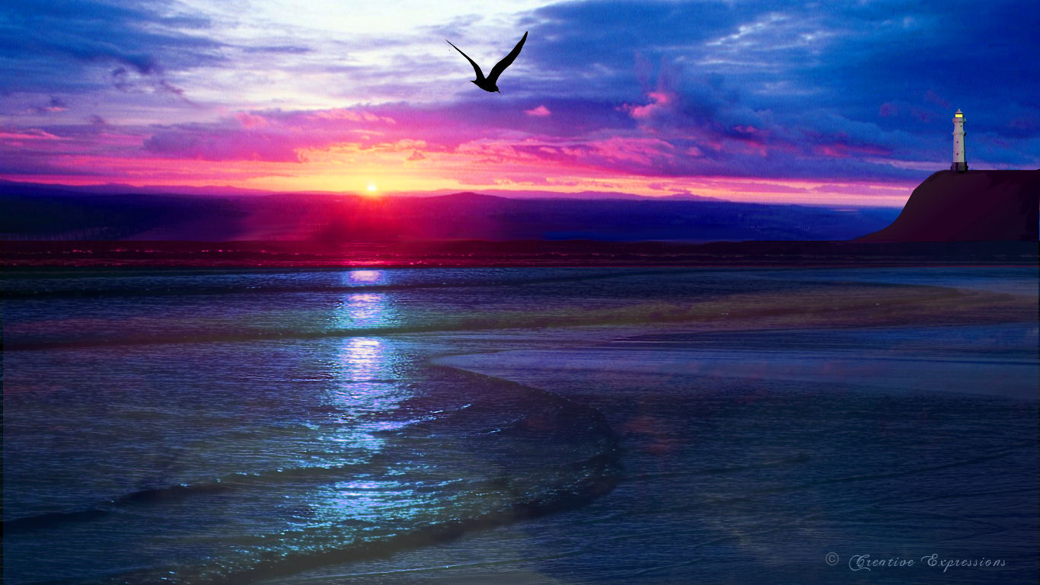
經過萬世代的風浪,孤單心靈時常厭倦
到路尾通得著安息,攏是各各他的大疼痛.
Through the hours of all the ages,
those tired of sailing on their own
finally rest inside the shadow cast
by Calvary's love across their souls.

Slide 38
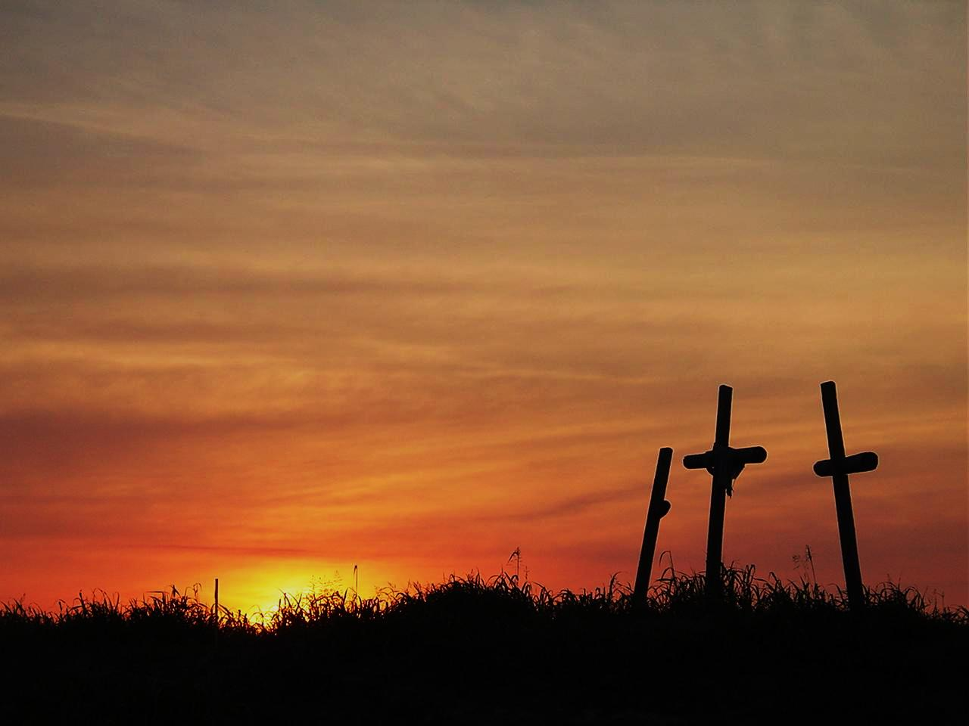
各各他的疼(2/5)
各各他大疼痛,基督今將咱看做寶貝.罪惡袂贏過,各各他大疼痛
Calvary's love, Calvary's love;
Priceless gift Christ makes us worthy of. The deepes sin can’t rise above
Calvary's love.

Slide 39
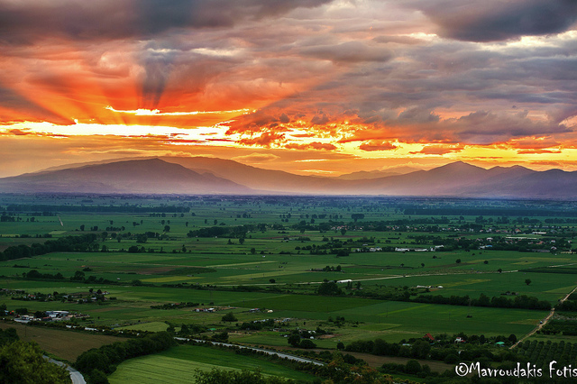
(3/5)
各各他的疼會醫治,互人受棄拺的心靈
通的著天頂的喜樂,空虛心肝今滿足
Calvary's love can heal the spirit life has crushed and cast aside; and redeem till Heaven’s promise joy once empty eyes.

Slide 40
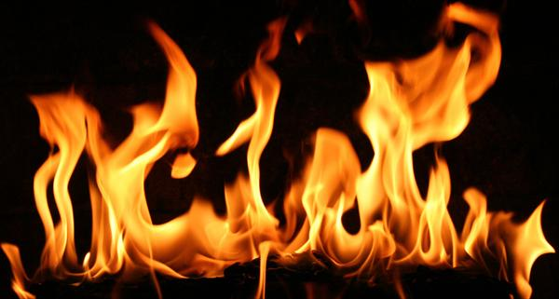
阮今愛宣揚這故事,因祂疼咱甘願受死
無別項疼比這卡大,
各各他大疼痛親像火焰
Se desire to tell the story of love that loved enough to die; burns away all other passions, and fed by Calvary’s love becomes a fire.

Slide 41
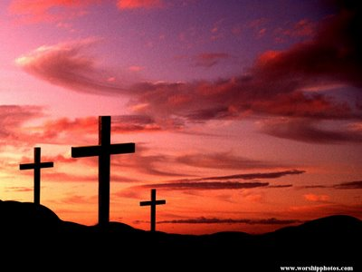
各各他的疼(4/5)
各各他大疼痛
基督今將咱看做寶貝
罪惡袂贏過各各他大疼痛
Calvary's love, Calvary's love;
Priceless gift Christ makes us worthy of. The deepes sin can’t rise above
Calvary's love

Slide 42

各各他永遠大疼痛,一切奇妙閣齊全
我靈魂行永活路程,罪得赦就到天庭
Calvary’s love has never faltered,
all its wonders will remain.
Souls still take eternal passage;
sins atoned and Heaven gained.

Slide 43

罪得赦就到天庭,
罪得赦 罪得赦
罪得赦就到天庭
sins atoned and Heaven gained,
sins atoned sins atoned
sins a toned and Heaven gained.

