Slide 1
主的聖手 Higher Hands
TPC 聖樂團 聯合詩班
TPC Choir

Slide 2
主的聖手引導我
主的聖手照顧我
我深知我無孤單
當我行世間路途
因為有主的聖手引導我
Higher hands are leading me I am not alone, I know As I walk this world below For higher hands are leading me
1/5

Slide 3
雖然我沒有互人看重
失落在宇宙間
上帝佇天頂啲看顧
雖然我沒看見祂
Though it seems I’m oft unnoticed And lost in time and space God above is watching o’er me Though I cannot see his face
2/5

Slide 4
主的聖手引導我
主的聖手照顧我
我深知我無孤單
當我行世間路途
因為有主的聖手引導我
Higher hands are leading me
I am not alone, I know As I walk this world below For higher hands are leading me
3/5

Slide 5
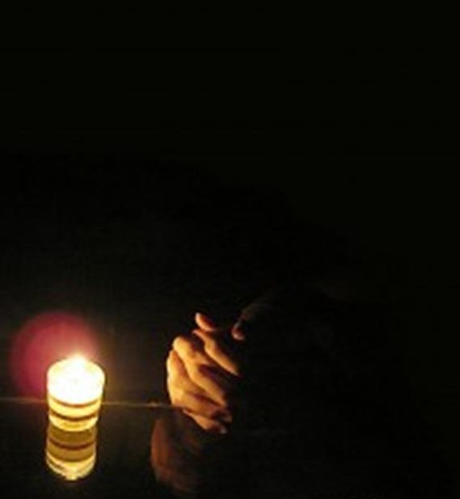
雖然我不會知將來
總是我攏無驚
因為我深信主照顧
祂要導我到永遠
So I face an unknown future Full of faith and unafraid And the peace I have
through trusting For the world I would not trade
4/5

Slide 6
主的聖手引導我 主的聖手照顧我
我深知我無孤單 當我行世間路途
因為有主的聖手引導我
因為有主的聖手引導我
聖手導我
Higher hands are leading me
I am not alone, I know As I walk this world below For higher hands are leading me
For higher hands are leading me
higher hands leading me
5/5

