Slide 1
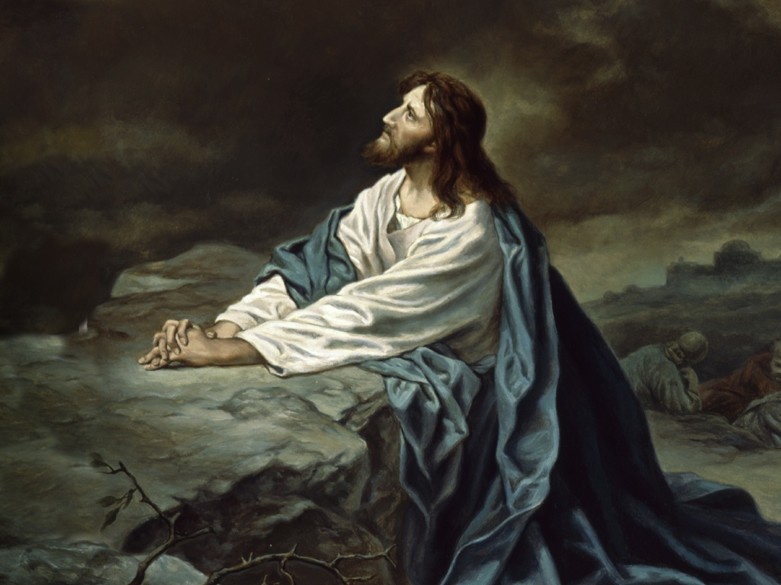
主日清晨禱告事項:
祈 禱
For our church
For you and me
為著咱的教會
為著你我 心意更新 全新的你我

Slide 2

歡迎您來到
柑縣台灣基督長老教會
Welcome To Join Sunday Worship. F.P.C.O.C.
同心建造 人人傳道
請肅靜,預備心來敬拜上帝
請關掉您的手機,傳呼器…
Notes:
2

Slide 3
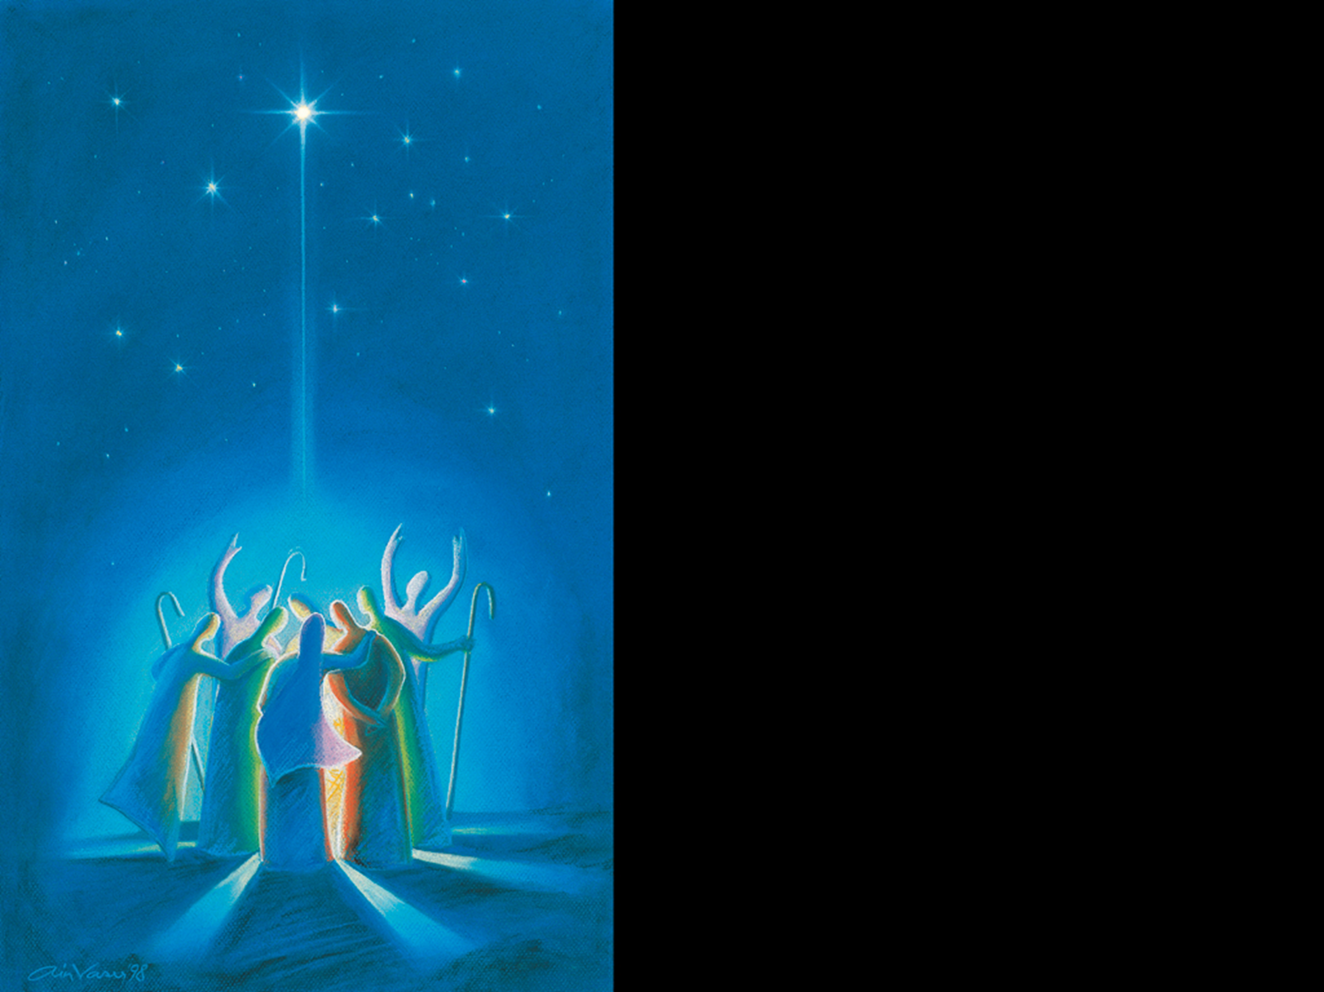
靜候上帝
Prelude
(Prepare your heart for the worship)
序樂
默禱敬拜

Slide 4
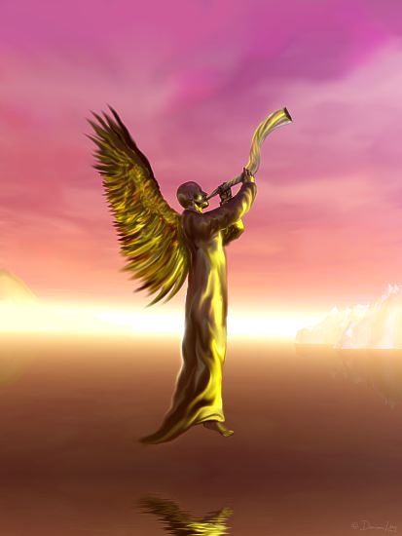
Call To
Worship
宣召

Slide 5
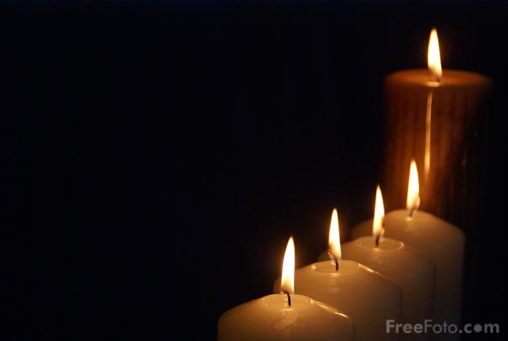
點待降節蠟燭
Advent Candle Lighting
Mr. & Mrs. Joseph Cheng
鄭省吾 長老夫婦

Slide 6

詩歌讚美
(咱來讚美敬拜主)

Slide 7

To Be Update

Slide 8
You are my all in all
你是我的一切

Slide 9

我主上帝何等偉大
Then sings my soul,
my Savior God, to thee:
How great thou art!
How great thou art!
我心出聲,讚美上帝聖名,
祢真偉大,何等偉大。
我主上帝 1/7

Slide 10
Then sings my soul,
my Savior God, to thee:
How great thou art!
How great thou art!
我心出聲,讚美上帝聖名,
祢真偉大,何等偉大。

Slide 11

O Lord my God,
when I in awesome wonder
Consider all the worlds
thy hands have made,
我主上帝,
我愈想就愈憨愕,
祢的聖手所做一切工程,

Slide 12
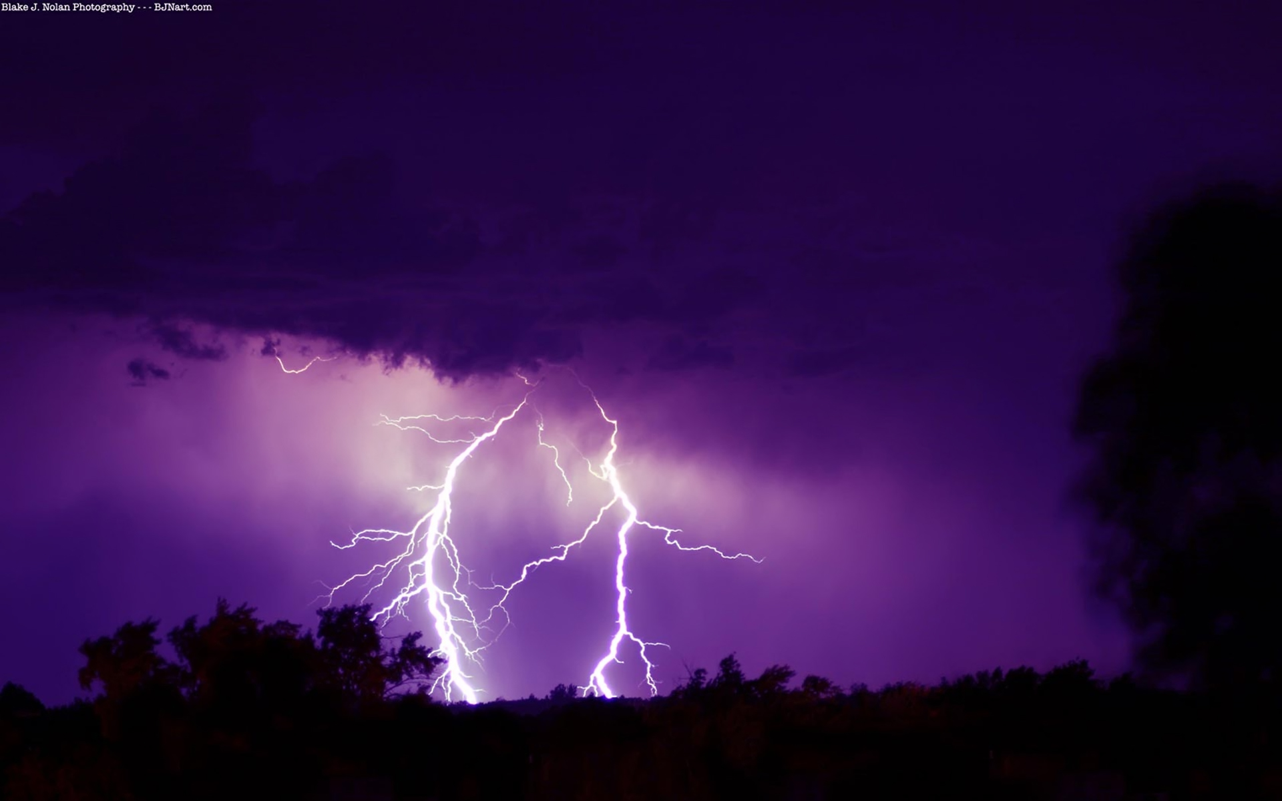
I see the stars,
I hear the rolling thunder,
Thy power throughout the universe displayed.
看見星辰,閣聽見雷的響聲, 宇宙充滿祢奇妙的工程。

Slide 13

Then sings my soul,
my Savior God, to thee:
How great thou art!
How great thou art!
我心出聲, 讚美上帝聖名,
祢真偉大, 何等偉大。(2X)

Slide 14
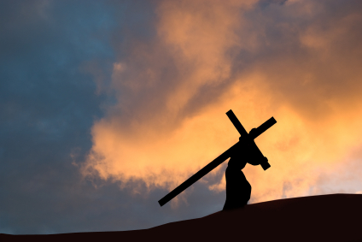
真懊了解, 上帝無惜祂聖子,
差來世間替人類獻生命,
And when I think, that God,
His Son not sparing;
Sent Him to die, I scarce can take it in;

Slide 15
佇十架頂,甘願替贖咱罪過,
流血慘死互我通得永活。
That on the cross my burden
gladly bearing,
He bled and died to take away my sin:

Slide 16

我心出聲, 讚美上帝聖名,
Góa sim chhut-siaⁿ, o-ló Siōng-tè sèng miâ
祢真偉大, 何等偉大。
Lí chin úi-tāi, hô-téng úi-tāi
Then sings my soul,
my Savior God, to Thee:
How great thou art! How great thou art!

Slide 17

When Christ shall come
with shout of acclamation
And take me home
what joy shall fill my heart!
主欲閣來,哨角的聲在大彈, 接我轉去天家快樂無限,

Slide 18

Then I shall bow
in humble adoration
And there proclaim, my God,
how great thou art!
我欲虔誠,謙卑跪落來敬拜,
報揚上帝,我主,祢真偉大。

Slide 19

Then sings my soul,
my Savior God, to Thee:
How great thou art!
How great thou art!
我心出聲, 讚美上帝聖名,
祢真偉大, 何等偉大。

Slide 20
我心出聲, 讚美上帝聖名,
Góa sim chhut-siaⁿ, o-ló Siōng-tè sèng miâ
祢真偉大, 何等偉大。
Lí chin úi-tāi, hô-téng úi-tāi
Then sings my soul,
my Savior God, to Thee:
How great thou art! How great thou art!

Slide 21
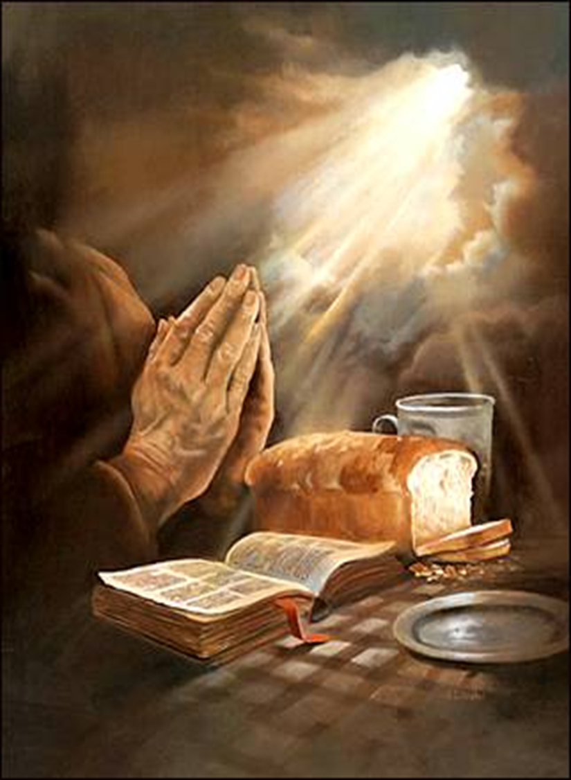
祈禱
司會領禱後
會眾同誦主禱文

Slide 22
阮在天裡的父,願祢的名聖,
祢的國臨到,祢的旨意得成,
在地裡親像在天裡.阮的日食
今仔日給阮.赦免阮的辜負,
Our Father which art in heaven, Hallowed be thy name. Thy kingdom come, Thy will be done in earth, as it is in heaven. Give us this day our daily bread. And forgive us our debts, as we forgive our debtors.

Slide 23
親像阮亦有赦免辜負阮的人.
勿得導阮入於試,
著救阮脫離彼個惡的.
因為國,權能,榮光攏是祢所有,
代代無盡,阿們.
And lead us not into temptation, but deliver us from evil: For thine is the kingdom, and the power, and the glory, for ever. Amen

Slide 24
主聽阮祈禱(3)
賞賜阮平安
阿們！
Lord, hear our prayer(3) bring us peace.
A-Men

Slide 25

聖經
Nehemiah 尼希米記
2:17-20
司會：這是上帝的話
會眾：感謝上帝

Slide 26

等待
Waiting
聖歌隊Choir

Slide 27

Waiting 等待
聖歌隊 獻詩

Slide 28
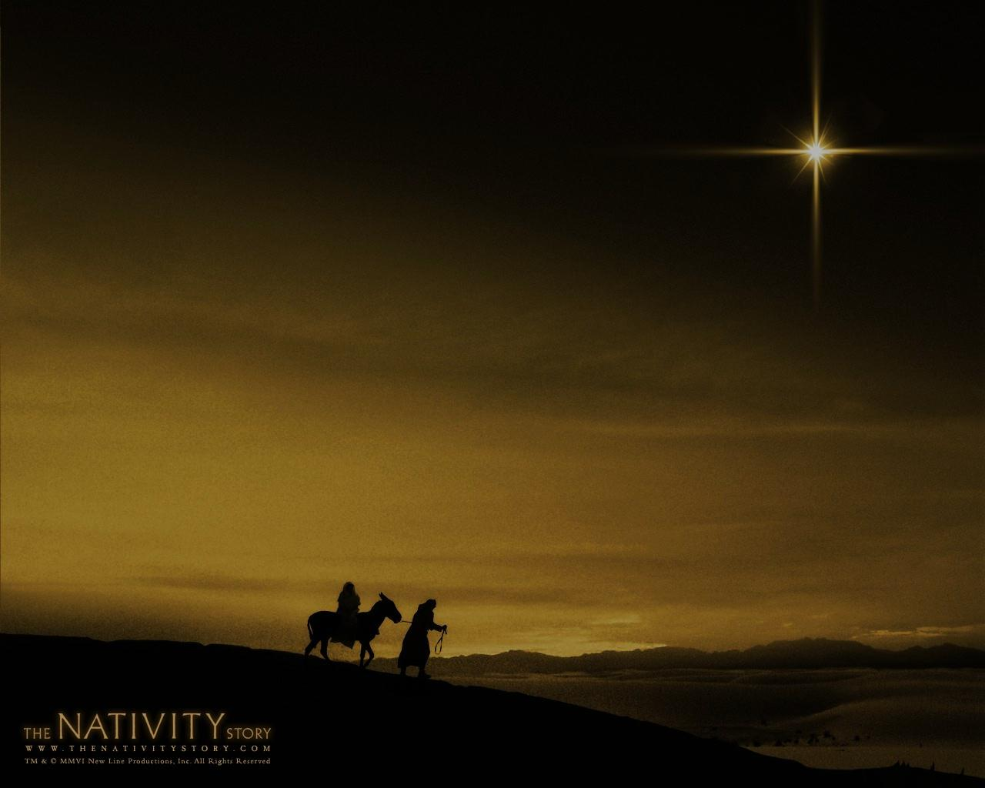
阮欲聽候 阮欲聽候看主面貌
阮欲期待 阮欲祈求主賜恩典
阮欲聽候 阮欲聽候
一粒啟明光星照佇嬰仔救贖主出世
We are waiting, we are waiting to see His face.
We are hoping, we are praying to know his grace.
We are waiting,we are waiting for a star shining bright for a baby, a Savior tonight.
Waiting 等待(1/5)

Slide 29
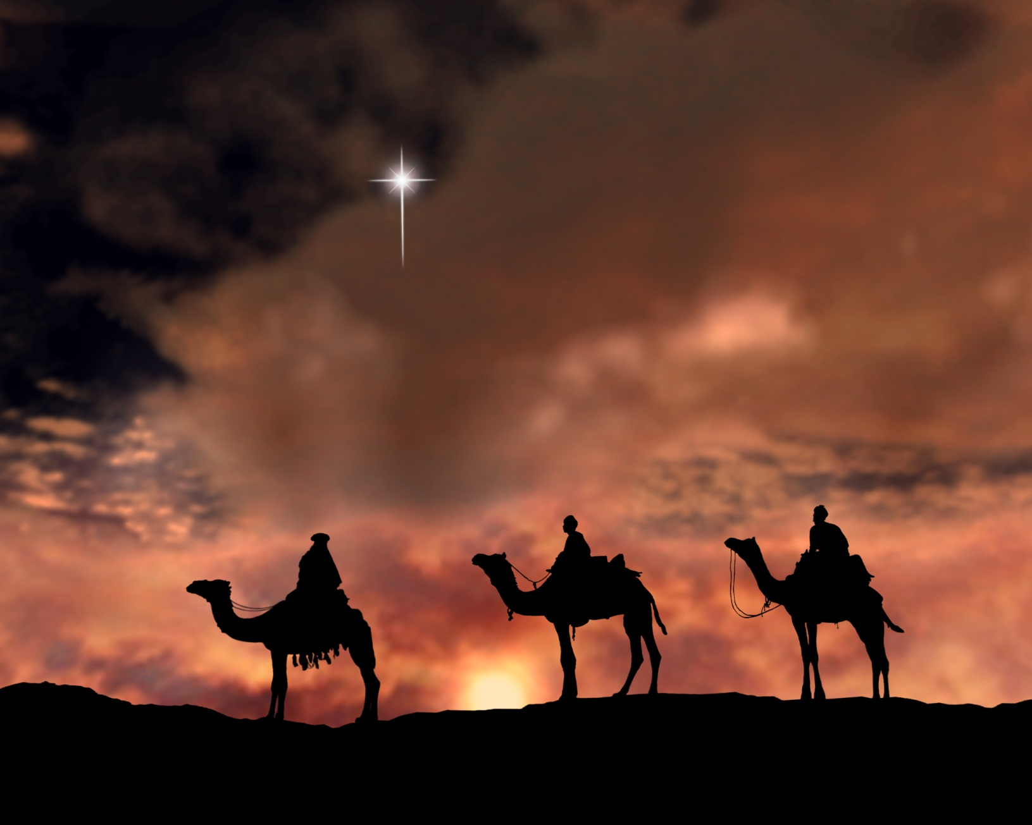
以馬內利至大君王 和平人君阮謳咾祢
喔 主佇祢內面 阮尋著通安歇所在
Emanuel, to you we sing; the prince of peace, the mighty king o come to set us free.
And we will find our rest in Thee.
Waiting 等待(2/5)

Slide 30
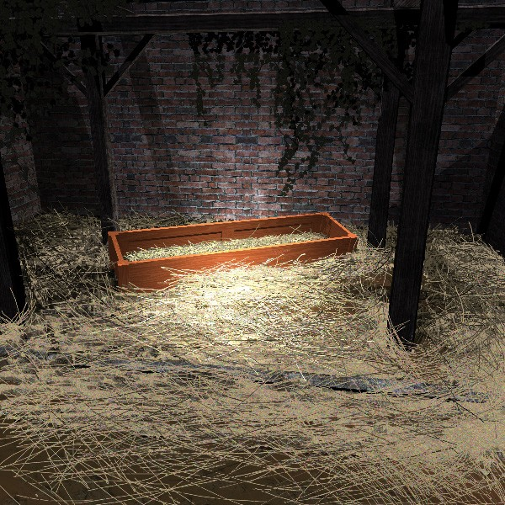
Waiting 等待(3/5)
當阮看見會認識祂
這細漢嬰兒溫柔謙順
至大救主咱攏著敬畏
When we see him,
we will know him a tiny child.
When we tremble like a Savior
so tender and mild.

Slide 31

Waiting 等待(4/5)
主會閣來 主會閣來 久久咱等待
親愛救主阮向祢唱歌 (親愛主)
He is coming, he is coming;
we have waited long, Christ the savior, they’ll hear our sweet song.
(hear our song)

Slide 32
以馬內利至大君王 和平人君阮謳咾祢
喔 主佇祢內面阮尋著通安歇所在
阮啲聽候 阮啲聽候主啊 阮虔誠等待
Emanuel, to you we sing; the prince of peace,
the mighty king o come to set us free.
And we will find our rest in thee.
We are waiting, we are waiting,
we will find our rest in thee.
Waiting 等待(5/5)

