Slide 1
¹ In the beginning was the Word, and the Word was with God, and the Word was God. ² He was with God in the beginning. ³ Through him all things were made; without him nothing was made that has been made.
¹佇起頭有道，道及上帝相及佇啲，道就是上帝。 ² 此個道佇起頭及上帝相及佇啲。 ³萬物對道來創造；見若受創造的，無一項呣是對伊來創造。

Slide 2
⁴ In him was life, and that life
was the light of all mankind.
⁵ The light shines in the darkness, and the darkness has not understood.
⁴活命佇伊的內面，此個活命是人的光。 ⁵光照佇黑暗，黑暗無接納伊。

Slide 3
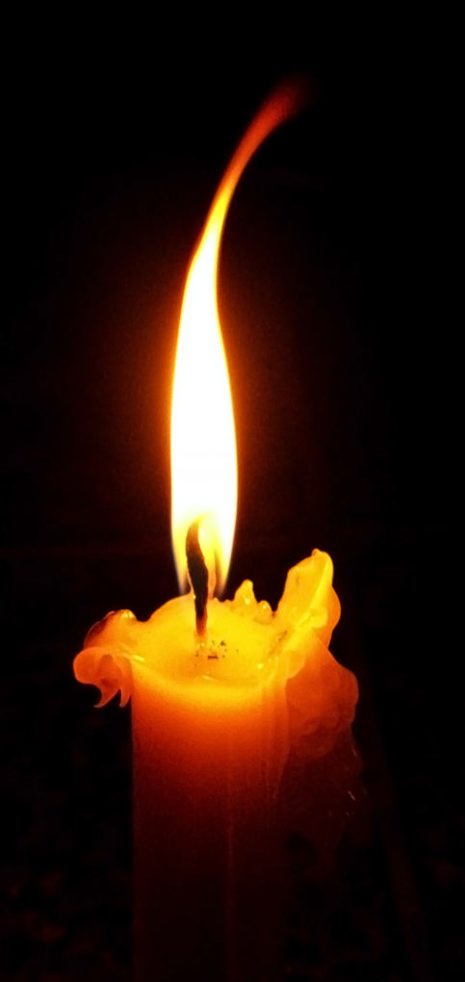
Light of the world, come live among us, our spirits long to be free. Love’s pure light, the hope of the ages, we yearn for the day we shall see. 世間的光,來佇阮中間, 阮的心靈要得自由 疼的光所盼望的禧年， 所思念釋放的日子.

Slide 4
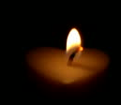
Emmanuel, born to dwell in love,
God’s gift to the world. Author of life, come end our strife,
we yearn for You, Holy Lord.
Come now, O Light of the World.
以馬內利,與阮亻店 的疼, 是上帝賞賜.生命源頭，息阮苦痛，阮思念祢，聖的主，
請來世間的真光。

Slide 5
The people who walk in the darkness, they shall see a great light!
The people who walk in the darkness,
on them a light shall shine!
徛起佇黑暗中的百姓，
要看見大光， 徛起佇黑暗中的百姓，
要有光來照 。
亻因
亻因

Slide 6
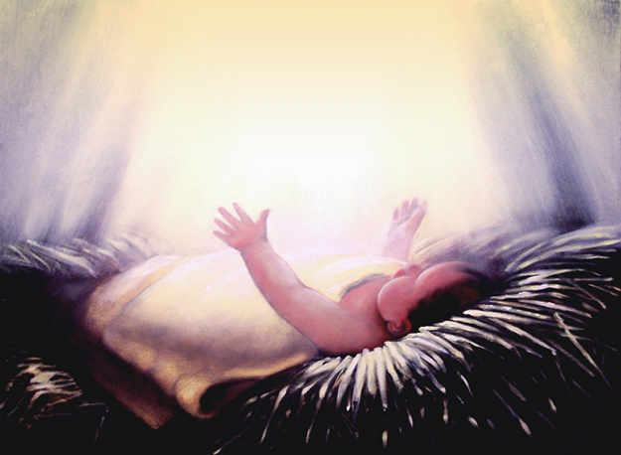
Those who live in the shadow of death shall be filled with joy!
And unto them shall a child be born, heaven’s gift a baby Boy.
徛起佇死蔭的地的,要充滿大歡喜. 有一個嬰仔為咱出世，
有一個子賞賜咱。

Slide 7
The people who walk in the darkness,
they shall see a great light!
The people who walk in the darkness,
a light shall shine!
徛起佇黑暗中的百姓，
要看見大光， 徛起佇黑暗中的百姓，
要有光來照 。
亻因
亻因

Slide 8
Wonderful Counselor, Mighty God, Living Father, Prince of Peace!
大奇妙的謀士,全能攵,
永活上帝,和平人君.

Slide 9
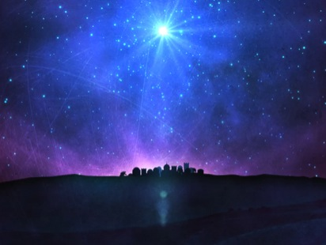
And He shall rule over David’s throne and His reign shall never cease,
His reign shall never cease.
Come now, O Light of the world.
祂要坐在大衛的寶座，
祂的國永遠無息,祂的國永無息
請來世間的真光.

