Slide 1
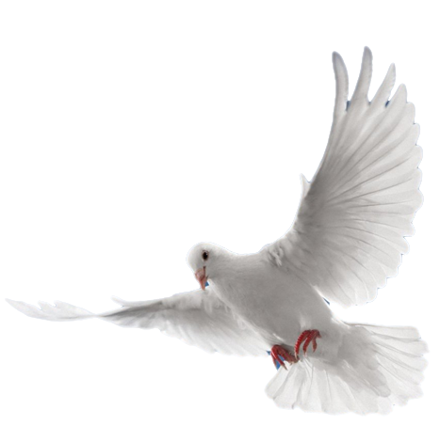
HE IS ALIVE!
祂有復活!

Slide 2
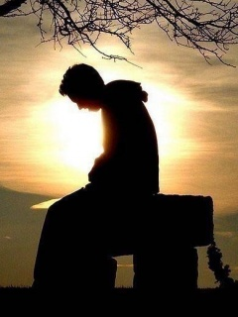
Why are you crying?
Why do you weep?
Who are you searching for?
What do you seek?
你為何啼哭? 你為何嚎? 你在找什麼人? 你找什麼?

Slide 3
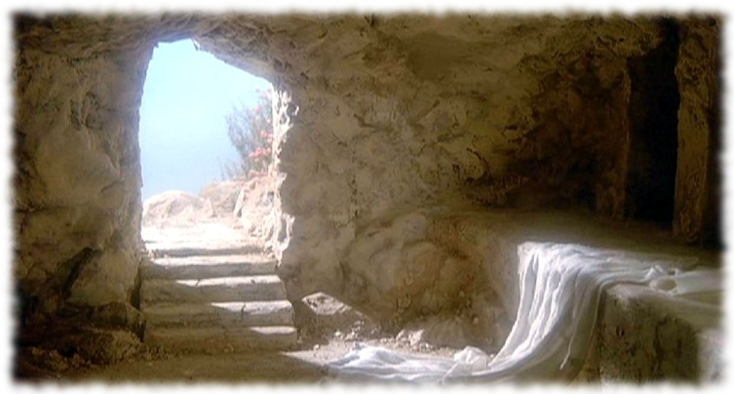
The tomb is empty, the stone is rolled away. Your Lord, once crucified,
the one who bled and died,
with arms stretched open wide,
is standing by your side.
墳墓是空空,石頭已經移開.
你的主受釘死,
祂有流血到死. 祂有展開雙手,
今站佇你身邊.

Slide 4
Open your eyes and see, open your
heart and know. Jesus is risen,
he is alive. And he is with you now,
and forever will keep you safely
by his side, in endless love abide.
開你目睭來看,開你的心來想, 耶穌有復活,祂有復活. 祂倚在你身邊，祂永遠保守你， 祂保守你平安，祂永遠愛惜你.

Slide 5
I come to the garden alone,
while the dew is still on the roses;
and the voice I hear, falling on my ear, the Son of God discloses.
我孤單一人來墓園,
露水還佇玫瑰花內, 我聽到聲音,入佇我耳朵，
上帝聖子近倚我.

Slide 6
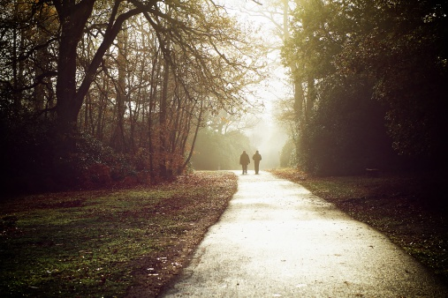
And he walks with me, and he talks with me, and he tells me I am his own,
and the joy we share, as we tarry there, none other has ever known.
祂與我同行,亦與我講話,祂給我講,我屬佇祂，阮作陣交陪,
滿心真歡喜,
無別物能
可相比。

Slide 7
Our Lord, once crucified,
the one who bled and died,
has opened heaven’s door,
Christ Jesus lives! He lives forever more.
咱的主受釘死,祂有流血到死.
祂打開天的門.基督活著,
祂有永遠活著.

Slide 8
Open your eyes and see,
open your hear and know.
Jesus is risen, he is alive!
開你目睭來看,開你的心來想, 耶穌有復活,祂有永活.

Slide 9
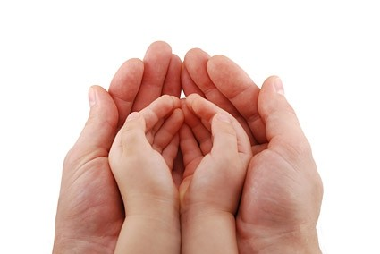
And he is with you now, and forever
will keep you safely by this side,
in endless love a bide.
Why do you weep?
祂倚在你身邊，祂永遠保守你， 祂保守你平安，祂永遠愛惜你.
你為何哭?

Slide 10
He’ll keep you by his side,
in endless love abide.
Why do you weep?
祂保守你平安，
祂永遠愛惜你.
你為何哭?

