Slide 1
“來隨我著來,緊緊跟隨我”
我願降服用心聽趁主呼召
有多多神蹟我袂會明瞭,
猶久我知祢是大有權能
You said, “Come, follow,” and
I quickly came. It seemed so compelling when you called my name.
Now I’ve seen wonders
I don’t understand.
Teacher, I know you are more than a man.

Slide 2
豈是按呢？汰會按呢？
佇祢面前我雙腳跪落地
祢是基督，
所應允的對天降落來，
上帝的子
Can it be true? Can it be real?
I can’t explain, but before you
I kneel. You are the Christ.
You are the One sent down from heaven; You are God’s Son.

Slide 3
跛腳得著行，
青瞑得著看，
所行所做帶氣力充滿權能
大海的水面頂祢伴我同行，
祢豈是我所信應允的主
I’ve seen the lame walk, the blind gain their sight. You speak with the power that pierces the night. I walked on the water when you called to me.
Are you the One I believe you to be?

Slide 4
豈是按呢？
汰會按呢？
佇祢面前我雙腳跪落地
祢是基督，
所應允的對天降落來，
上帝的子.
Can it be true? Can it be real? I can’t explain, but before you I kneel. You are the Christ. You are the One sent down from heaven; You are God’s Son.

Slide 5
信仰路程與主同行，
我就有確認
主祢是基督，
是永活上帝的子
I know from the steps of faith together we have trust That you are the Christ,
the Son of the Living God.

Slide 6
豈是按呢? 汰會按呢？
佇祢面前我雙腳跪落地
祢是基督,
所應允的對天降落來,
上帝的子.
Can it be true? Can it be real?
I can’t explain but before You I kneel.
You are the Christ. You are the one sent down from heaven; You are God’s Son.

Slide 7
對天降落來,
上帝的子
Sent down from heaven, You are the Christ.

Slide 8
出來的時，抵著一個古利奈人名西門，勉強伊相及去，互伊夯耶穌的十字架.
As they went out, they found a man of Cyrene, Simon by name. They compelled this man to carry his cross.

Slide 9
到一所在名各各他，就是「頭殼碗」的所在...就釘伊佇十字架 馬太27:32-33
And when they came to a place called Golgotha…there they had crucified Him.
Matthew 27:32-33

Slide 10
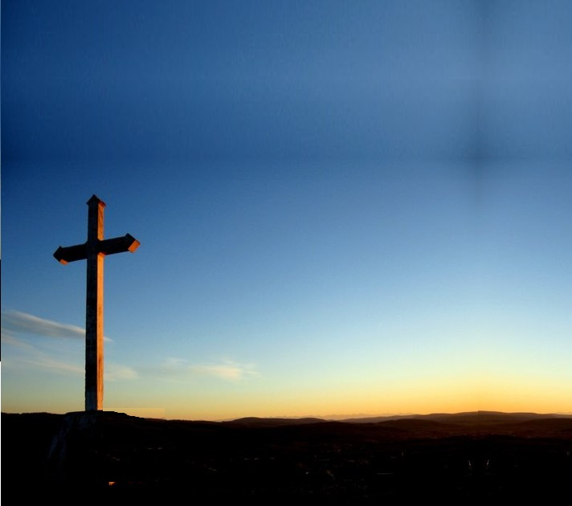
祂所行的路是叫做 “受苦的路”. 行佇彎曲難行的路，他身軀承受十架的重擔，心中也承受 世間人罪的沉重。 It was called the way of sorrows. On this winding cruel course, Jesus fell from the weight of the cross and from the burden of sin that He had taken upon His heart.

Slide 11
當門徒對遠遠看祂，祂白白得將自己為這世上的罪來付出。 在那個透風的山頂，十字架也完成它恩典的旅程。 As His followers watched from afar, He gave Himself freely for the sins of the world. It was there upon that windswept hill that grace at last completed its journey.

Slide 12
無祂目屎, 就無有安慰 無祂的死, 就無活命 無祂寶血, 就無赦罪 無十字架, 就無冠冕.
Without His tears, there is no comfort
Without His death, there is no life.
Without His blood there is no pardon,
Without His cross, there is no crown.

Slide 13
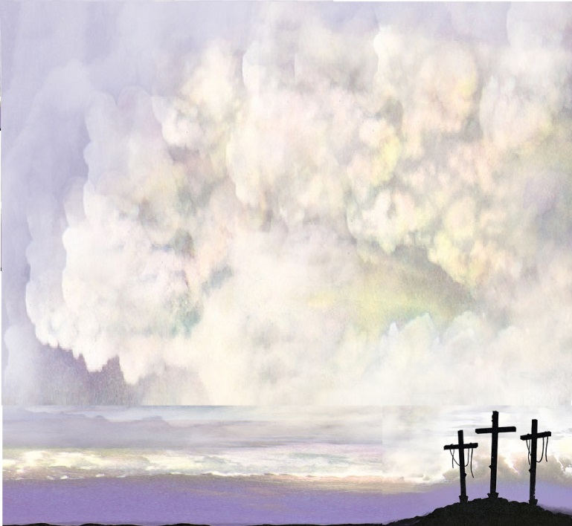
無祂見誚, 就無有榮耀 無祂嘆氣, 就無喜樂 無祂鞭打, 就無有完全
無十字架就無冠冕
Without His shame, there is no glory. Without His grief, there is no joy.
without His stripes, there is no healing. Without His cross, there is no crown.

Slide 14
親愛主，親愛主祢施落拯救 用祢慈悲，用慈悲將阮蓋印 用祢疼的目屎擦去阮悲傷 祢的恩典大顯現 Lamb of God You bring salvation And with Your grace our hearts are sealed Lord, with Your tears of love You bathe our sorrows, In Your eyes we stand revealed.

Slide 15
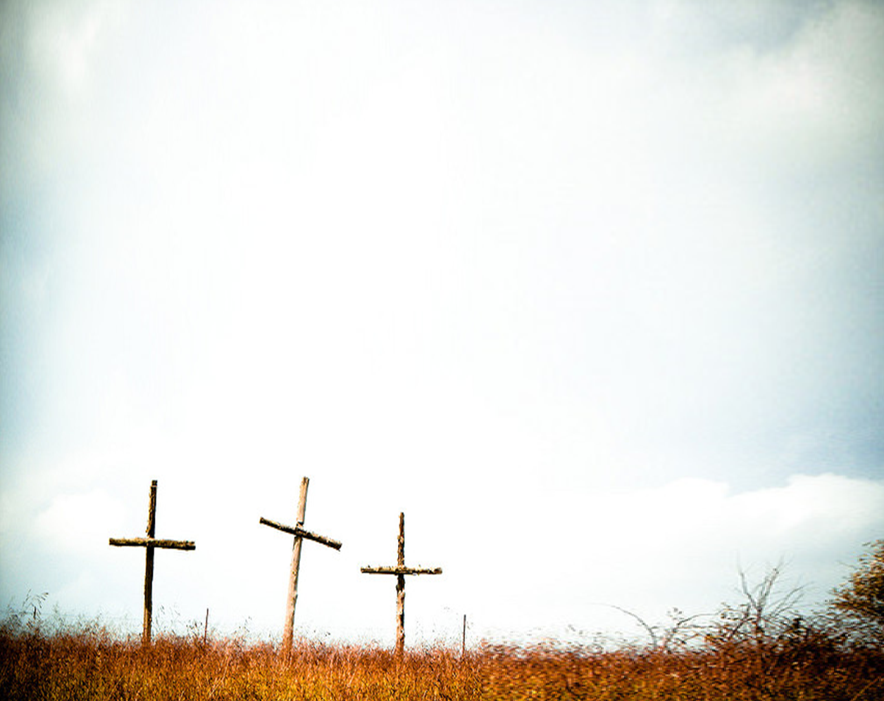
無祂目屎就無有安慰 無祂的死就無活命 無祂寶血就無有赦罪 無十字架就無冠冕
Without His tears, there is no comfort, Without His death there is no life. Without His blood, there is no pardon. Without His cross, there is no crown.

Slide 16
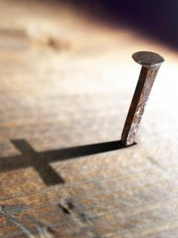
無祂寶血就無有赦罪 無十字架就無冠冕 無十字架就無冠冕
Without His blood there is no pardon without His cross, there is no crown. Without His cross, there is no crown.

Slide 17
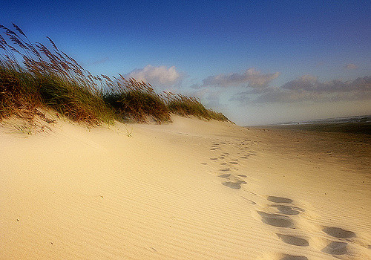
On the third day two of the disciples were going to a village named Emmaus. While they were talking and discussing together, Jesus himself drew near and went with them. 主復活的第三日，兩個學生去一個鄉社，叫以馬忤。在談論相問的時 耶穌本身近依，及他們相及行。

Slide 18
Unrecognized by them, He began to expound upon all the scriptures and the things concerning Himself. Suddenly, their eyes were opened and they recognized Him. 他們兩個人不認得伊，耶穌開始談論有關自己的經文，及代誌。學生的目睭開，忽然認得伊.

Slide 19
And they rose that same hour and returned to Jerusalem. And they found the eleven and those who were with them gathered together, saying, “The Lord has risen indeed!” 就即時起身，倒去耶路撒冷遇著 其他的學生及同在的人講 “主果然復活!”

Slide 20
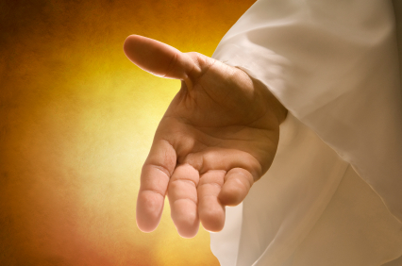
Therefore be followers of Christ as dear children, holding to His grace scarred hands and clinging to his love as you go along life’s way. 所以,咱成做基督的學生及子女,著扲住祂的恩典,受釘的手,行在人生道路的時,牢著祂的愛。

Slide 21
May hope be your constant companion and may you always walk in the light as His is in the light until you come to His promised rest. 信心常常陪伴你，行在祂的光明中。因為衪本身會在光明中迎接你進入祂應允的安息。

Slide 22
Jesus, You are the journey…. and You are the journey’s end. Amen! 耶穌，你是阮的道路及人生的旅程，也是阮行到最後的終點， 阿門。

Slide 23
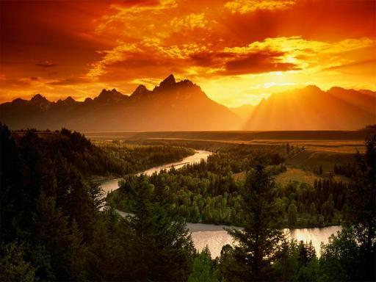
Pathway of Hope

Slide 24
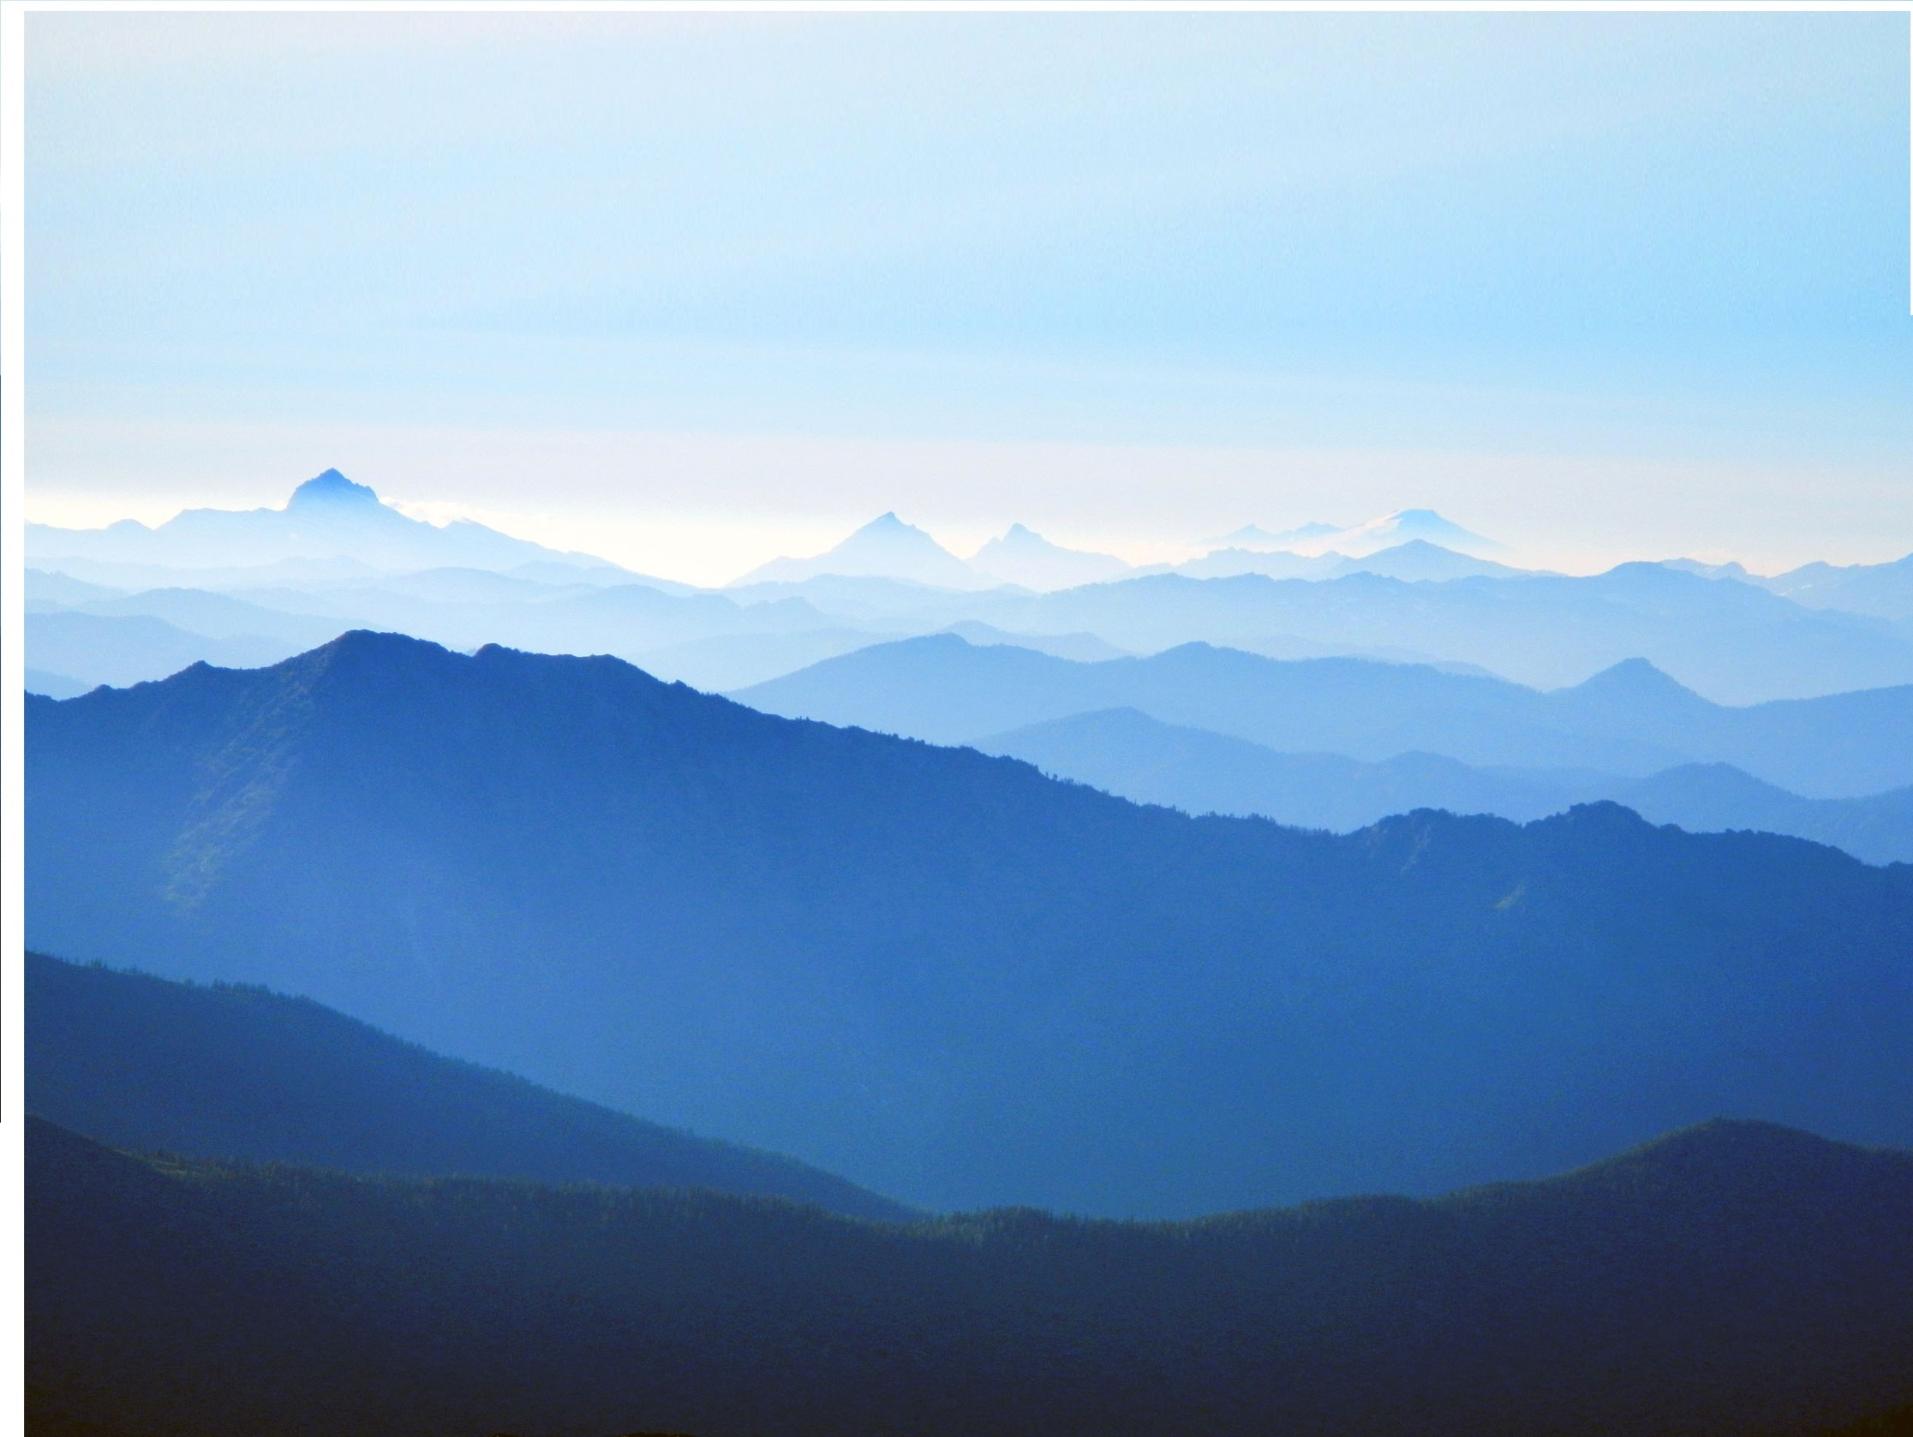
The road is long, the way is narrow. The path is steep, the mountains high. Lord, when we walk through valleys filled with fear, You wipe away our tears. We know that You are near. 這路是長,這路是真窄, 閣是真陡, 高親像山. 主,當阮行過驚惶的淵谷, 祢擦去阮目屎.阮知祢就佇此.

Slide 25
And when we stray, You are our shepherd. when we fall, You give us grace. When we are lost You find us where we are, You hold us to Your heart with everlasting arms. 當阮迷路,祢是阮牧者, 當阮跌倒祢來救阮, 當阮失落,你佇那找到阮. 祢永活的聖手抱阮佇祢胸前.

Slide 26
Oh, Lord, Your are the way,
You are the journey.
Come walk beside us as we go.
Lord, You are the way, You are the journey,
You are our legacy , eternal destiny.
喔,主祢是道路,人生的旅程,
請主祢來與阮同行.
喔,主祢是道路,人生的旅程,
主祢是阮寶貝,阮永生的歸屬.

Slide 27
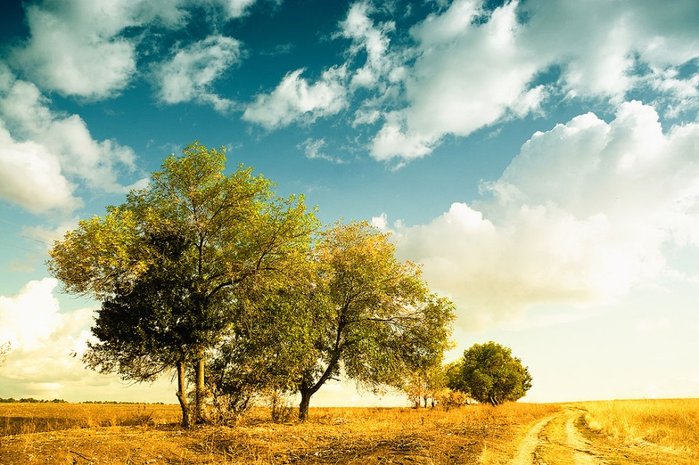
You are the pathway of Hope,
You are the pathway of hope.
主祢是阮盼望的道路,
祢是阮盼望的道路.

Slide 28
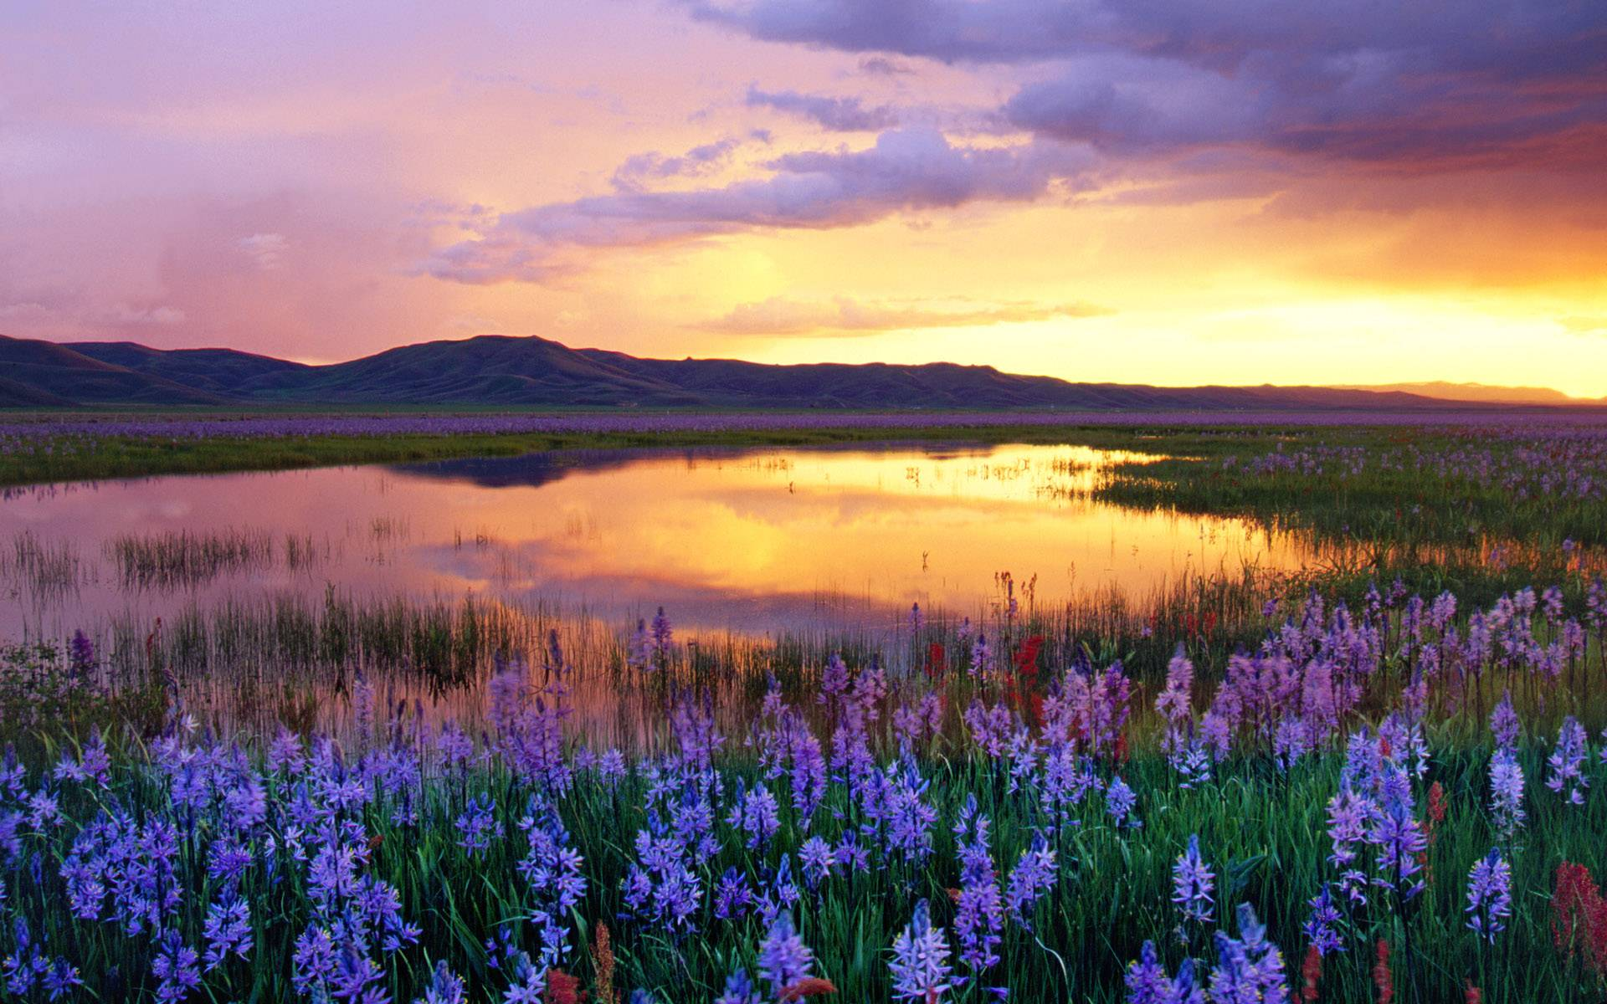
Come join us, faithful pilgrim. We’ll walk the road as one. And when we’ve walked ten thousand years, the journey will have just begun. 來與阮同行天路 阮要同心來行 閣當阮行千萬年久 這旅程才要開始

Slide 29
We’ll walk with God through ev’ry valley. We’ll walk with God through ev’ry storm. And on the day our earthly walk is done, we’ll sing before the throne, “We never walked alone!” 與主同行,經過眾山谷 與主同行,過大風雨. 到有一日, 地上的路盡程, 佇寶座前吟詩,“ 與主行不孤單”

Slide 30
Oh, Lord, You are the way. You are the journey. Come walk beside use as we go, Lord, You are the way. You are the journey. You are our legacy, eternal destiny. 喔,主祢是道路,人生的旅程, 請主祢來與阮同行. 喔,主祢是道路,人生的旅程, 主祢是阮寶貝,阮永生的歸屬.

Slide 31
You are the pathway of hope , You are the pathway of hope. You are our legacy, eternal destiny. You are the journey. You are the pathway of hope! 主祢是阮盼望的道路, 祢是阮盼望的道路. 主祢是阮寶貝,阮永生的歸屬. 人生的旅程, 祢是阮盼望的道路

