Slide 1
In the morning, when I rise In the morning, when I rise In the morning, when I rise Give me Jesus 每日透早我起來， 每日透早我起來， 每日透早我起來 我要耶穌。

Slide 2
Give me Jesus, Give me Jesus You can have all this world But give me Jesus 我要耶穌，我要耶穌。 你可擁有世界， 我只要耶穌。

Slide 3
And when I am alone Oh, and when I am alone And when I am alone Give me Jesus 當我感覺孤單， 哦！當我感覺孤單， 當我感覺孤單，我要耶穌。

Slide 4
Give me Jesus, give me Jesus You can have all this world Just give me Jesus 我要耶穌，我要耶穌。 你可擁有世界， 我只要耶穌。

Slide 5
And when I come to die oh, when I come to die and when I come to die Give me Jesus 當到生命路尾， 哦！當到生命路尾， 當到生命路尾， 給我耶穌，

Slide 6
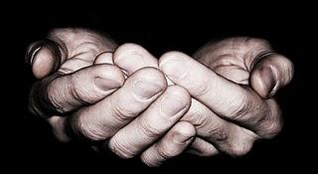
Give me Jesus, Give me Jesus You can have all this world You can have all this world You can have all this world but give me Jesus 我要耶穌，我要耶穌。 你可擁有世界，你可擁有世界， 你可擁有世界， 我只要耶穌。

