Slide 1
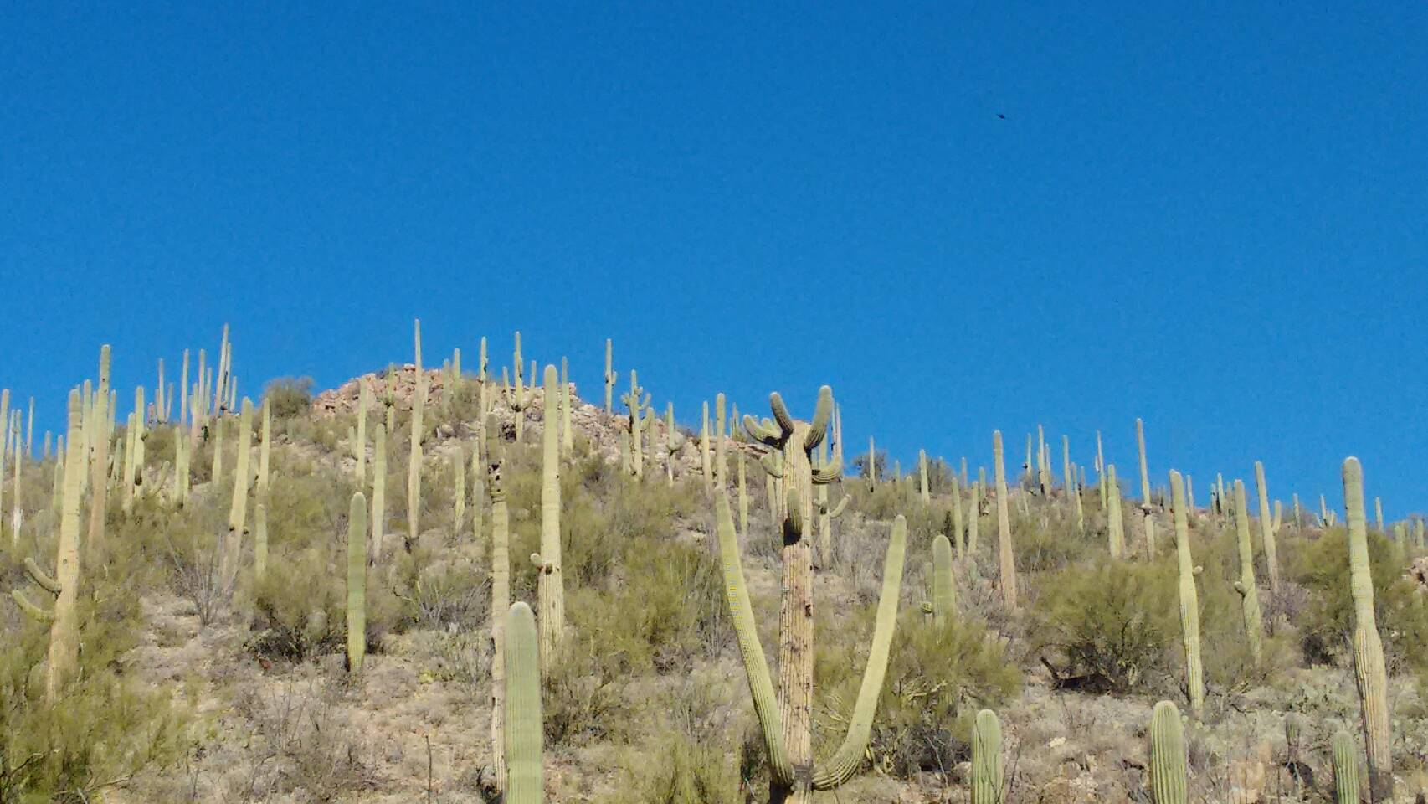
耶穌是我所有一切
聖歌隊 獻詩

Slide 2
耶穌是我所有一切,
我喜樂與生命。
祂是我每日的氣力,
無主那準佇黑暗。
Jesus is all the world to me,
my life, my joy, my all;
He is my strength from day to day,
without Him I would fall.

Slide 3
我傷心的時祂安慰,
無別人親像主耶穌,
當我憂傷,祂扶持我,
祂是主。
祂是主,喔祂是我的主。
When I am sad, to Him I go,
no other one can cheer me so;
When I am sad, He makes me glad,
He’s my Friend.

Slide 4

耶穌是我所有一切,
我救主我朋友,
患難艱苦祂倚近我,
祂恩典賜福滿滿。
Jesus is all the world to me,
my Friend in trials sore;
I go to Him for blessings,
and He gives them over and over.

Slide 5

祂賜雨水閣賜太陽,
祂賜豐盛五穀收成。
雨水太陽,五穀豐收,
我朋友。
He sends the sunshine and the rain,
He sends the harvest’s golden grain;
Sunshine and rain, harvest of grain,
He’s my Friend.

Slide 6

耶穌是我所有一切,
我盡心跟隨祂。
祂是真實,我在找尋,
豈通離開耶穌？
Jesus is all the world to me,
and true to Him I’ll be;
O how could I this Friend deny,
when He’s so true to me?

Slide 7

我知影跟隨主耶穌,
祂逐日安慰看顧我。
無分暝日跟隨救主,我朋友。
Following Him I know I’m right,
He watches over me day and night;
Following Him by day and night,
He’s my Friend.

Slide 8

耶穌是我所有一切,
我至好的朋友,
我倚靠祂,我信仰祂,
到末日來的時。
Jesus is all the world to me,
I want no better Friend;
I trust Him now, I’ll trust Him
when life’s fleeting days shall end.

Slide 9

豐盛生命有主耶穌,
永遠活命不有路尾,
永生活命,
喜樂平安,祂是主。
耶穌是我的好朋友,好朋友。
Beautiful life with such a Friend,
beautiful life that has no end;
Eternal life, eternal joy,
He’s my Friend.

