Slide 1
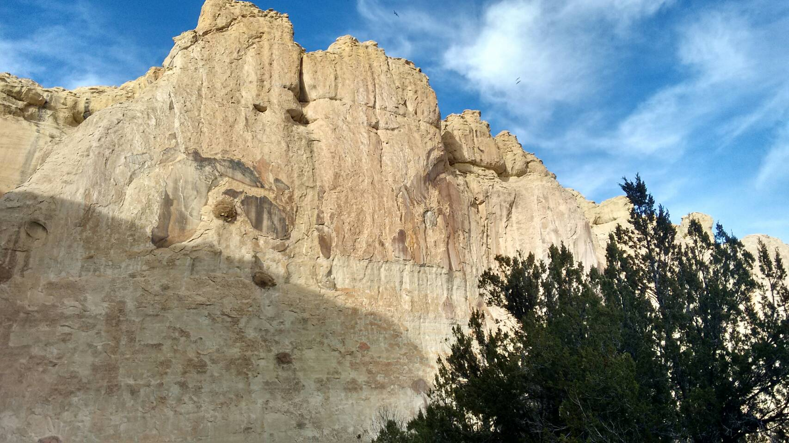
踮佇我
聖歌隊 獻詩

Slide 2
我是葡萄樹，恁是葡萄枝，
我是葡萄樹，恁是葡萄枝
凡若踮佇我的，就欲結果子
若互我踮佇他的，他欲結多多果子
若無佇我，你不會作什麼
I am the vine, you are the branches, (2X)
He that abides in me shall bring forth much fruit, and he in whom I abide the same shall bring forth much fruit,
for without me you can do nothing.

Slide 3
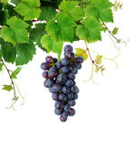
你踮佇我，我踮佇你 你踮佇我，我踮佇你 葡萄枝不會自己結果子 恁若無踮佇我，就不會結果子
Abide in me, and I in you. Abide in me, and I in you. As the branch cannot bear fruit of itself, no more can you,
except you abide in Me.

Slide 4
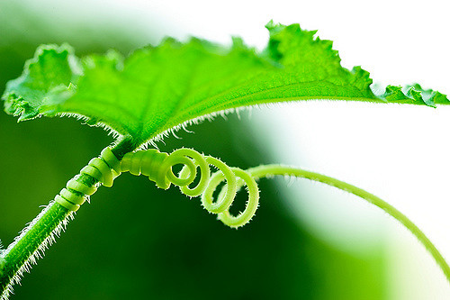
(凡若踮佇我的)凡若踮佇我的， (就欲結果子)就欲結果子 (若互我踮佇他的)若互我踮佇他的 他就欲結多多果子，多多果子 若無佇我，你不會作什麼
He that abides in me shall bring forth much fruit, and he in whom I abide,
the same shall bring forth much fruit,
for without me, you can do noting.

Slide 5
凡若踮佇我的(凡若踮佇我的)， 就欲結果子(就欲結果子) 若互我踮佇他的(若互我踮佇他的) 他就欲結多多果子，多多果子 若無佇我，你不會作什麼 著踮佇我
He that abides in me shall bring forth much fruit, and he is whom I abide,
bring forth much fruit, for with out me,
you can do nothing. A bide in me.

