Slide 1
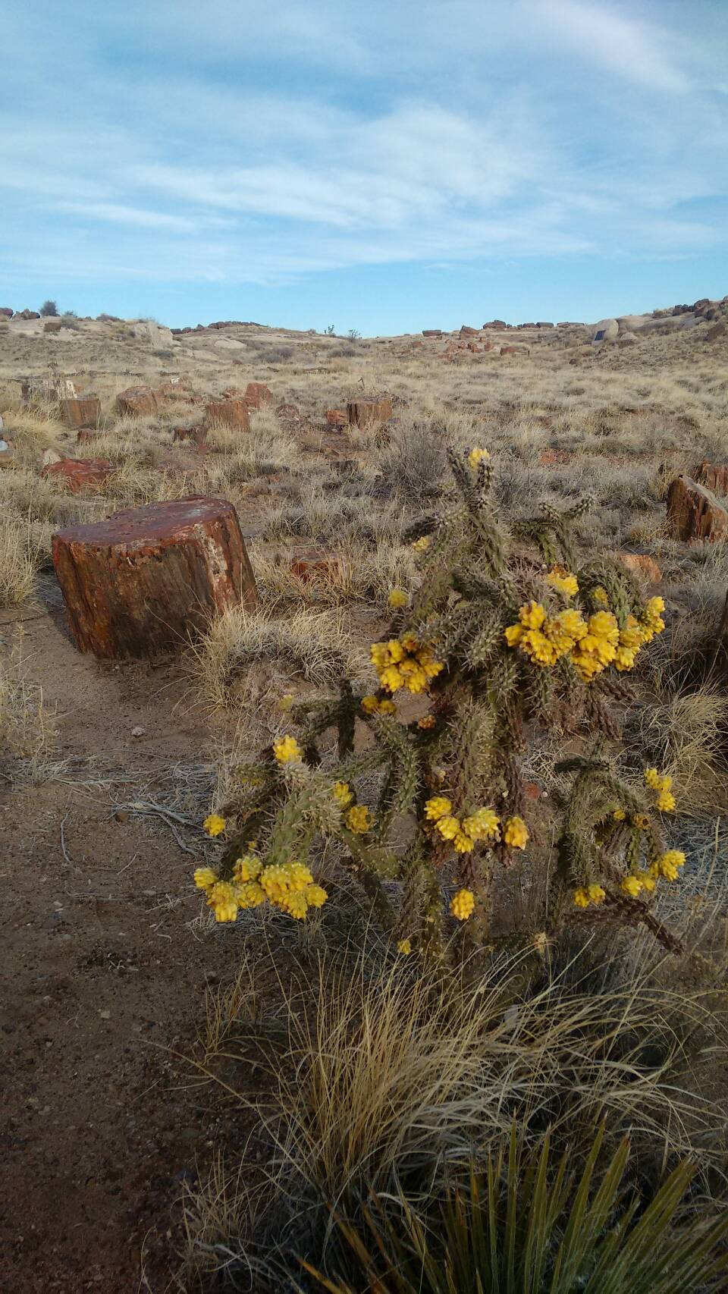
同心唱歌嘔咾上帝
聖歌隊 獻詩

Slide 2

咱來同心謳咾我主 咱同齊唱歌謳咾主 互全宇宙攏充滿咱的歌聲 咱同齊出歡喜的聲謳咾萬物主宰 互逐所在歌聲攏響亮
We will sing a song to the Lord, we will sing a song to the Lord.
All the world will hear our music fill the air.
We will make a joyful noise
unto our Lord and our God,
with praises resounding everywhere.

Slide 3

咱來同心謳咾我主 咱同齊唱歌謳咾主 著彈琴彈瑟和音樂同齊聲
聽阮唱出歡喜感謝 謳咾祢聖尊名無息 將榮光尊貴寶座歸互祢
We will sing a song to the Lord,
we will sing a song to the Lord,
as our instruments and voices now we raise.
Hear our joy and exultation,
as we join in celebration,
and sing out our song of glory and praise!

Slide 4

當阮同心謳咾感謝 人人攏著出歡喜的聲 咱著互世間人攏知影 只有歌聲會互人喜樂
When we praise the Lord with music,
every heart rejoices as we sing.
We touch the lives of all who hear us
with the joy that only music brings.

Slide 5

當咱獻上謳咾感謝 全地攏著出歡喜的聲 感謝主賜咱和藹的聲 福氣的聲 愛疼的聲
Now we lift our thanks and praises.
Hear them ring through earth and heaven above.
Come share God's wondrous gift of music,
a gift of joy, a gift of love.

Slide 6

咱來同心謳咾我主 咱同齊唱歌謳咾主 互全宇宙攏充滿咱的歌聲 當阮獻上阮的感謝 當阮唱出阮的歌聲 阮獻上謳咾, 唱出感謝, 謳咾的歌
We will sing a song to the Lord,
we will sing a song to the Lord,
as our instruments and voices now we raise.
Hear our joy and exultation,
as we join in celebration, and sing out our song,
sing out our song, our song of praise!

