Slide 1
EM and 聖歌隊 獻詩
Waiting
Sleep, Little Lamb
3. Sing Noel
Notes:
柑縣台灣基督長老教會 主日禮拜程序 主後2005年11月13日

Slide 2
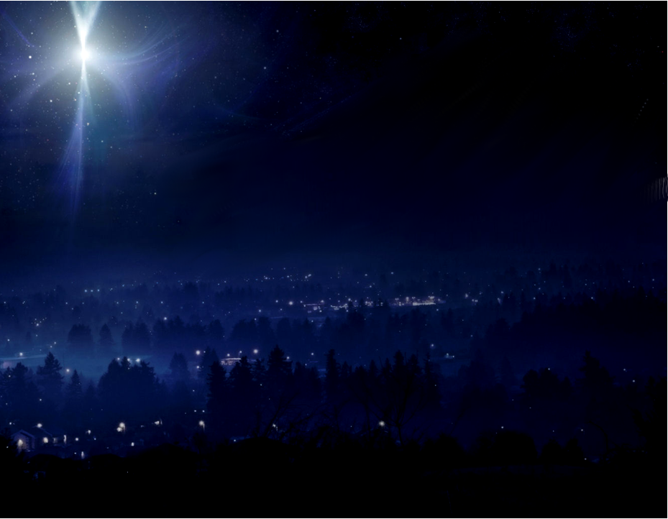
We are gathered here to remember when God visited the earth in the form of a child.
咱聚集佇遮是為了追憶當上帝
以嬰孩樣式降生佇地上的時候.
And we meet to worship the Lord and
to celebrate the new life He offers us.
咱欲迎接敬拜主,並慶祝祂賜互
咱新的生命.

Slide 3
We pray that we will experience God’s presence in a fresh way.
The angel said He would be called “Emmanuel,” which means,
“God with us.”
咱祈求用新的方式來體會上帝的顯現。天使說：人要稱祂的名為『以馬內利』，翻出來就是『上帝及咱同在』

Slide 4
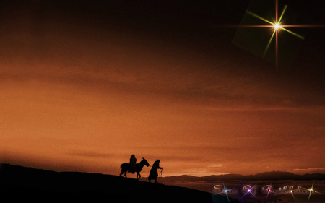
God is always with us, and when we welcome His Spirit into our hearts and minds, we experience the comfort and the power of God’s presence.
上帝一直與咱同在，當咱迎接聖神進入咱的心靈時，咱感受上帝臨在的安慰及力量.

Slide 5
The psalmist said, “The Lord is good to those whose hope is in Him, to the one who seeks Him. It is good to wait quietly for the salvation of the Lord.”
有詩人說：「 見若等候耶和華，心裡尋求祂的，耶和華必施恩互他。人仰望耶和華，靜默等候祂的救恩這原是好的。」(哀3:25-26)

Slide 6
Come… let us be still before the Lord and wait patiently for Him.
來吧！互咱靜默佇主的面前，
耐心等待祂

Slide 7
Waiting 等待
Waiting, we are waiting, Lord.
Waiting, we are waiting, Lord.
Fill the mind ‘til we find
Your light, Your truth.
等待,阮啲等待主.
等待,阮啲等待主.
充滿阮心通看
光和真理.

Slide 8
Waiting, waiting,
we are waiting, Lord.
Waiting, waiting,
we are waiting, Lord.
Fill the mind ‘til we find
Your will, Your way.
等待,等待,阮啲等待主.
等待,等待,阮啲等待主.
充滿阮心通知 你的旨意.

Slide 9
Now let us know
Your presence, Lord, Emmanuel,
God, be with us.
今阮知主與你同在,
以馬內利,
主,永同在.

Slide 10
We welcome You with
open hearts, Emmanuel,
God be with us.
God be with us. Emmanuel.
阮開心門歡迎阮主,
以馬內利,主, 永同在.
主,永同在.以馬內利.

Slide 11
List’ning list’ning,
we are list’ning, Lord. List’ning, list’ning,
we are list’ning, Lord.
Draw near, let us hear
Your Word for us.
著聽,著聽, 阮注神聽主. 著聽,著聽, 阮注神聽主.
著近 倚通聽主講的話.

Slide 12
Now let us know Your presence, Lord, Emmanuel, God be with us.
We welcome You with open hearts, Emmanuel, God be with us.
God be with us. Emmanuel.
今阮知主與你同在,
以馬內利, 主, 永同在.
阮開心門歡迎阮主,
以馬內利, 主, 永同在.

Slide 13
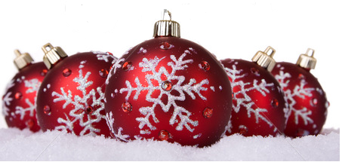
Patience, give us patience, Lord. Patience, give us patience, Lord.
When we pray, give us faith that you hear ev’ry prayer. As we’re waiting…. We are waiting… Waiting…Waiting..
吞忍,主助咱吞忍.吞忍,主助咱吞忍.
當祈禱有信心,主要聽阮祈禱,
阮啲等待……等待…等待…

Slide 14
瑪麗亞與他之丈夫，約瑟，就開始了一段往伯利恆艱難之旅行，如此，就欲應驗先知所預言的。
他們到彼所在之時，耶穌出世了。
Mary and her new husband, Joseph, made the arduous journey to
Bethlehem so that the prophecy
could be fulfilled . While they were there, Jesus was born.

Slide 15
因為客館無位可給他們住，瑪麗亞就將耶穌放在馬槽𥚃，當瑪麗亞注神看此位應允之主，她就獻出她對這位小小嬰兒之讚美：祂有完全的人性，也有完全之神性
And because there was no room for them in the inn, or anywhere else, Mary laid her son in a manger.
As Mary gazed upon the Promised One, she offered her a quiet praise to this tiny baby: completely human and completely divine.

Slide 16
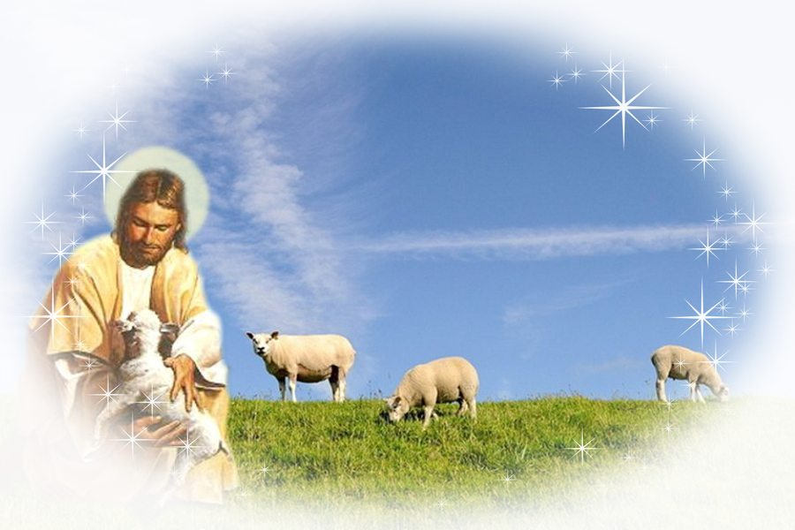
In the cold of winter, on the cloudless night, Shepherds gazed upon Him in the pale moonlight;
佇寒冷之冬天，
無雲之暗暝，
在霧霧之月光暝，
牧者注神看祂。
1/8

Slide 17
Eyes so full of wonder, hearts so rich with joy, quietly they praised Him, the precious Baby Boy.
目睭充滿奇妙,
心歡喜趒跳,
怹對至寶聖嬰
輕聲讚美無停。
2/8

Slide 18
Quietly we praise You. Gently we adore You. Tenderly we lift our songs to the newborn King.
阮輕聲讚美祢,
阮謙遜尊崇祢。
阮溫柔出聲唱歌
獻給新生王。
3/8

Slide 19
One day loud hosannas will praise the great I Am; But tonight, hearts whisper, “Sleep, little Lamb.”
響亮之和散那
欲讚美大君王;
阮輕聲到祂面前,
“羊羔恬靜。”
4/8

Slide 20
Tiny Babe, so holy, on this starry night, You bring peace (to all mankind); Peace be yours tonight.
星辰光滿天,
賜平安,賜平安
給眾百姓,
平安佇今暝。
5/8

Slide 21
Lamb, Tiny Lamb, I love You. (I would hold You close,) As my Lord, You’ve held me so many times before.
主,聖羊羔,我愛祢
我愛親近祢,
我之主,
祢曾多多次做我保護.
6/8

Slide 22
Quietly we praise You. Gently we adore You. Tenderly we lift our songs to the newborn King.
阮輕聲讚美祢。
阮謙遜尊崇祢。
阮溫柔出聲唱歌,
獻給新生王。
7/8

Slide 23
One day loud hosannas will praise the great I Am; 「But tonight, hearts whisper, “Sleep, little Lamb.”」x2
響亮之和散那
欲讚美大君王。
「阮輕聲到祂面前,
羊羔恬靜。”」x2
8/8

Slide 24
在山之彼邊，無相款的慶典在進行。有一群顧羊者，他們攏因為天使所傳報＂聖子出世＂之大好消息，
心肝大驚。
Across the hillsides, A different type of celebration was taking place. A group of shepherds, keeping watch over the temple sheep, were startled by a host
of angels bring word of the
holy birth.

Slide 25
上帝並無選擇將此個好消息傳播給在伯利恆之貴族與大官。反轉，祂差遣天使對一般之平民，因為祂講：我來欲將好消息傳播給貧窮人。
God choose not to announce his Son’s arrival to the nobility and aristocracy in Bethlehem. Instead, he sent the angels to the common citizens, for he said, “ I have come to preach the good news to the poor“。

Slide 26
他們都聚集大聲唱
“聖誕“ ”歡喜“
They all gathered and sang
“Noel” “Noel”

Slide 27
Sing No el Sing No el. No el. No el
Sing No el Sing No el. No el. No el
Sing No el Sing No el. No el. No el
Sing No el Sing No el. No el. No el
1/5

Slide 28
Sing We All No el
Now Sing No el. Sing We All No el
Now Sing No el. Sing No el.
Sing No el Sing No el. No el. No el
Sing No el Sing No el. No el. No el
2/5

Slide 29
Long ago One Winter Night
Sing No el. Sing No el. No el. No el.
Little Baby we born
It was quite a sight
Sing No el. Sing No el. No el. No el.
3/5

Slide 30
The angels sang with a glorious sound
Sing No el. Sing No el. No el. No el.
When the baby was born
Down in Bethlehem town
Sing No el. Sing No el. No el. No el
4/5

Slide 31
Sing No el Sing No el. No el. No el
Sing we all No el. Now sing No el
Now sing No el. Now sing No el.
Sing No el Sing No el. No el. No el
5/5

