Slide 1
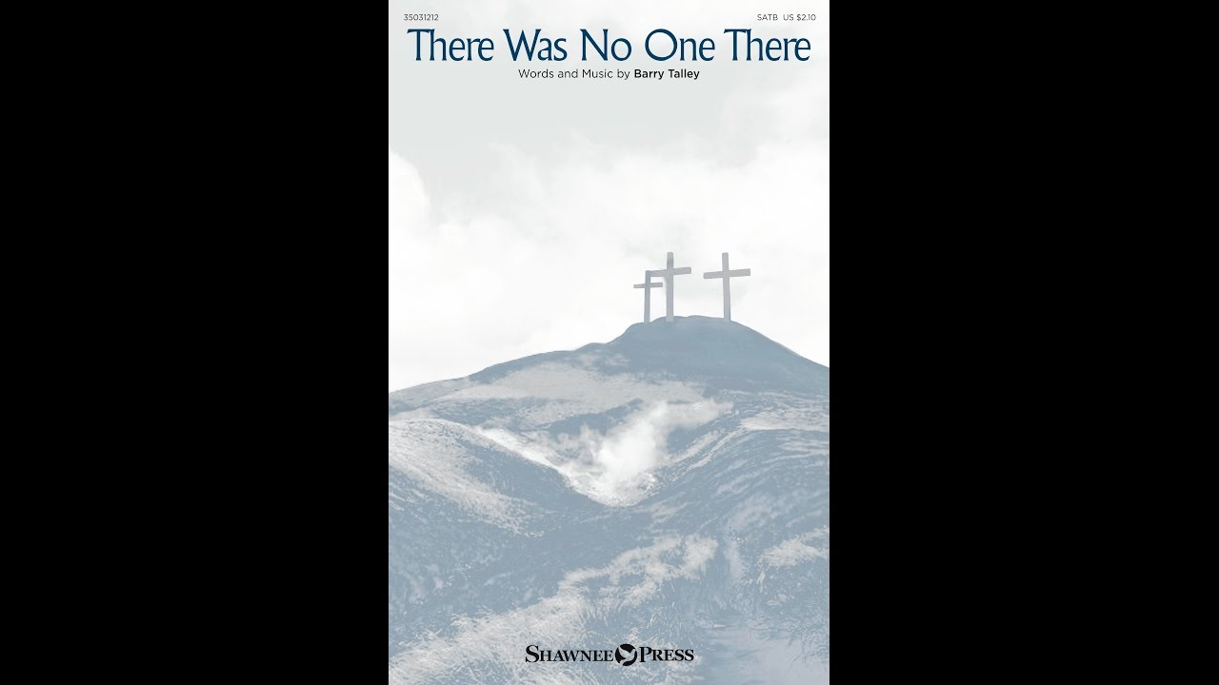
獻 詩
無人踮佇遐
EM &聖歌隊

Slide 2
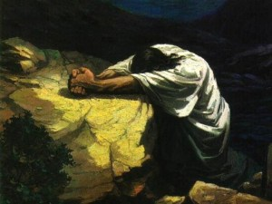
He was all alone in the garden,
He was all alone
when He prayed.
祂孤單ー人
踮佇花園,
祂孤單ー人
在祈禱。

Slide 3
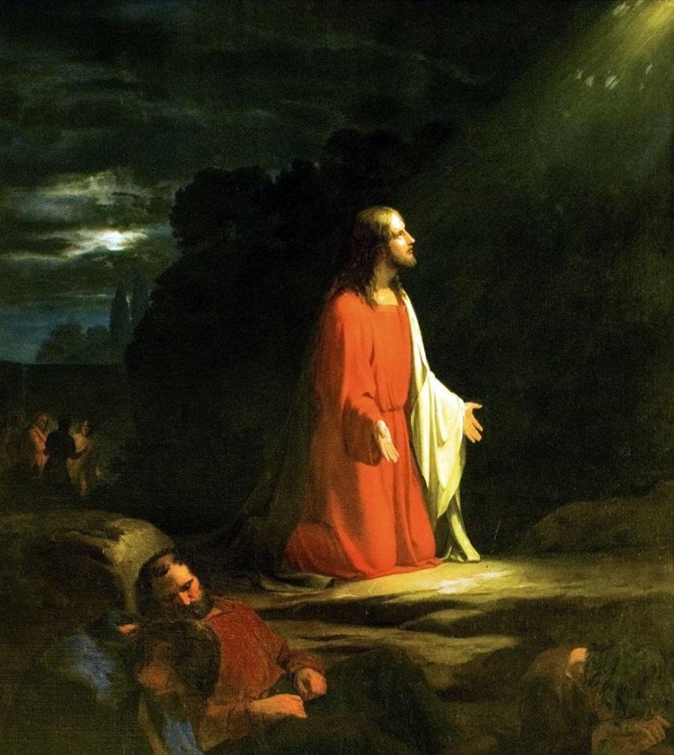
He said “Father, let this cup pass from me, not my will but Thine be done.”
祂説,“父啊,
將這杯離開我,
無照我是
照祢旨意.”

Slide 4
Father, Father, forgive them,
( Kyrie eleison) (主啊求袮憐憫阮)
for they know not what they do.
(Kyrie eleison ) (主啊求袮憐憫阮)
Father, dear Father,
they know not what they do.
父啊, 父啊,赦免怹,
怹呣知怹所做的
父啊,阿爸父, 怹呣知怹所做

Slide 5
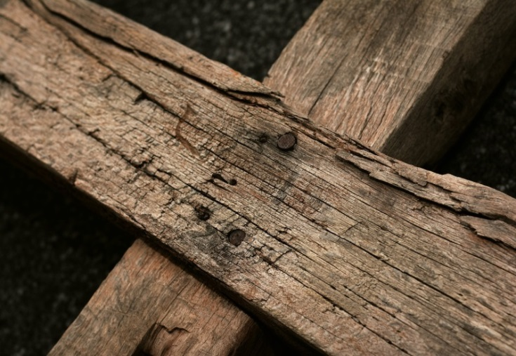
There was no one there
to stand beside Him.
There was on one there
to take His place.
沒人陪伴祂
當祂受審判,
沒人陪伴祂
擔咱的罪,

Slide 6
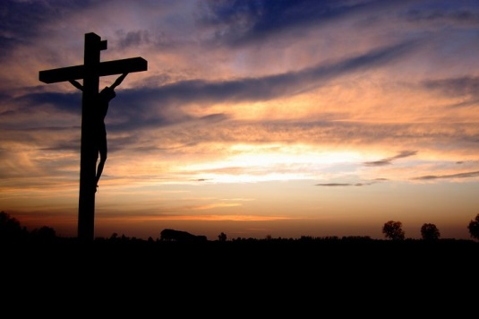
There was no one there
to bear the shame Jesus
felt as they nailed Him
to the cross.
沒人陪伴祂,
耶穌受釘十字架,
承受各種的恥辱.

Slide 7
Father, Father, forgive them,
( Kyrie eleison) (主啊求袮憐憫阮)
for they know not what they do.
(Kyrie eleison ) (主啊求袮憐憫阮)
Father, dear Father,
they know not what they do.
父啊, 父啊,赦免怹,
怹呣知怹所做的
父啊,阿爸父, 怹呣知怹所做

Slide 8

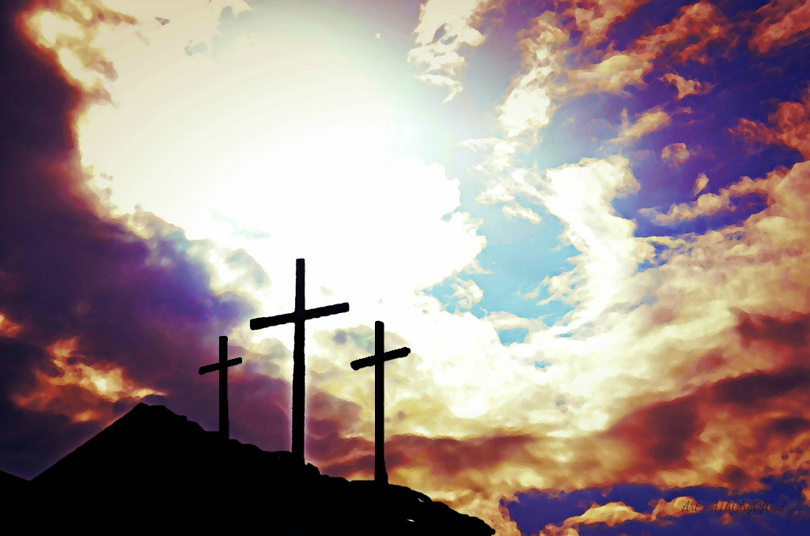
There was no one there,
who said I know him.
There was no one there,
when Jesus cried.
沒人踮佇遐,
説我認識祂
沒人踮佇遐,
當祂嚎叫

Slide 9
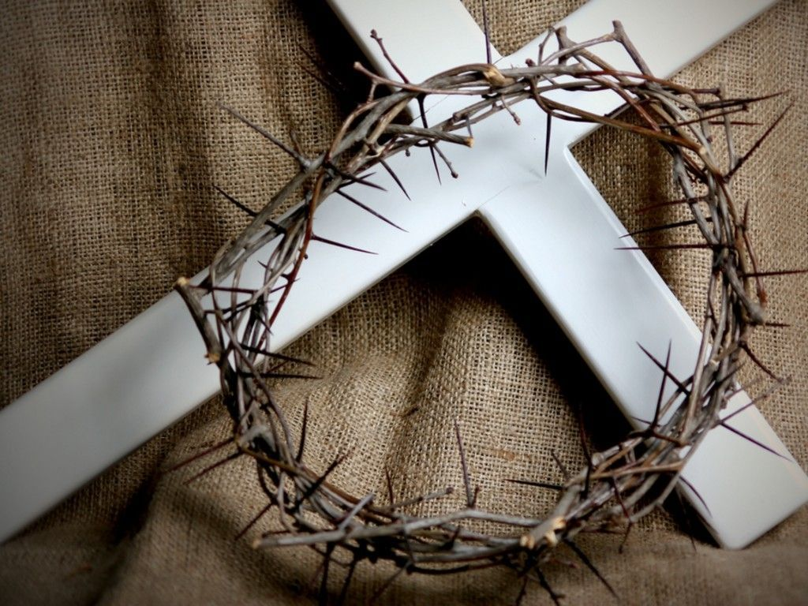
There was no one there, to wipe the blood from His brow as they nailed Him to the cross.
沒人踮佇遐,
可拭去受釘十架,
額頭流出的寳血

Slide 10
Father, Father, forgive them,
( Kyrie eleison) (主啊求袮憐憫阮)
for they know not what they do.
(Kyrie eleison ) (主啊求袮憐憫阮)
Father, dear Father,
they know not what they do.
父啊, 父啊,赦免怹,
怹呣知怹所做的
父啊,阿爸父,怹呣知怹所做

Slide 11

There was no one there,
who said I know him.
There was no one there
to take His place.
When Jesus died..…..
沒人踮佇遐,説我認識祂
沒人陪伴祂擔咱的罪,
當主斷氣

Slide 12
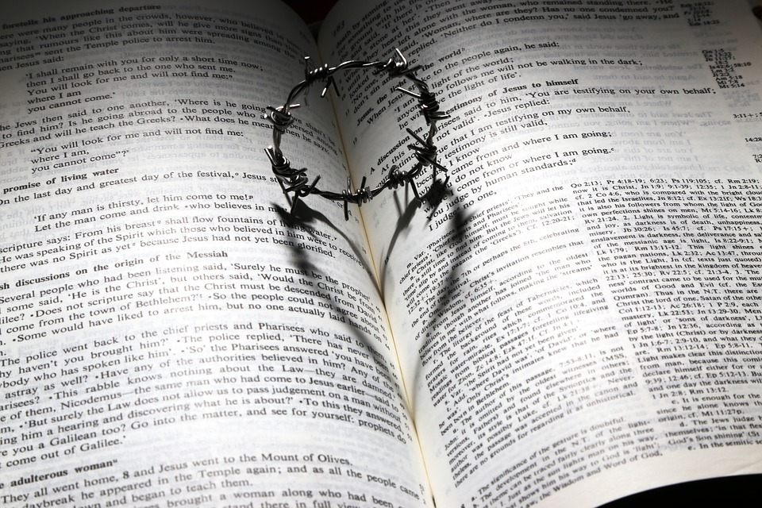
Responsive Reading 2
會眾啟應文 2

Slide 13
Leader : On the first day of the week, very early in the morning, the women took the spices they had prepared and went to the tomb. They found the stone rolled away from the tomb, but when they entered, they did not find the body of the Lord Jesus.
He is Risen!
七日的頭一日，天昲光，許個婦仁人帶所備辦許個香料到墓，看見石已經對墓門翱開，就入去，無看見主的身屍. 主有復活
Congregation: He is risen indeed!
會眾:伊真正有復活！

Slide 14
Leader : While they were wondering about this, suddenly two men in clothes that gleamed like lightning stood beside them. In their fright the women bowed down with their faces to the ground, but the men said to them, “Why do you look for the living among the dead? He is not here; he has risen! “
為著按呢啲躊躇的時，忽然有二人徛佇in身邊，衣裳光爁爁。婦仁人驚惶，面俯落地。彼二人給in講：「啥事佇死人中尋活人啊？伊無佇遮，已經復活。
Congregation: He has risen indeed!
會眾:伊真正已經復活！

Slide 15
Leader: Remember how he told you, while he was still with you in Galilee: The Son of Man must be delivered into the hands of sinful men, be crucified and on the third day be raised again.’ He is Risen!
恁著記得伊猶佇加利利的時有怎樣給恁講：『人子的確著交佇罪人的手，互in釘佇十字架，第三日復活。』 主有復活
Congregation:: He is risen indeed!
會眾:伊真正有復活!

Slide 16
Leader: Death has been swallowed up in victory.
死亡已經給勝利吞滅！
Congregation: Where, O death is your victory?
Where, O death is your sting?
會眾:死啊，你得勝的權勢佇叨落？
死啊，你的毒鉤佇叨落？」
Leader: He is Risen! 主有復活
Congregation: He is risen indeed!
會眾:伊真正有復活！

Slide 17

Christ is Risen
基督有復活

Slide 18
Christ is risen from the dead
Trampling over death by death
Come awake, come awake
Come and rise up from the grave
基督有從死復活
殺贏死亡的權勢
醒起來，醒起來
來，從墳墓中站起

Slide 19
Christ is risen from the dead
We are one with Him again
Come awake, come awake
Come and rise up from the grave
基督有從死復活
咱通與祂同活
醒起來，醒起來，
從墳墓中起來

Slide 20
O death, where is your sting?
O hell, where is your victory?
O church, come stand in the light
The glory of God
has defeated the night
哦死亡，你的毒鉤在哪裡？
哦地獄！你的得勝佇叨落？
眾教會，來站在真光中
上帝的榮光已經較贏暗冥

Slide 21
Christ is risen from the dead
Trampling over death by death
Come awake, come awake
Come and rise up from the grave
基督有從死復活
殺贏死亡的權勢
醒起來，醒起來
來，從墳墓中站起

Slide 22
Christ is risen from the dead
We are one with Him again
Come awake, come awake
Come and rise up from the grave
基督有從死復活
咱通與祂同活
醒起來，醒起來，
來，從墳墓中站起

Slide 23

O death, where is your sting?
O grave, where is your victory?
O church, come stand in the light
哦死亡，你的毒鉤在哪裡？
哦墳墓！你的得勝佇叨落？
眾教會，來站在真光中

Slide 24

Our God is not dead !
He’s alive.
He’s alive.
咱的上帝較贏死！
祂永活.祂永活.

Slide 25
Christ the Lord is ris’n today!
Come awake, come awake!
Come and rise up from the grave.
Sons of men and angels say.
Come awake, come awake!
Come and rise up from the grave.
耶穌真正死復活!
醒起來，醒起來，來，從墳墓中站起
天使世人傳開闊
醒起來，醒起來，來，從墳墓中站起

Slide 26
Made like Him,
like Him we rise , Alleluia!
Ours the cross, the grave the skies!
Come awake, come awake
and sing!
同死同活同上天，
哈利路亞！
榮光尊貴萬萬年
醒起來，醒起來，謳咾

Slide 27
Christ is risen from the dead
Trampling over death by death
Come awake, come awake
Come and rise up from the grave
基督有從死復活
殺贏死亡的權勢
醒起來，醒起來
來，從墳墓中站起

Slide 28
Christ is risen from the dead
We are one with Him again
Come awake, come awake
Come and rise up from the grave
基督有從死復活
咱通與祂同活
醒起來，醒起來，
來吧，從墳墓中站起來

Slide 29
O death, where is your sting?
O grave, where is your victory?
O church, come stand in the light.
Our God is not dead !
哦死亡，你的毒鉤在哪裡？
哦墳墓！你的得勝佇叨落？
眾教會，來站在真光中
咱的上帝較贏死！

Slide 30
Our God is not dead !
Our God is not dead !
He’s alive. Christ is alive.
He’s alive.
咱的上帝較贏死！
咱的上帝較贏死！
祂永活.基督永活.
祂永活。

Slide 31
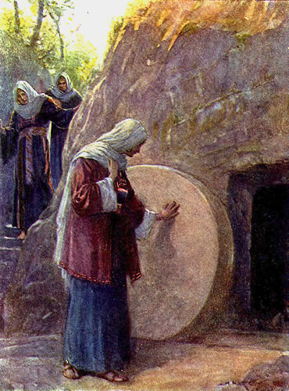
殿樂
Postlude

