Slide 1
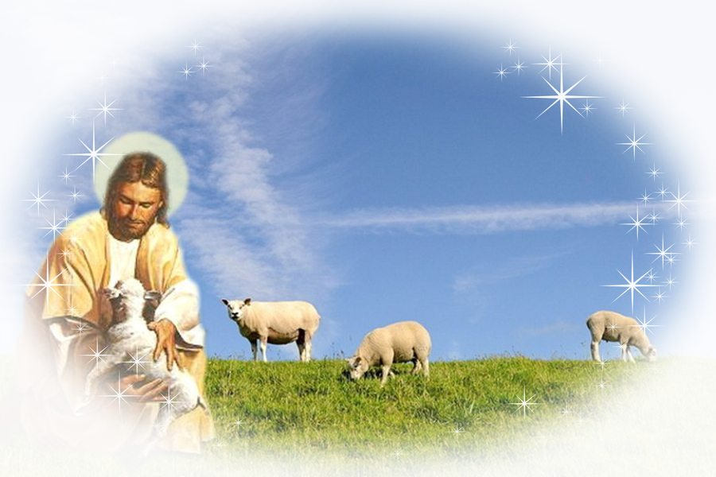
我主,是我的牧者 The Lord, will be my Shepherd
聖歌隊 獻詩

Slide 2
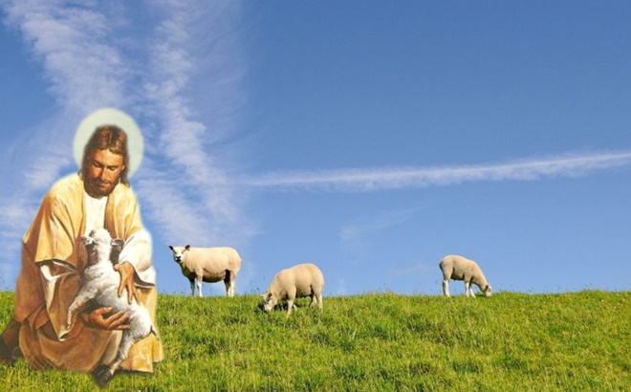
我主,是我的牧者 The Lord, will be My Shepherd
1/6
我主是我的牧者,祂知我所欠用
賞賜我當項有夠額,我可全心信靠祂
The Lord will be my shepherd,
He knows my every need.
He renews my faith each morning
with the promise of His peace.

Slide 3
我主,是我的牧者 The Lord, will be My Shepherd
2/6
引導躺在青翠草埔,導到安靜的水邊
我主是我的牧者,我必跟隨祂腳步
As I rest in a quiet meadow,
or beside a clear blue stream,
the Lord will be my shepherd,
I will follow where He leads.

Slide 4
我主,是我的牧者 The Lord, will be My Shepherd
3/6
雖然行過死蔭的山谷,我也攏呣驚災害
因為主必保護照顧我,導我脫離黑暗路
Though the shadows of darkness
surround me, I will never be afraid,
for I know the Lord will protect me
from the dangers I must face.

Slide 5
我主,是我的牧者 The Lord, will be My Shepherd
4/6
有時煩惱與憂傷包圍,心內驚惶真艱苦
祂在我身邊安慰扶持,永遠攏無離
When there’s anger or trouble around me, and I want to run and hide,
I will find Him near to calm my fear, always at my side.

Slide 6
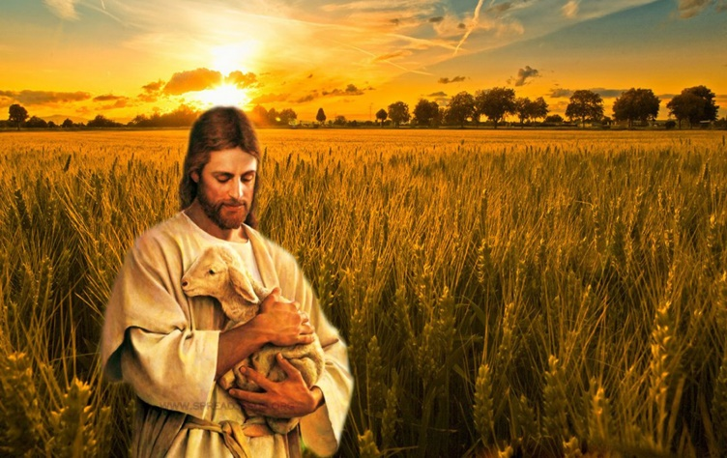
我主,是我的牧者 The Lord, will be My Shepherd
5/6
我主是我的牧者祂與我相同行
賞賜我有慈悲憐憫賞賜氣力與盼望
The Lord will be my shepherd
wherever I may go.
He will fill me with His kindness,
He will strengthen me
with hope.

Slide 7
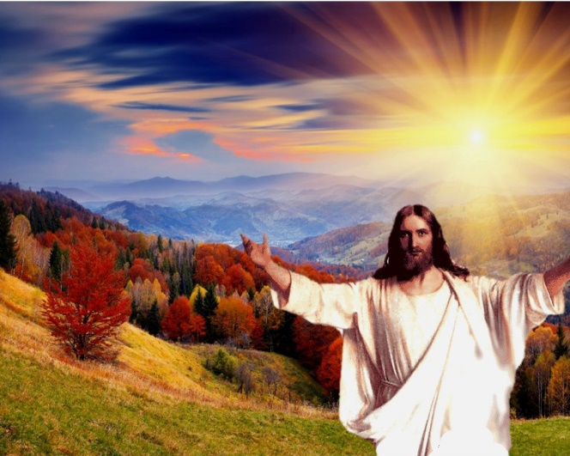
我主,是我的牧者 The Lord, will be My Shepherd
6/6
主耶和華是我牧者,永遠攏無放拺我
我主是我的牧者永遠與我相同行
When my day at last is over,
He will come and take me home.
The Lord will be my shepherd,
I will never be alone.

