Slide 1
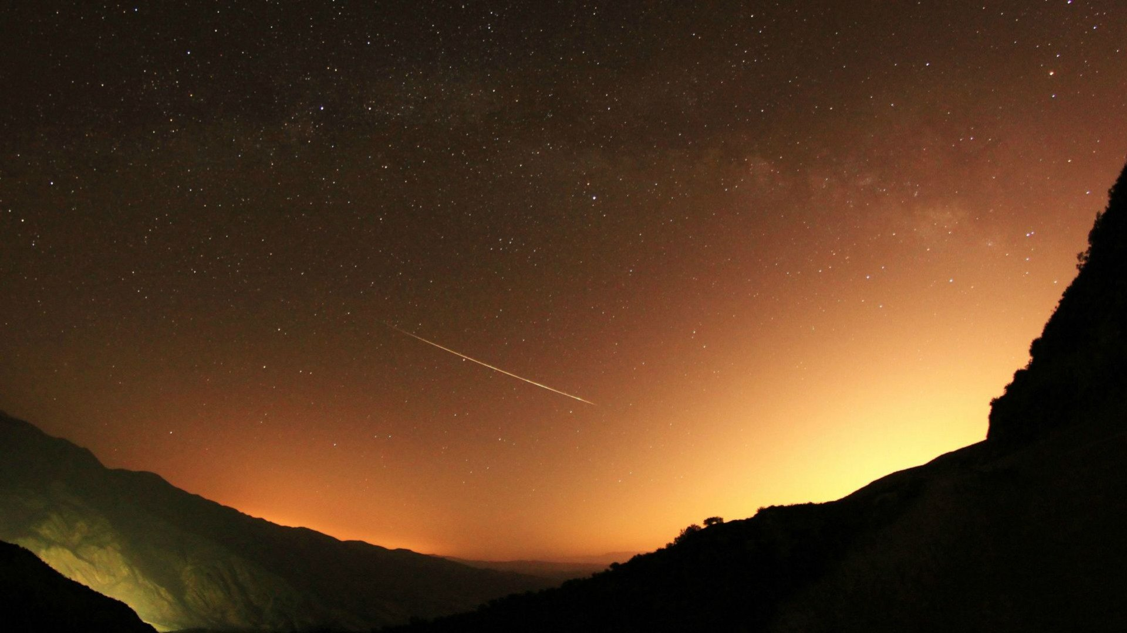
當讚美耶和華 O Praise the Lord our God
婦女會
Women Fellowship

Slide 2
Praise the Lord all ye people; praise God in His sanctuary, All ye people should come, praise Him with Angeles The Sun, moons, stars and all, Come and praise His name for His Glory.
當讚美耶和華,從天頂讚美祂,
眾使者當近倚,眾天軍當吟詩,
在天發光日月星辰,
攏當讚美祂名無盡.

Slide 3
All over the sky and the water, join together to praise Him, God speaks, all have been created, He built everything eternally, He has rules that cannot be abolished.
頂面的天與水,恁攏當來讚美,
因為上帝出嘴,萬物攏受創造,
祂將各項永遠建造,
祂有定例不能廢無.

Slide 4
All the abyss big fish, the fire and the clouds are hail, The fruit of the trees, all the flowers on the top of the mountain, Beast, flying bird, worm everything Come and praise His name.
一切深淵大魚,火與雲霧冰雹,
樹木所結果子,山頂所有花草,
野獸飛鳥精牲,虫蟲
攏當讚美祂名無息.

Slide 5
The king of the world, all the nobles, Whoever the young, old, and men, women, All should praise His name for His Glory, This is our Lord, His is the honorable.
世上君王萬民,一切貴族官長,
青年男女世人,大小男婦老幼,
攏當對主讚美稱讚,
因為主名尊貴無限.

