Slide 1
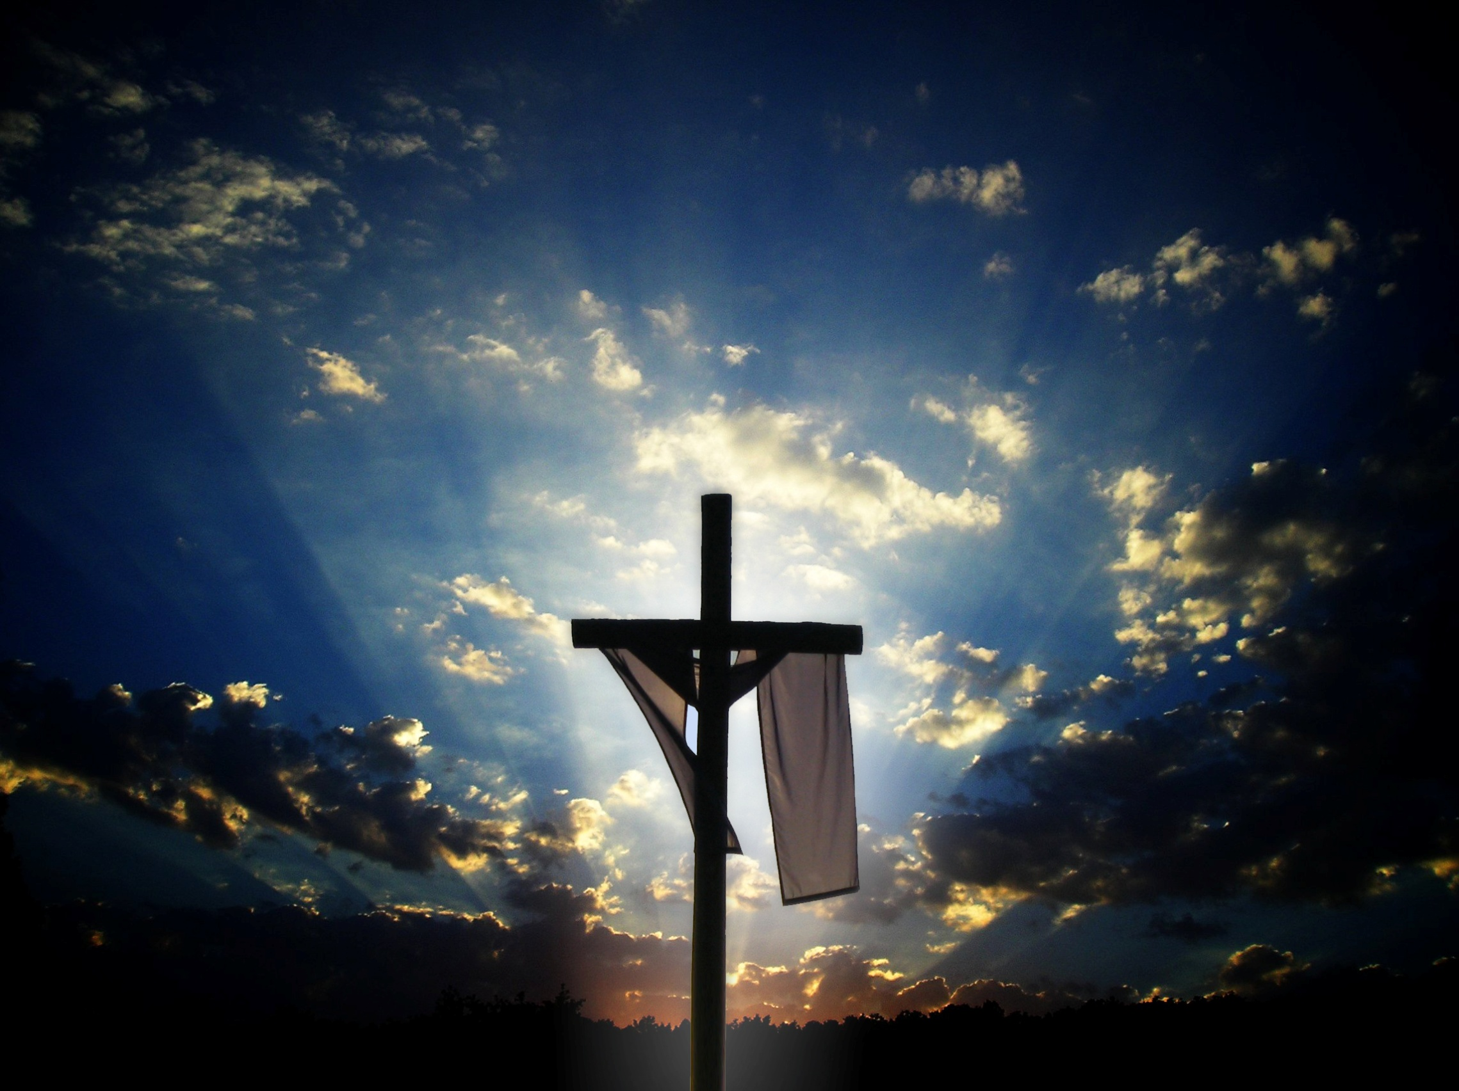
復活的確據
The Certainty
of the Resurrection
林前15:1-11
1 Corinthians 15:1-11

Slide 2
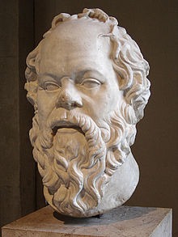
In one of Plato’s dialogues, there is an account of Socrates’ last day on earth. As he awaited execution, a group of his followers came to visit. Naturally the discussion turned to the subject of immortality. Where would the philosopher Socrates go after death?
What lies beyond the grave?
Could Socrates shed any light on these questions?

Slide 3
They talked all day, examining the questions from every angle they could. They concluded that it was almost impossible to attain any certainty about such questions in this present life.
These Anti-Theist friends who assembled in the jail in Athens never found the sure word of God. But we have it. It is given to us in 1 Corinthians 15. Clearly, according to verse 12, some in Corinth doubted the resurrection of the dead and said so. So Paul begins this chapter by giving proofs of Christ’s resurrection.

Slide 4
Paul begins with the gospel that Christ died, was buried, and rose again on the third day. But can we justify such a contention? He lived; no intelligent being can deny that. He died; that fact nobody needs to deny.
He died quivering on a cross after about six hours of agony and suffering. To be
sure of his death, one of the soldiers
pierced his side with a spear, and
his blood were poured out to prove
that he had died. They soldiers didn’t
even take the trouble to break his legs,
for he was clearly dead.

Slide 5
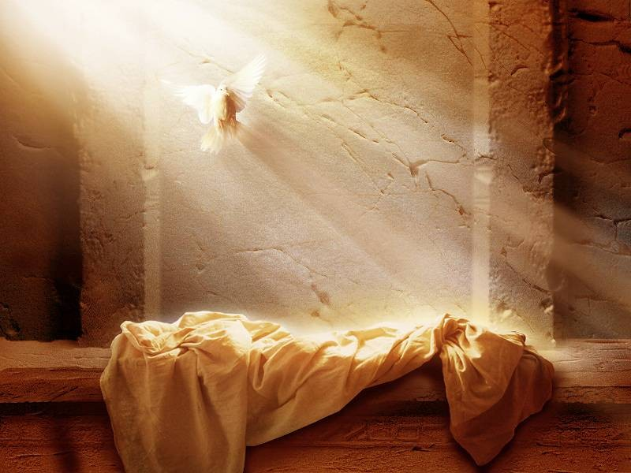
That is all well—but what about his resurrection? What are the proofs of that? Paul gives us three solid proofs in the text.

Slide 6
The testimony of Scripture (v.v.3-4)
The resurrection of Christ should not have been a surprise. Jesus often spoke of it.
“because he was teaching his disciples. He said to them, “The Son of Man is going to be delivered into the hands of men. They will kill him, and after three
days he will rise.”(Mark 9:31)

Slide 7
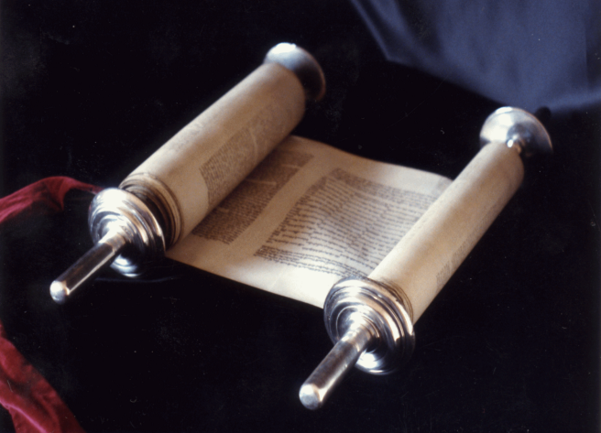
But before Jesus spoke of it, it had been prophesied in the Old Testament.
“After two days he will
revive us; on the third day
he will restore us, that we
may live in his presence.”
(Hosea 6:2)

Slide 8
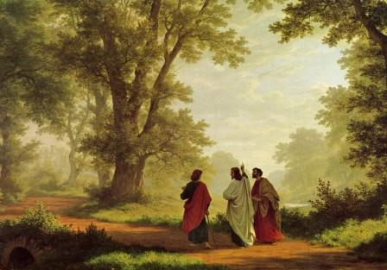
Jesus referred to these prophecies on the road to Emmaus (Luke 24:25-27). The scripture Jesus used were Psalms 16:10 and 68:18.

Slide 9
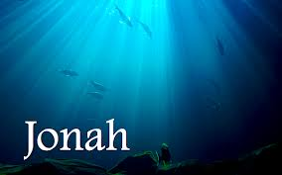
If we look at the principal Old Testament passage cited in the Gospels with respect to Jesus’ resurrection, we find the story of Jonah and the whale. “For as Jonah was three days and three nights in the belly of the whale, so will the Son of Man be three days and three nights in the heart of the earth” (Matthew 12:40).

Slide 10
What shall we say of this kind of evidence? Fulfilled prophecy is the greatest and highest of all the attestations that Christ is truly the son of God and was raised from the dead.

Slide 11
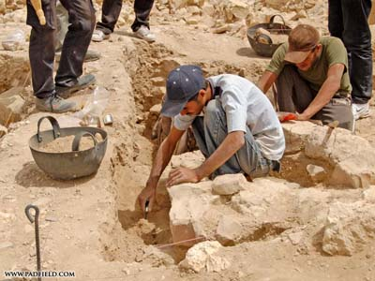
Because the New Testament provides the primary historical source for information on the resurrection, many critics during the 19th century attacked the reliability of these biblical documents. By the end of the 19th century, however, archaeological discoveries had
confirmed the accuracy
of the New Testament
manuscripts.

Slide 12
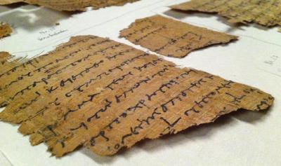
Discoveries of early
papyri bridged the gap
between the time of
Christ and existing
manuscripts from a
later date. Those findings increased scholarly confidence in the reliability of the Bible. Coinciding with the papyri discoveries, an abundance of other manuscripts came to light (over 24,000 copies of early New Testament manuscripts are known to be in existence today).

Slide 13
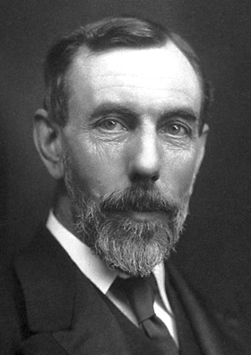
Sir William Ramsay, who spent 15 years attempting to undermine Luke credentials as a historian, and to refute the reliability of the New Testament, finally concluded: "Luke is a historian of the first rank . . . This author should be placed along with the very greatest of historians. "

Slide 14
2. The testimony of eyewitnesses (vv.5-7)
If one man told you that he saw a meteorite streaked across the sky and exploded somewhere, you may or may not believe it. If ten people told you that they all saw the same thing, you would have to be impressed. If five hundred people told you that they saw the same thing at the same time, you could not doubt the veracity of their statements.

Slide 15
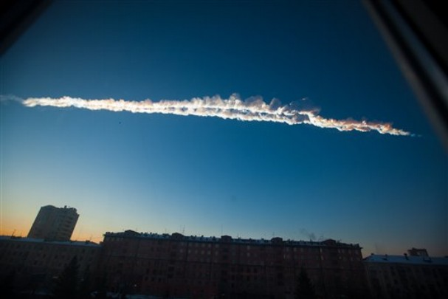
A meteorite streaked across the sky and exploded over central Russia on Feb. 15 2013, raining fireballs over a vast area and causing a shock wave that smashed windows, damaged buildings and injured 1,200 people. What those people said was the truth.

Slide 16
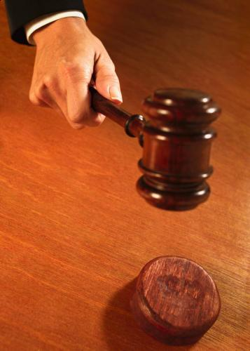
Paul next releases a list of those who had seen Christ. The word “SEEN” refers to seeing with the eye as opposed to a vision or a hallucination. This is also strong evidence.
How do you prove anything?
In a court of law, we determine
the credibility of a case by the
number, agreement, and
reliability of witnesses.

Slide 17
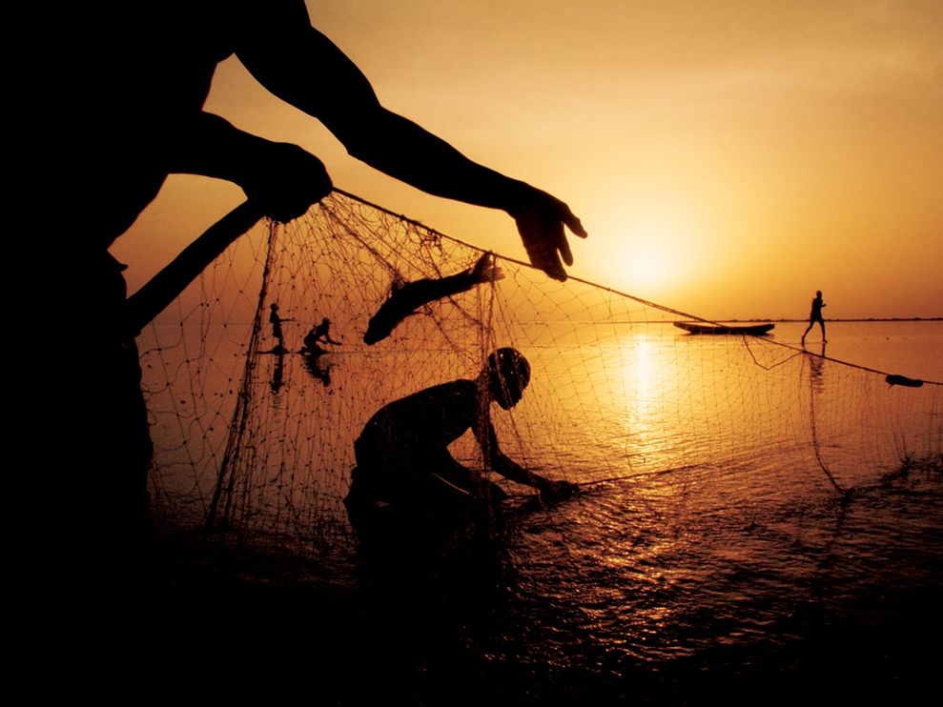
A. The resurrected Christ was seen by Peter and then by the rest of twelve disciples (v.5).

Slide 18
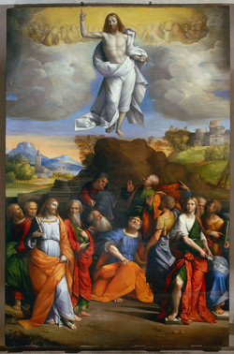
B. The resurrected Christ was seen by five hundred brethren at one time. When Paul wrote this, most of these people were still alive and could have been questioned if his readers had desired to do so (v.6).

Slide 19
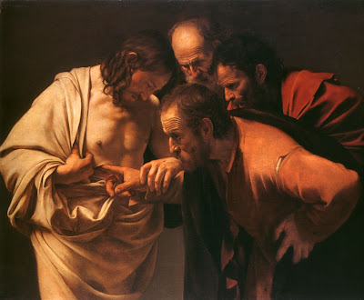
C. The resurrected Christ was seen by
James.
James was the half
brother of our Lord.
At the time he saw
Jesus, he and his family did not believe Jesus was the Messiah until after the resurrection.

Slide 20
3. The testimony of a changed life (vv.8-10)
Paul’s last, and perhaps strongest,
argument is a personal testimony of the
change Christ had made in his life. Paul
would certainly be classified as a hostile
witness. He was devoting his life to
destroying Christianity at that time.
The resurrected Christ was seen by the
apostle Paul himself on the road to
Damascus. His life was totally changed
since then.

Slide 21
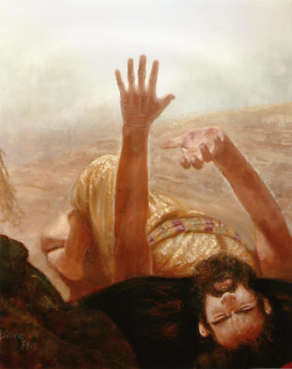
He tells about his past life.
“I persecuted the Christ of
God”(v.9).
B. He tells what wade the
difference in his life. “But by the grace of God I am what I am” (v.10).
C. He tells about his changed life:
“I labored more abundantly than they all” (v.10).

Slide 22
In essence, Paul’s words here have all the ingredients of a good testimony.
Paul says, “You know what I used to be, you know what I am now: meeting the resurrected Christ is what made the difference.

Slide 23
Conclusion:
Here are the three convincing evidences of the resurrection:
the testimony of Scripture,
the testimony of eyewitnesses,
the testimony of a changed life.

Slide 24
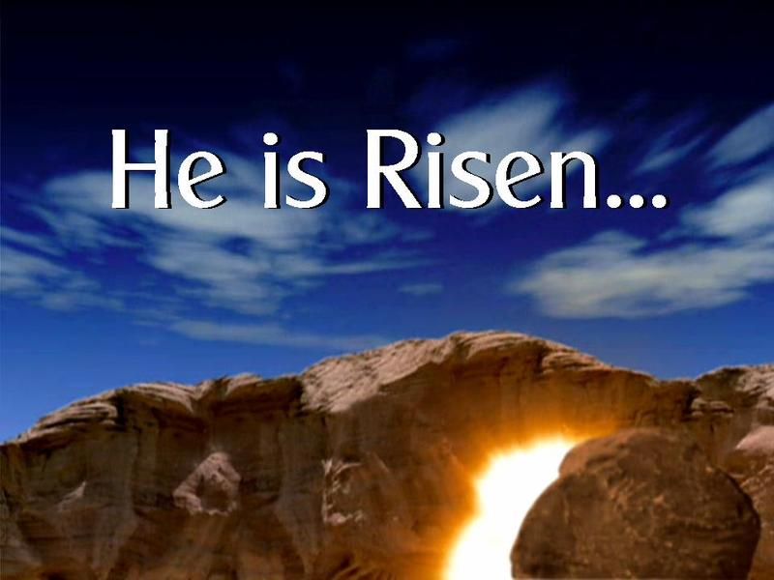
Dear brothers and sisters, God has a most important purpose in your life.
You are the perfect witness for the resurrected Christ.
Praise the Lord! Christ is alive!
He is living forever.

