Slide 1
忠心事主的女子—呂底亞
Faithful, Hospitable Lydia
使徒行傳Acts 16:9-15

Slide 2
As I thought about the message about Mother’s day joint worship this morning, I wondered, what can I say about mothers that has not already been said many times before? Mary— mother of Jesus, Hannah-- mother of Samuel, Rebecca-- mother of Jacob, Elizabeth-- mother of John the Baptist.
The answer is, I doubt seriously there is anything I can say that would be new to you or would be something you have not heard before.

Slide 3
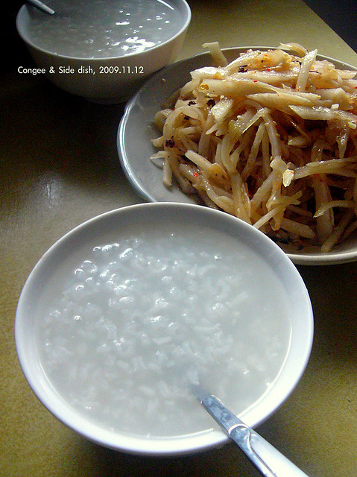
It just so happened that the lectionary scripture of this week is Acts 16:9-15—the story of Lydia. If these famous mothers are compared to the main dishes at five-star restaurant, then the person “Lydia” that I talk about today is like a light dish at your daily life. The ordinary taste is the main
source of the strength. In fact,
Lydia only appears once in the
Acts 16 among the whole Bible.
I hope, Lydia’s story may inspire
us to change our lives.

Slide 4
1.Who was this woman?
First of all, we have to admit that we know almost nothing about Lydia, but what we know from the scripture fascinates us. Who was this woman making her way independently in a world run by men?
Who was this gentile woman who sought the only true God? In the context and background of today’s Scripture, Silas, Timothy, and Luke are accompanying Paul on his second apostolic journey.

Slide 5
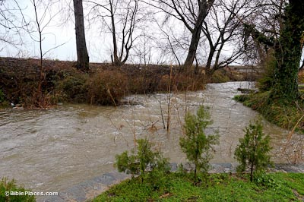
Luke narrates:
“12 from there we traveled to Philippi, a Roman colony and the leading city of that district of Macedonia. And we stayed there several days.13 On the Sabbath we went outside the city gate to the river, where we expected to find a place of prayer. We sat down and began to speak to the women who had gathered there.” (Acts 16:12-13).

Slide 6
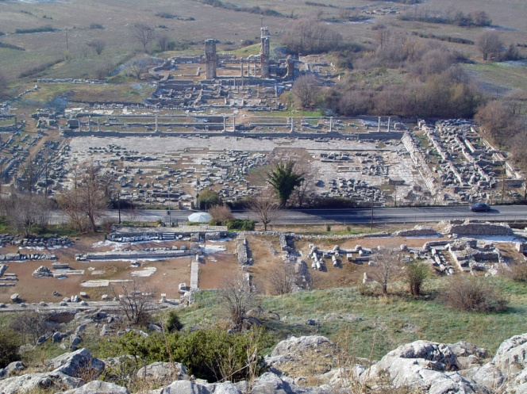
Luke has accurately described Philippi as “a leading city of the district of Macedonia and a roman colony”(v.12). Ancient Greece was composed of two Roman provinces: Macedonia in the north and Achaia in the south. Macedon was offered by Emperor Augustus as a gift for
Retired army officers who
Had faithfully served him.

Slide 7
In the era of Paul the apostle, the city had a population of about 15,000. Approximates that the elite made up 3 percent of the population; landowning farmers and colonists made up 25 percent; skilled work, merchants, and service providers
amounted to 45 percent;
and the poor comprised
the remaining 27 percent.
25%
45%
27%
3%

Slide 8
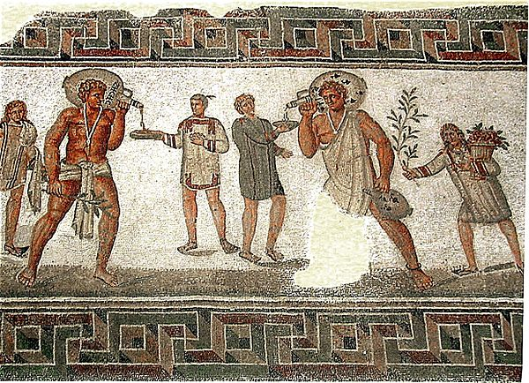
Slaves (about 20% of the total population) were included in the households of the first three groups (elite, farmers, and colonists had several slaves for a variety of tasks; families in the service class might have one or two slaves per household).

Slide 9
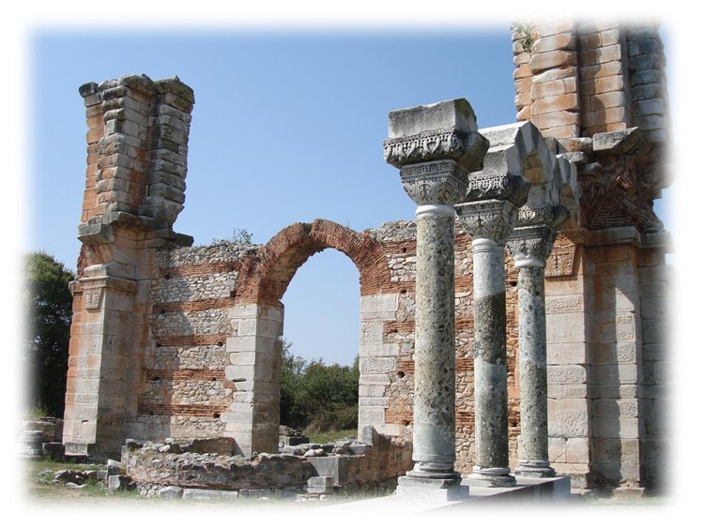
The church that formed at Philippi probably had a modest membership of perhaps 75-100 persons who mirrored the general population. This is why the tone of his letter is joyful and full of thanksgiving for the Philippians’ generosity toward his ministry.

Slide 10
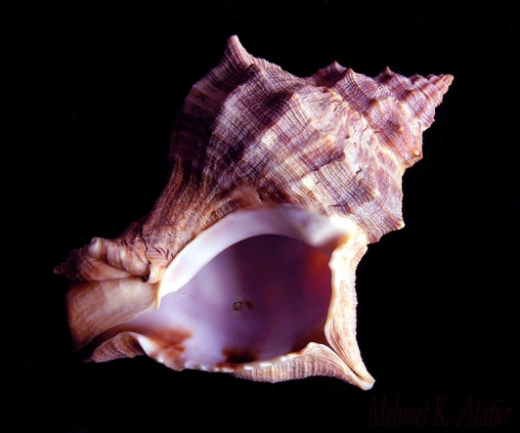
The text tells us “One of those listening was a woman from the city of Thyatira named Lydia, a dealer in purple cloth.” (Acts 16:14a).
Based on the background, Lydia was a merchant, most likely a Greek even though she lived in a Philippi - a Roman settlement. She was evidently a well-to-do business woman of a purple-dye firm in Thyatira. As we know that purple color was extracted from deep-sea shellfish is extremely expensive. Only wealthy people could afford it. Most
portray this holy woman wearing a
purple shawl or veil, which show us
that she was a merchant of specifically
purple cloth.

Slide 11
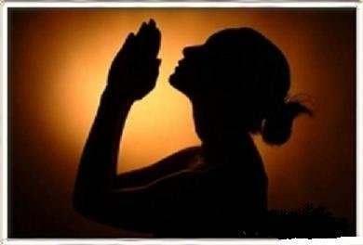
“She was a worshiper of God.” (Acts 16:14b)
The Bible tells us that she was a worshiper of God. She was a gentile who believed in the True God of Israel but had not fully converted to Judaism and she had not yet become a believer in Christ. However, in just those two phrases, scripture show us that work and worship both had their place in the life of this remarkable woman.

Slide 12
2.Human faithfulness and divine guidance
On one Sabbath day, Lydia came to the riverside, to a secluded place of prayer. Maybe she expected to meet other woman, Jewish worshipers or Gentile seekers, for prayer together. What she did not know was that on this particular day outside the city gates, she would be met by Paul and his companions, missionaries looking for anyone who was seeking God in this hidden place of prayer. There at the riverside, Lydia found the God who was finding her.

Slide 13
It almost did not happen. Think back to the controversy in the early church over the preaching of the gospel to the Gentiles (Acts 15) or twice the text tells us that the Spirit prevented Paul from going the wrong way and get him to Philippi. (Acts 16:1-8). Recall for a moment in history, that long list of improbable events that led to Lydia’s encounter with Paul. Dear brothers and sisters, we can only imagine what it is like to have the experience of the Holy Spirit leading us in the right way or stopping us from doing something wrong.

Slide 14
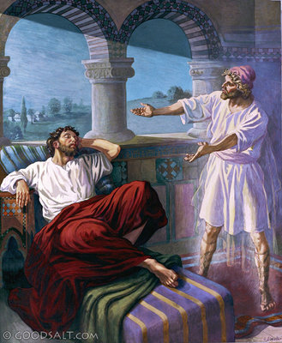
Then, of course, there is Paul’s vision of the “man of Macedonia” who pleads for help. Only when Paul discusses the vision with his companions do they conclude that they must go to Philippi, and they leave immediately. We don’t even know who the “man of Macedonia” is. Did they ever meet the “man of Macedonia”? or was Lydia the one to whom the Spirit was guiding them?

Slide 15
All we learned is the meeting of the businesswoman and the missionaries, and it surely would not have happened were it not for the inexplicable convergence of human faithfulness and divine guidance. Paul and Lydia and the Holy Spirit all worked together in this event, this “chance” encounter by the river. Paul would not have been guided to this place at this moment, were he not first of all at God’s disposal, open to being guided, sensitively attuned to being steered in one direction and away from all others.

Slide 16
Lydia would not have arrived at this place or time, had she not first of all been a worshiper of God. She doesn’t even know that a seeker already on her way. Paul does his part and Lydia hers, but it is God who guides all things and works in and through all things, not just for good but for what would otherwise be impossible. It is the Spirit who brings Lydia to Paul so that she became the first fruit of mission of Europe.

Slide 17
3.We all have to fulfill God’s calling
However this is only half of what is required. True, Lydia must first hear the words of good news, and to do that she must meet Paul. She also must hear the words as truth, as gospel, as the answer to her search. “The Lord opened her heart to give heed to what was said by Paul” (Acts 16:14). It is the Spirit of the Lord Jesus Christ who prepares Lydia’s heart to hear, receive, and understand.

Slide 18
Here is the center of the story, the moment of intersection between human obedience and divine initiative. Lydia’s longing, Paul’s obedience and God’s grace meet there on the bank of the river. The action
of the Holy Spirit inspired me most
in this passage. It has been said
“when one door closes, another
opens.” Like Lydia we are
astonished when, looking
back, we can say only that
our steps were guided and
our heart opened.

Slide 19
After receiving God’s love, Lydia was baptized and her household, then she opens her house as a base for Paul and his companions, insisting that they stay there while continuing their work in Philippi. In fact, she attaches a condition to her request that makes it difficult for Paul to say no. Come and stay, she says,
“If you consider me a believer in the Lord,” she said, “come and stay at my house.” (v.15).

Slide 20
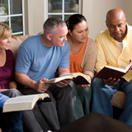
How could Paul argue with that? More than hospitality, however, is at stake. By hosting the missionaries, she becomes one of them, a new convert already in the business of converting others. We can only imagine how many heard the good news while gathered at Lydia’s house.

Slide 21
God opened her heart, and immediately she opened her home. Apparently without any hesitation, she is baptized and turns her house into a base for the spread of Christianity in Europe. Almost as if in a single action, her faith leads to baptism, her baptism leads to opening her house, which issues immediately in hospitality and in sharing in all the risks of the mission enterprise.

Slide 22
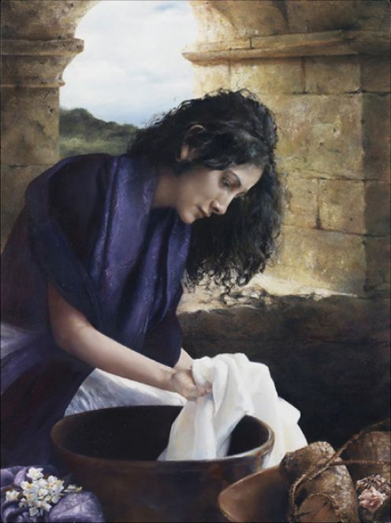
What is remarkable for us is how decisive Lydia appears to be. Unlike so many of us, she is the spiritual modal for all mothers. She sees the truth before her and decides what course to take, and it is done. The whole family receives God’s blessings through her.

Slide 23
Conclusion
I share Lydia’s story as a
mother’s day gift to all
mothers and all women.
Before I finish the sermon, what did you learn from Lydia?
Every step of the way, the Spirit prompts in Lydia’s soul.
Every step of the way, the Spirit prompts and calls and blesses her and, through her, blesses us.

Slide 24
Do you hear the Holy Spirit whispering
to you?
How is God continuing his divine
guidance over you?
Where might God be leading you to
share the good news?
Are you willing to share what you have
got from God’s grace?
May God bless all of us whom continue to follow his command, Amen.

