Slide 1
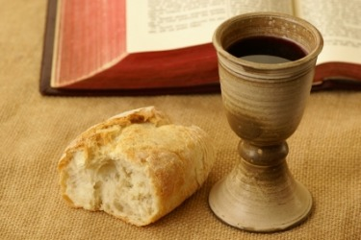
聖餐的默想
Communion Meditation
林前1 Corinthians 11:23-26

Slide 2
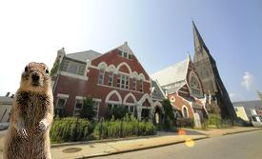
A small town had three churches:
Presbyterian, Methodist, and Catholic.
All three had a serious problem with squirrels in the church building and each, in its own fashion, had a meeting to deal with the problem.

Slide 3
The Presbyterians decided that it was predestined that squirrels be in the church and that they would just have to live with them.
The Methodists decided they should deal with the squirrels lovingly. They humanely trapped them and released them in a park at the edge of town.
Within 3 days, they were all back in the church.
The Catholics had the best solution. They baptized and confirmed the squirrels. Now they only see them at Christmas and Easter.

Slide 4
No matter what denomination, Christians have long celebrated Holy Communion. Holy Communion also known as "The Lord's Supper" (Eucharist), was established by the Lord Jesus for more than two thousand years ago.
Some churches hold it every Sunday, some once a month, others once a quarter, just like us. The Lord took bread and said, "This is my body". These four phrases “‘take bread’, ‘given thanks’, ‘break it’, ‘give it to them’ ” represents the life of Jesus, and also similarly summarize our life as a Christian. Today, we meditate together on the meaning of the Holy Communion.

Slide 5
1.Take Bread
"Take" is translated from the Greek word “Lambano”. This word appears 266 times in the Bible. If we say “our life was taken by God”, it sounds a bit cold and is more difficult to figure out the meaning. Let’s look at two verses:
“The Lord God took the man and put him in the Garden of Eden to work it and take care of it.” (Genesis 2:15)
“I will take you as my own people, and I will be your God.”(Exodus 6:7)

Slide 6
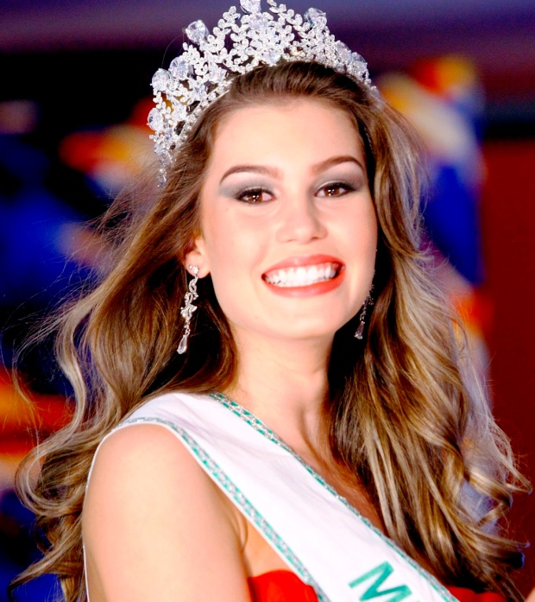
So, we understand that “Lambano” can also be
translated into "chosen". In life, the "chosen" or
"elected" are often selected at the expense of the
“unchosen” or "unsuccessful",
whether it is in an
election for class president,
valedictorian election,
or the election of Miss World.

Slide 7
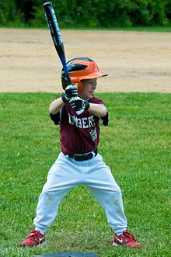
When I was a kid, baseball was most popular sport in my era. Usually, the first two chosen become team captains. The two captains then take turns to choose their team members. Towards the end, there are always a few people left who do not get picked. The only position left is the referee. So I often was the referee. An old man like me still remembers these things.

Slide 8
The spiritual definition of God's chosen, however, is completely different from the competitive world of the "elected". The world’s "elected" implies the exclusion of others.
God does not exclude certain people, but rather includes and accepts others. Because each person is unique in God's eyes. You are a person who unique and chosen by God.
The meaning of “Lambano” tells us that we are already chosen by God. Let our hearts be thankful for what He has prepared for us all.

Slide 9
2.Given Thanks
Jesus took bread, and then he "gave thanks" for the bread. In many churches, the last prayer in Sunday worship is called "Benediction", which comes from the Latin words,
"bene" (which means beauty) and
"diction" (which means a saying, expression, word).
Together, "benediction" means “the words with blessings”.

Slide 10
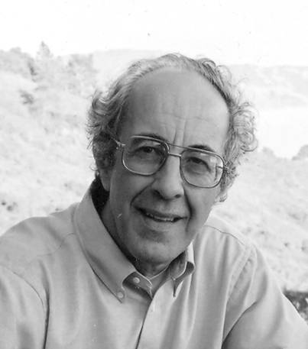
Henri Nouwen (盧雲) used to be a theology professor at Harvard University. One day, he was invited to the synagogue and it just so happened to coincide with the Jewish rite, Bar Mitzvah. A 13-year-old boy was being received as an adult by the congregation. He first led worship, read scripture from Genesis, shared a short message, and was then declared by the Rabbis.

Slide 11
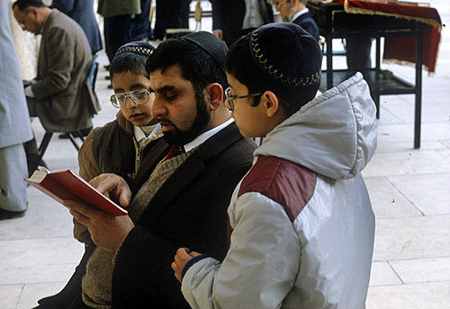
In observing this ceremony, Nouwen was most deeply moved by the final blessing of the parents of the child. The father said, "My son, no matter what happens to you, success or failure, whether you become famous or not, healthy or not, always remember your mother and I love you!”

Slide 12
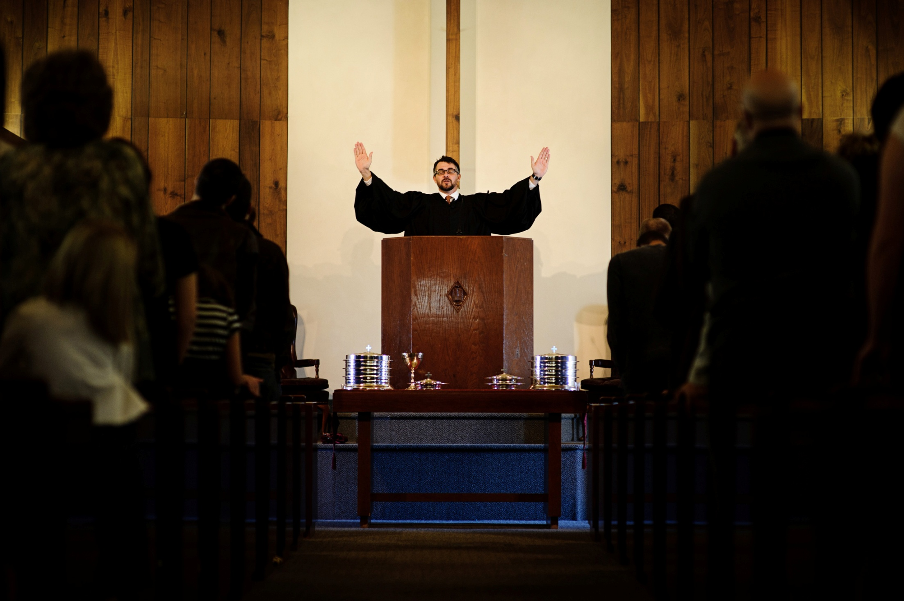
Dear brothers and sisters, we all hope and pray to get the blessings from God and God has given the authority of blessing to the Lord Jesus. The power of blessing is real. We should also follow the example of the Lord: bless others always!

Slide 13
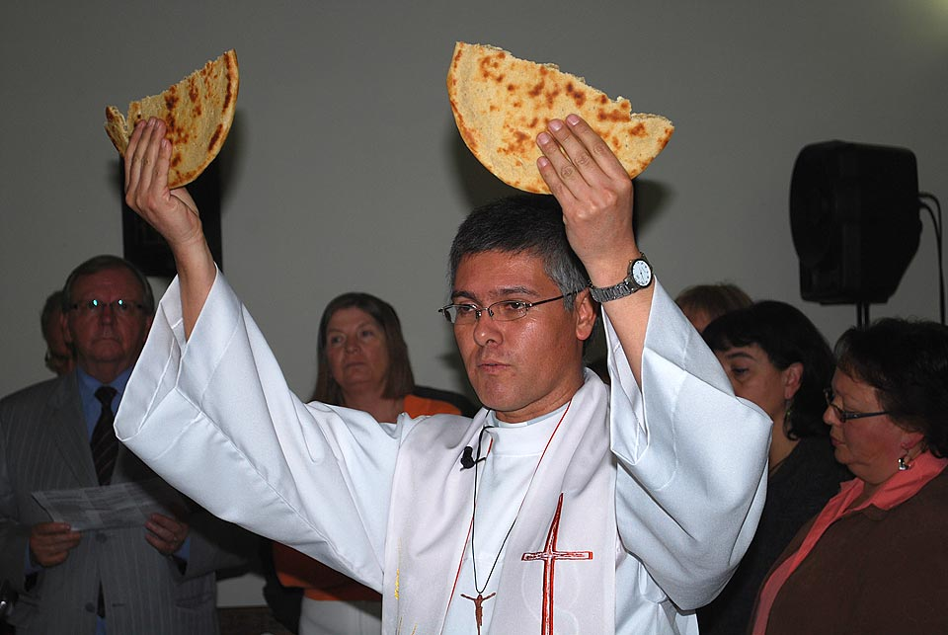
3. Break it
“They all ate and were satisfied. Afterward the disciples picked up seven basketfuls of broken pieces that were left over.” (Matthew 15:37)

Slide 14
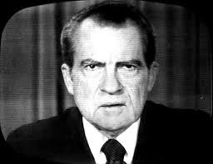
U.S. President Richard M. Nixon was asked to step down because of the Watergate scandal. It was a big shock and struck a huge blow to his spirits. After stepping down, he became ill and was rushed to the hospital for treatment. In his depression, he even told his wife that he wanted to give up.

Slide 15
One day, a nurse ran into his room. She opened the curtains and pointed to the sky. There was a small plane with a long banner tied to its tail that read: "Mr. President, God loves you, we love you." It was later found out that it was Mrs. Ruth Graham, the wife of Reverend Billy Graham, who specifically rented a small plane to tell President Nixon that "He is a person whom God still loves.” That was the turning point of Nixon’s life. In experiencing someone who still loves him regardless of what had happened before in his life, this gave him hope and courage.

Slide 16
4.Give it to them
Jesus took bread, gave thanks, broke it, and with his final action "he gave it to them.“
" And he took bread, gave thanks and broke it, and gave it to them, saying, “This is my body given for you; do this in remembrance of me.” (Luke 22:19)

Slide 17
Dear brothers and sisters, you whom God chose, are touched the love of God and blessed by God, God has given you unique life experiences with the purpose of sharing it.
Only when we know how to share with other people, can we can truly appreciate the ultimate meaning of life.

Slide 18
Just as Jesus said in Holy Communion, "that the Lord Jesus was betrayed that night, took bread, and gave thanks, and break it, and said, this is my body, broken for you", Here we learn an important truth: “Give, and you will receive”. Imagine a cold night, you see a man squatting and shivering on the ground. Unless someone is willing to take off his coat, that man will feel warm.

Slide 19
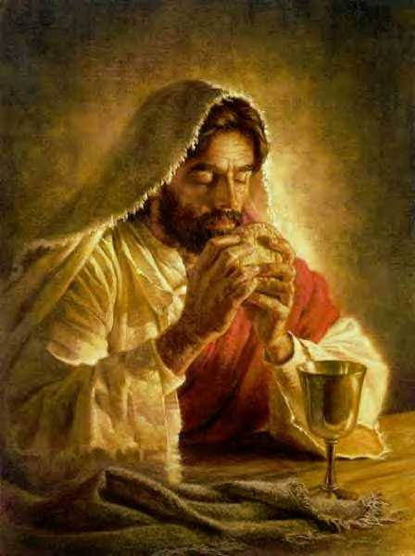
Conclusion: After the establishment of Holy Communion, Jesus said, “This cup is the new covenant in my blood; do this, whenever you drink it, in remembrance of me.” FPCOC holds this once every quarter, we should cherish this opportunity. Do not miss the sacrament. Please remember Jesus’ word. You are chosen by God, and have received His blessings. Through our
broken experiences, go and share the
blessings of God to the people.
And when you do so, you will live
a wonderful testimony to God.

