Slide 1
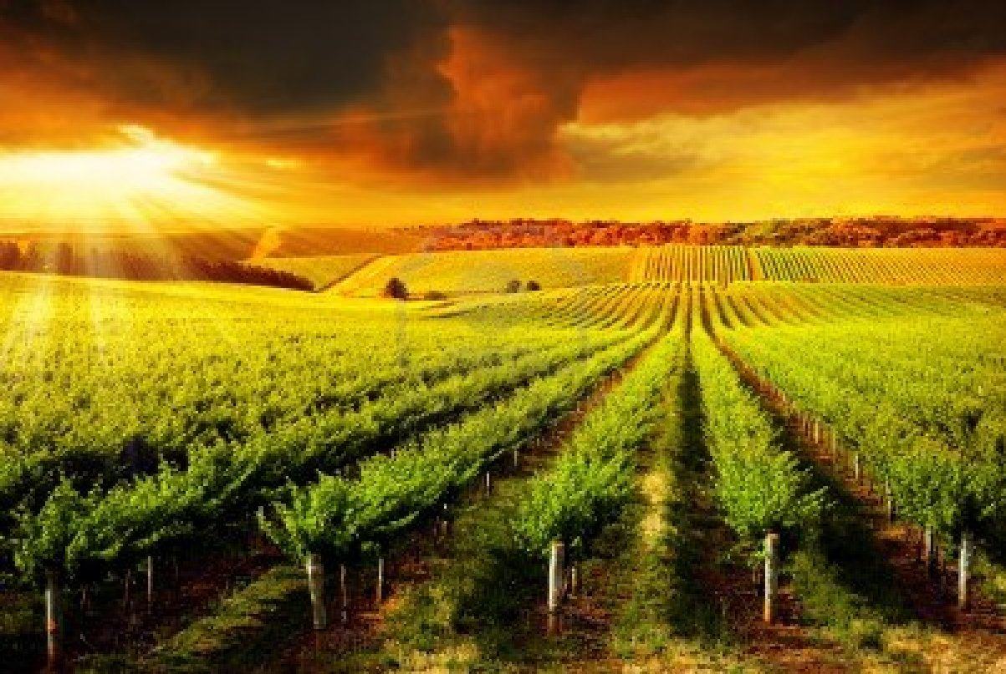
葡萄園的故事
-- The Kingdom of God is hiring
馬太20:1-7

Slide 2
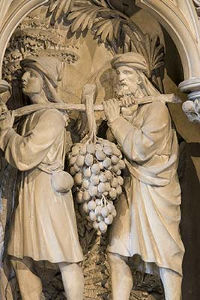
Valley of Eshkol 以實各谷

Slide 3
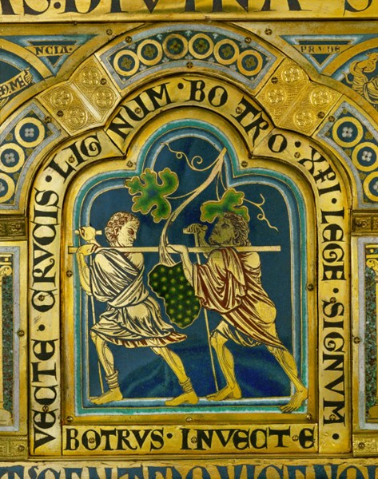

Slide 4
一、主耶穌呼召人進入葡萄園
Jesus calls people into the vineyard
天國好像家主清早去雇人進他的葡萄園做工
For the kingdom of heaven is like a landowner who went out early in the morning to hire workers for his vineyard. （v.1）
到了晚上，園主對管事的說，叫工人都來，給他們工錢
When evening came, the owner of the vineyard said to his foreman, Call the workers and pay them their wages. （v.8）

Slide 5
耶穌將天國濃縮為早上六點到晚上六點From 6am to 6pm

Slide 6
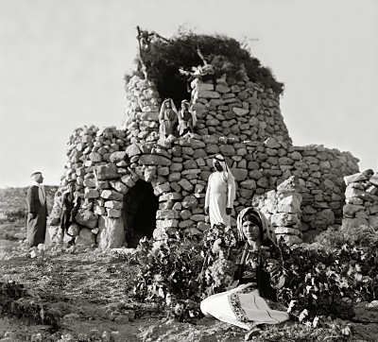
守望台(watchtower)

Slide 7
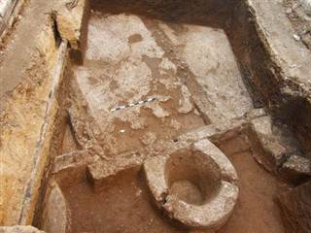
榨酒池 (Ancient wine-making factory)

Slide 8
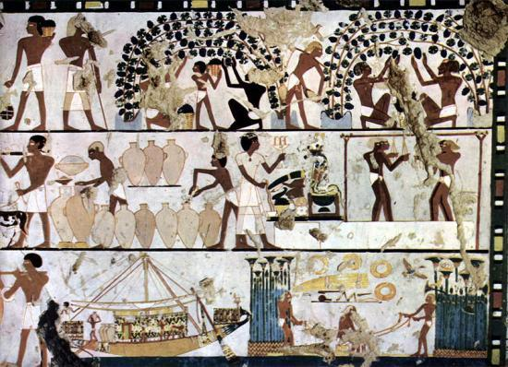
A variety of works in vineyard

Slide 9
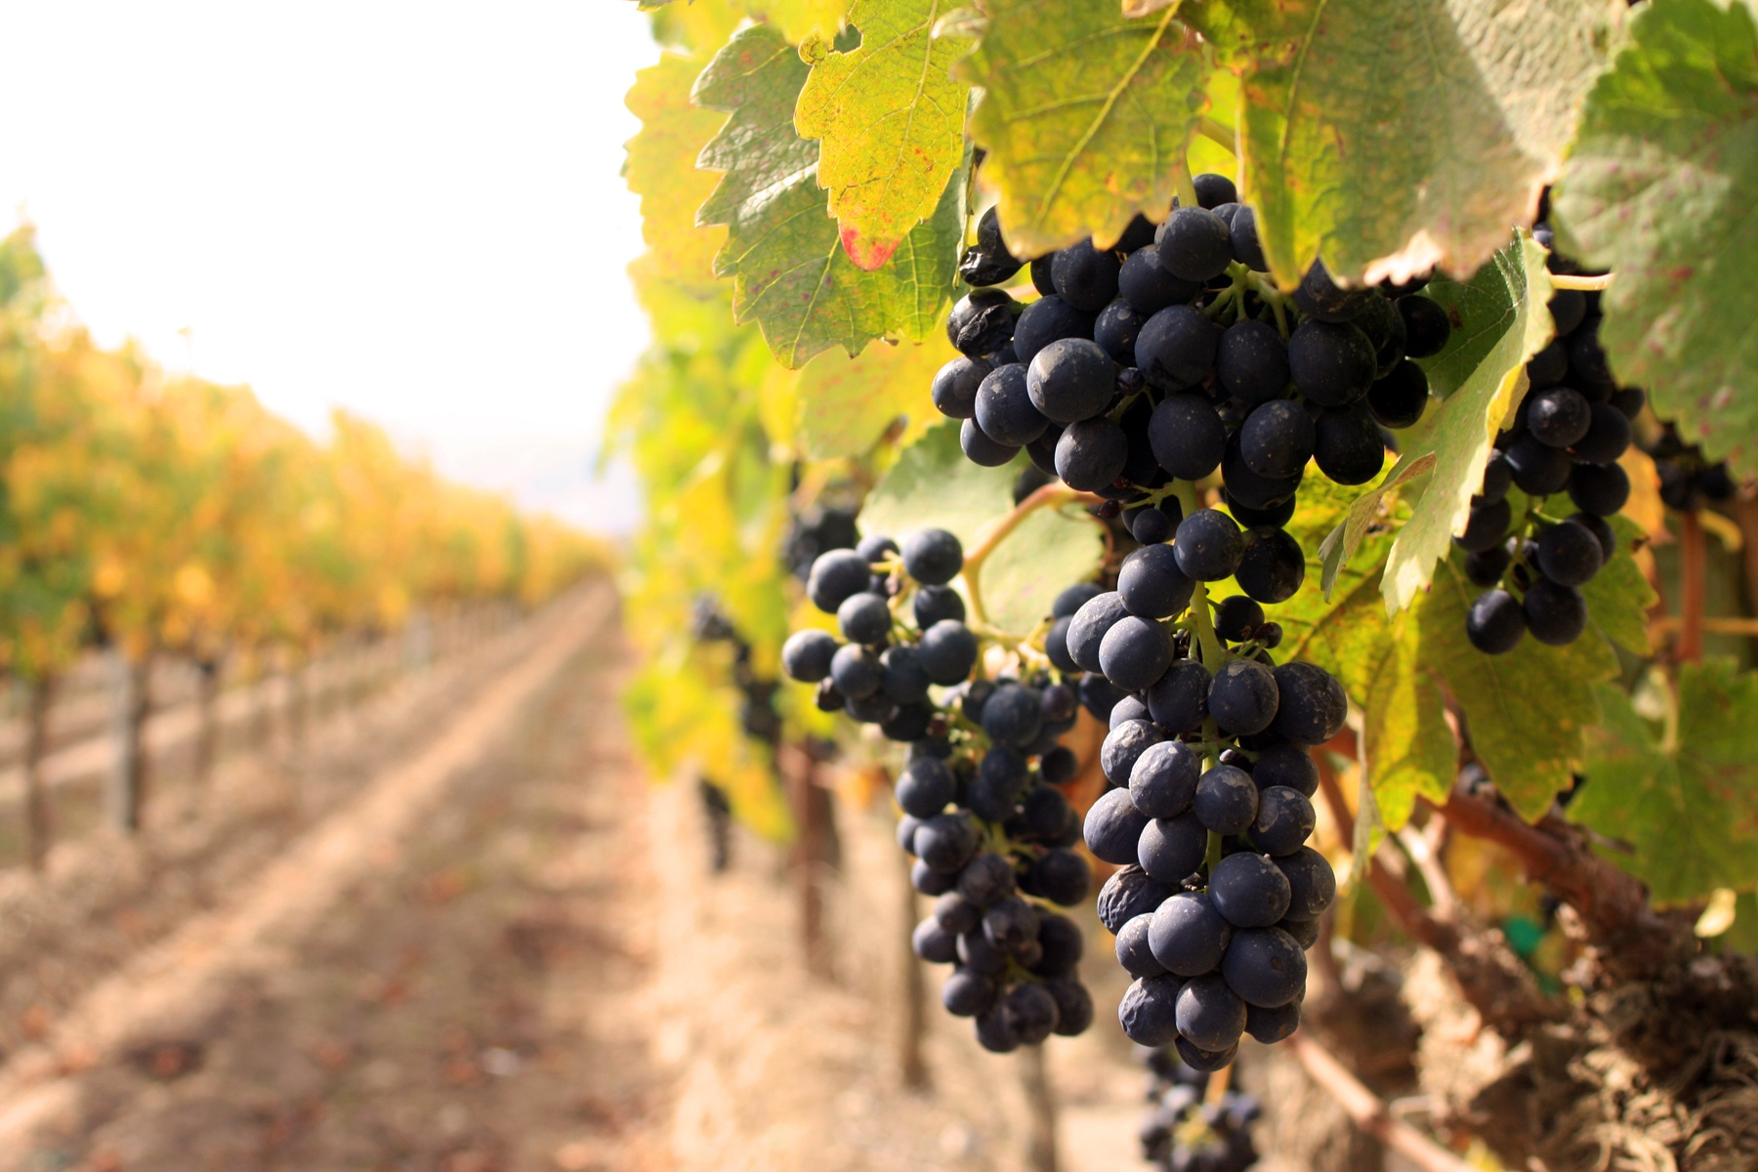

Slide 10
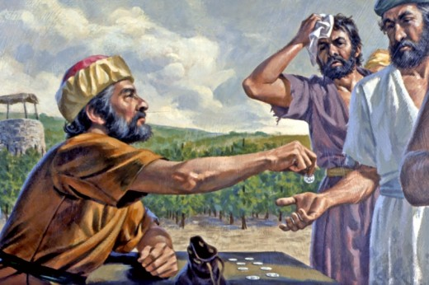
朋友、我不虧負你．你與我講定的、不是一錢銀子麼。
I am not being unfair to you, friend. Didn’t you agree to work for a denarius?

Slide 11
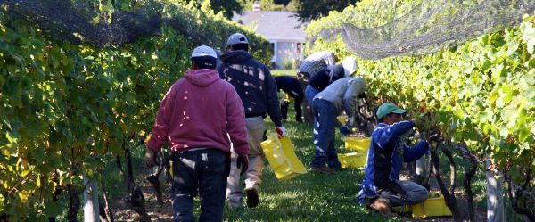
What is your attitude?
Complaining or Gratitude
常常埋怨？還是心存感恩？

Slide 12
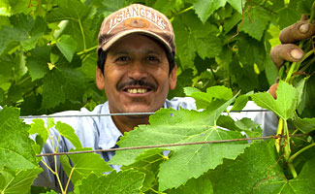
這樣、那在後的將要在前、在前的將要在後了。
So the last will be first, and the first will be last. (Matt. 19:30, 20:16)

Slide 13
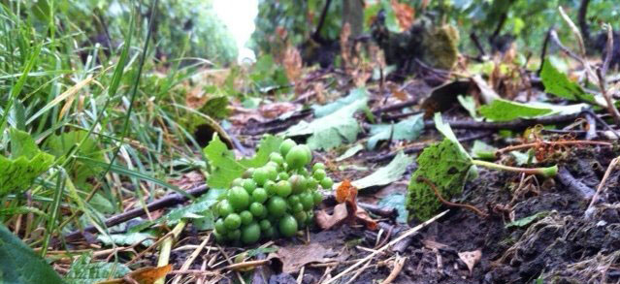
二.與時間賽跑--採收葡萄時間所剩不多
Race against time - the grape harvest time is running out

Slide 14
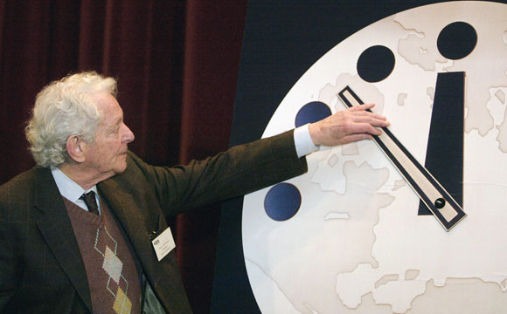
距離午夜剩5分鐘
5 minutes left to midnight
末日時鐘 Doomsday Clock

Slide 15
Descriptive sections
Basic universal problems (170)
Cross-sectoral problems (575)
Detailed problems (2,162)
Emanations of other problems (3,857)
Exceptional problems (3,072)
Cross-referenced sections
Very specific problems (2,153)
Problems under consideration (214)
Total: 12203 problems

Slide 16
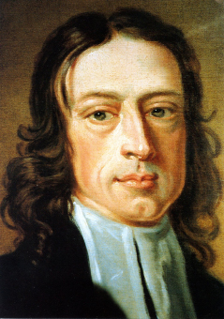
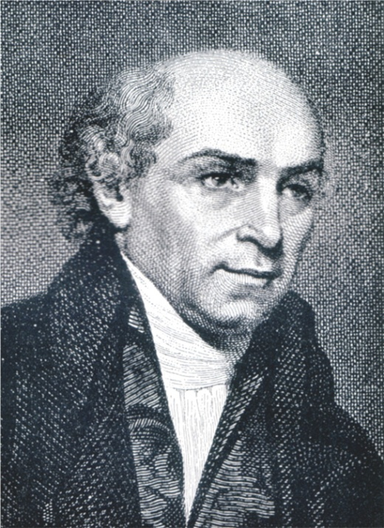
約翰衛斯理：「世界是我的教區」
The world is my parish.
– John Wesley
威廉克里:「為神謀劃大事，求主成就大事」
“Expect great things from God, attempt great things for God.”
-- William Carey

Slide 17
什麼是「大事」？
What is great thing?
「人在最小的事上忠心，在大事上也忠心，在最小的事上不義，在大事上也不義」 (路加福音16:10)
“If you are faithful in little things, you will be faithful in large ones. But if you are dishonest in little things, you won’t be honest with greater responsibilities. Luke 16:10 (NLT)

Slide 18
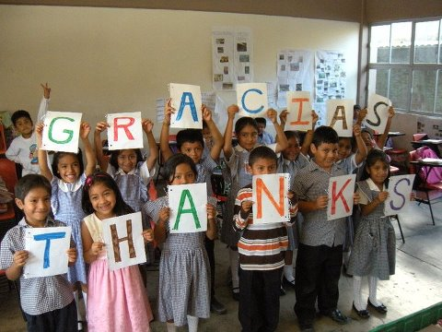
El Niño
"The Little One"
Let’s start from here.

