Slide 1
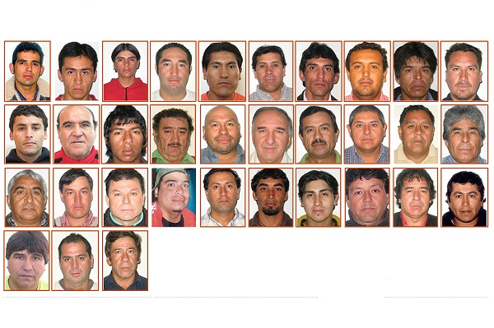
One afternoon beginning around
2:00pm, August 5, 2010, a copper
mine in northern Chile caved in.
At the time of the collapse, there
were two groups of workers present in the mine. The group nearest the entrance escaped immediately without incident. A second group of 33 men was stuck deep inside the mine. A thick dust cloud caused by the rock fall blinded the miners for up to six hours. The buried men fell into panic immediately. What started as talk that quickly turned into quarrel.

Slide 2
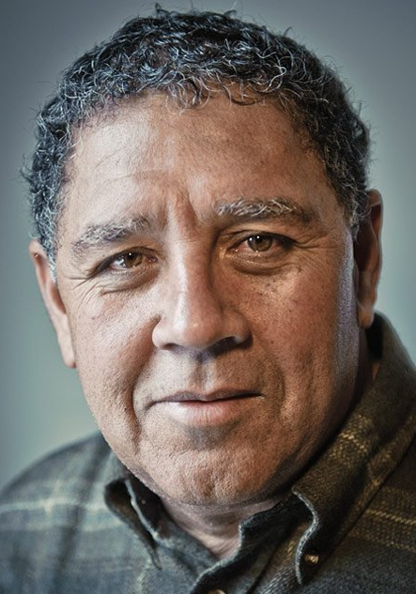
Luis Urzúa, the duty shift supervisor
said, "If we do not unite at this
moment, work together for survival
struggle, we can only quarrel utually,
waiting for death in the fission."
Today’s scripture, Psalm 80 was a community lament back during the time of Assyria’s military defeat. The people had been captured and the country fell into the darkness. Asaph, the director of music, prayed three times “make your face shine on us, that we may be saved.” (Psalm 80:3, 7, 19)
Luis Urzúa

Slide 3
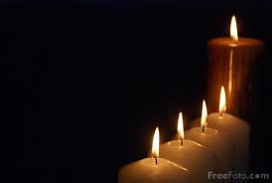
This psalm is often read on the fourth Sunday of Advent in many Western Christian churches. Advent (from the Latin word adventus meaning "coming") is a time of expectant waiting and preparation for the celebration of the
Nativity of Jesus at Christmas.
We celebrate not only because He
was born two thousand years ago,
but we also wait with joy for
His second coming.

Slide 4
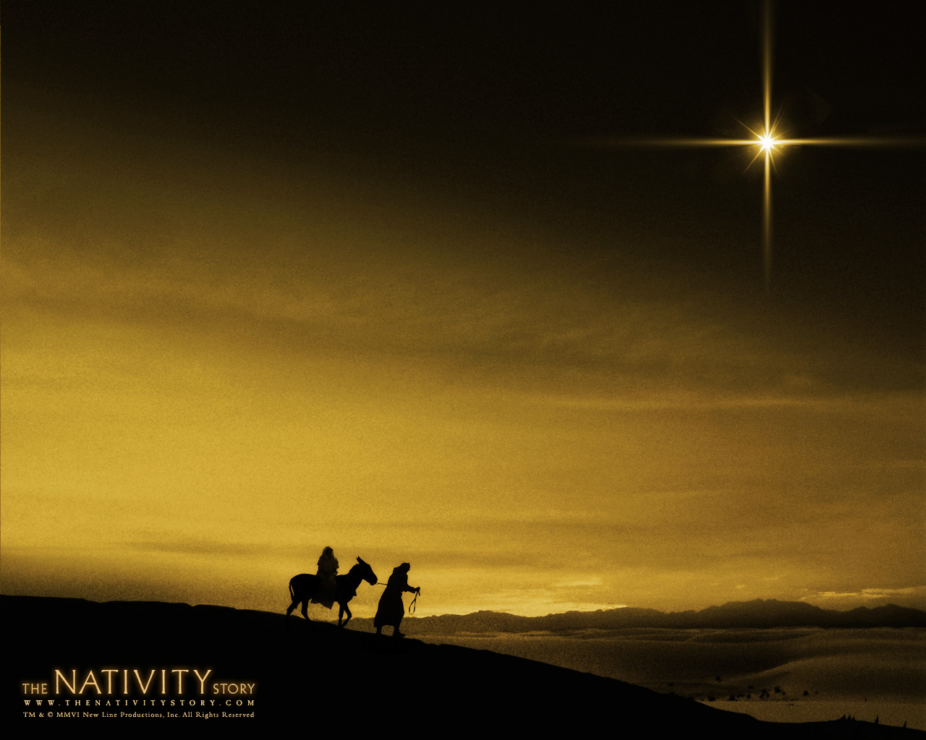
Therefore, during the Advent season,
besides preparing to celebrate
Christmas day, the more important
thing is that Jesus Christ will come again. Nobody knows when He will come.
Jesus once reminded us to be ready through the parable of the Ten Virgins. Are you ready? The time of waiting and preparation is always mixed with anxiety, anticipation and challenges.

Slide 5
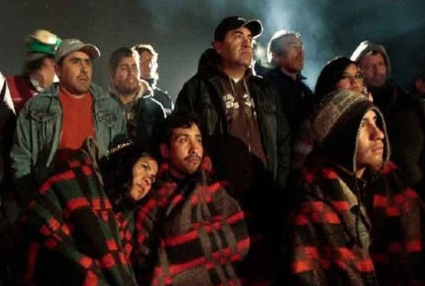
After the accident happened, a relief operation was immediately launched. Families waited anxiously on the ground. The rescue team was forced to race against time. 33 people were trapped 2,300 ft underground and about 3 miles from the mine's entrance. Although the trapped
miners found the emergency
supplies stocked in the shelter,
these supplies were intended to
last only two days. No one knew
how long the rescue work would take. The only thing to do was to wait and prepare.

Slide 6
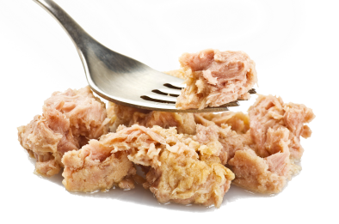
Luis Urzua immediately decided that first, everyone needed to follow the regular schedule: eight hours of work, eight hours of sleep, and eight hours of leisure (for meals, physical exercise and entertainment). Secondly, everyone can eat a meal every two days (which included 2 small soupspoons
of tunas, 1 small piece of bread,
and 2 small soupspoons of milk)
and must wait until every miner
received their portion to eat.

Slide 7
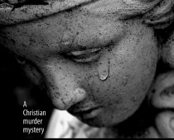
“You have fed them with the bread
of tears; you have made them drink
tears by the bowlful.” (Psalms 80:5)
Amidst the darkness, people eat and drink but with tears because everybody knows that with every bite, the remaining amount of food decreases. The NIV Bible says "bread of tears" and "tears to drink", helping us relate to the Holy Communion sacrament: the receiving of bread and cup. Through the blessing of bread and cup, we participate in the new life Christ gives.

Slide 8
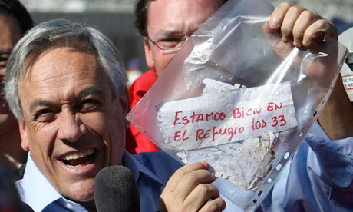
The time passed by day after day. 16 days had already passed since the collapse. There remained only enough food for what seemed like a last meal. However, a miracle happened. On the 17th day, at a depth of 2,257 ft, the eight drill bit broke through into
the mine, and finally reached a
ramp. The drilling engineers
were surprised to discover the
notes written on a piece of
paper, “We are well in the shelter, the 33”, when the drill bit was pulled out.

Slide 9
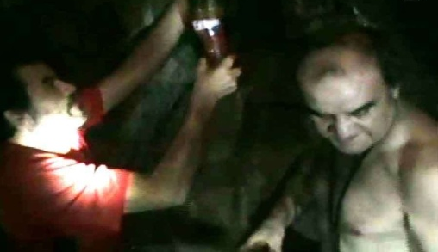
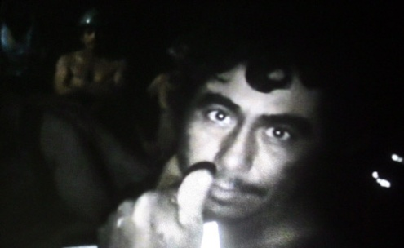
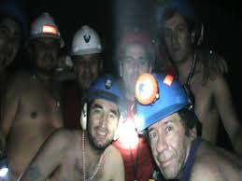
The words became the motto of the miners' survival and the rescue effort. The drill holes became a lifeline, allowing the back and forth transportation of water, food, medicine and clothes. All men were rescued after 69 days. But the most miraculous part of the story is not the rescue. The real miracle -- and most inspiring part of this story -- is how the duty shift supervisor Luis Urzua managed to overcome darkness, despair, and the possibility of starvation to organize a team who worked together to make sure that every man survived in the worst of conditions.

Slide 10
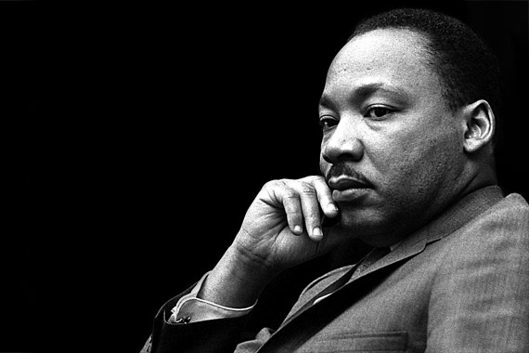
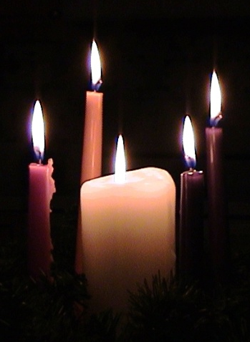
“Darkness cannot drive out darkness,
only light can do that.”
Martin Luther King Jr.
We light the first purple candle in Advent
season to represent "Hope". The second
purple candle represents "Peace"; the third
purple candle represents "Joy"; the fourth
purple candle represents "Love";
the last white candle proclaims that Jesus Christ is the light of the world that will shine in this dark world.

Slide 11
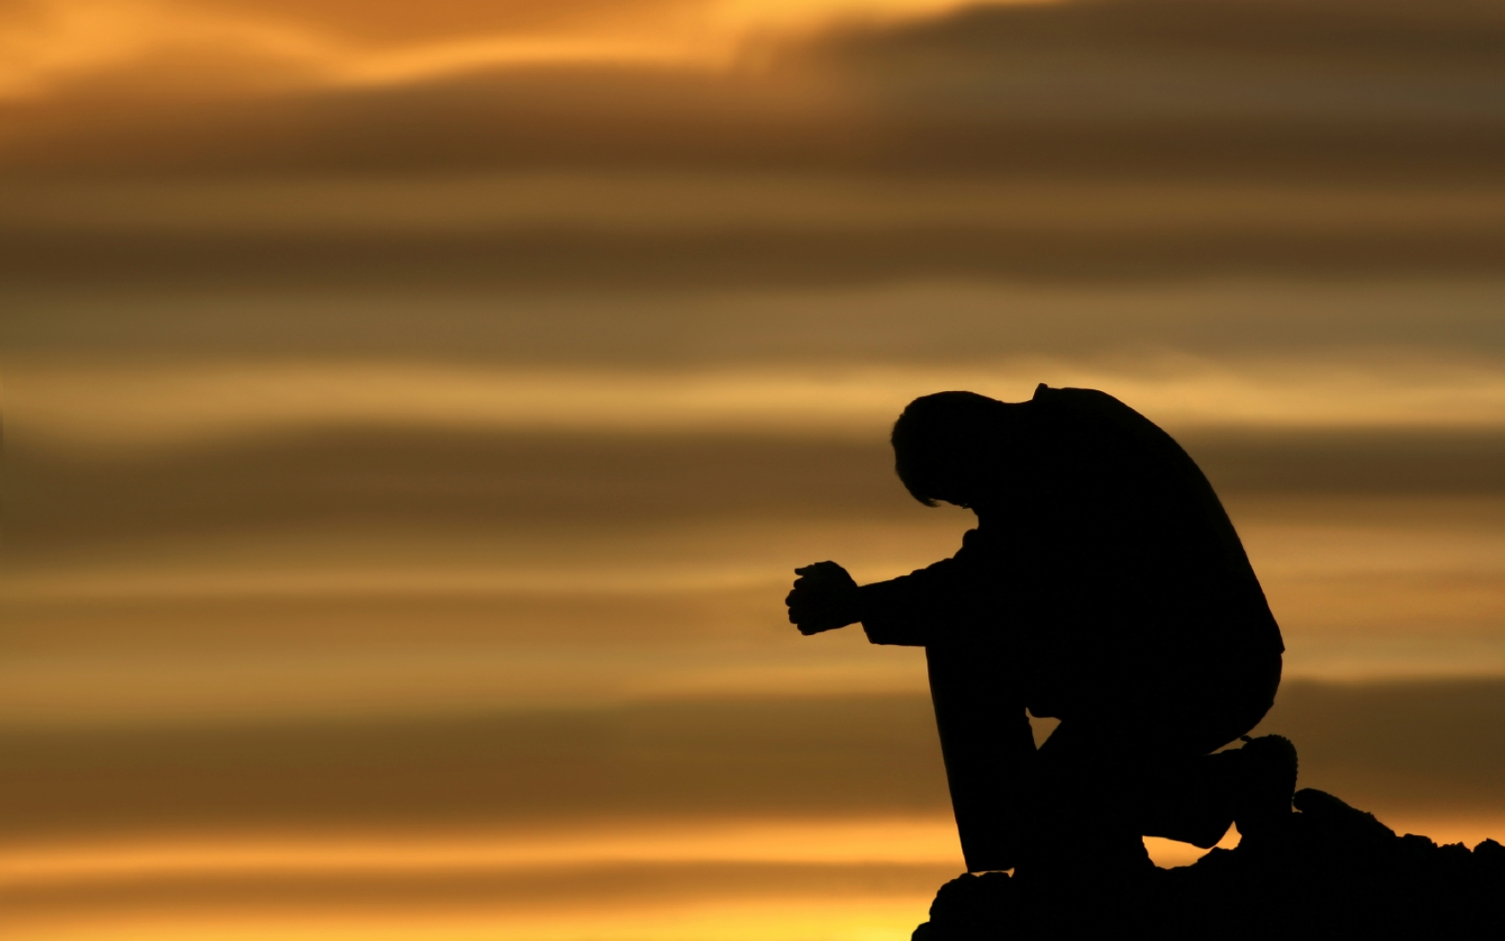
The psalmist prays…
¹⁷Let your hand rest on the man at your right hand, the son of man you have raised up for yourself. 18 Then we will not turn away from you; revive us, and we will call on your name.
19 Restore us,
LORD God Almighty; make
your face shine on us,
that we may be saved.

Slide 12
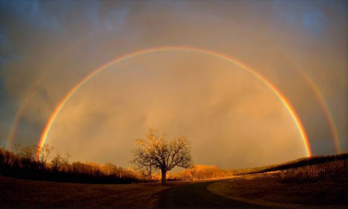
God did answer their prayer—God gave them life—the people promised they will never turn away from God. This is our prayer too. The life that we humbly seek is to survive, to have a future, and to live in a restored relationship with God.

Slide 13
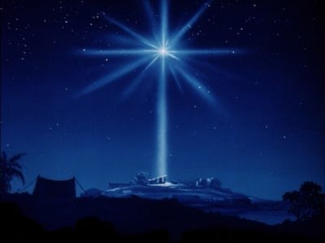
Christ is the one at God’s right hand, and one who saves the people. When God’s face shines, we are saved. Advent is a good time to spread the good news to people. “Make your face shine on us, that we may be saved”, the Lord will arise upon you, and His glory will appear over you.

