Slide 1
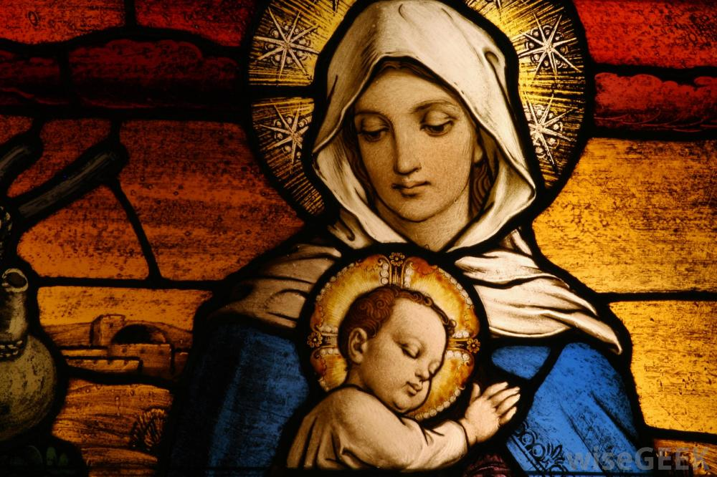
一位信心的母親和偉大的兒子 A Faithful Mom and A Great Son

Slide 2
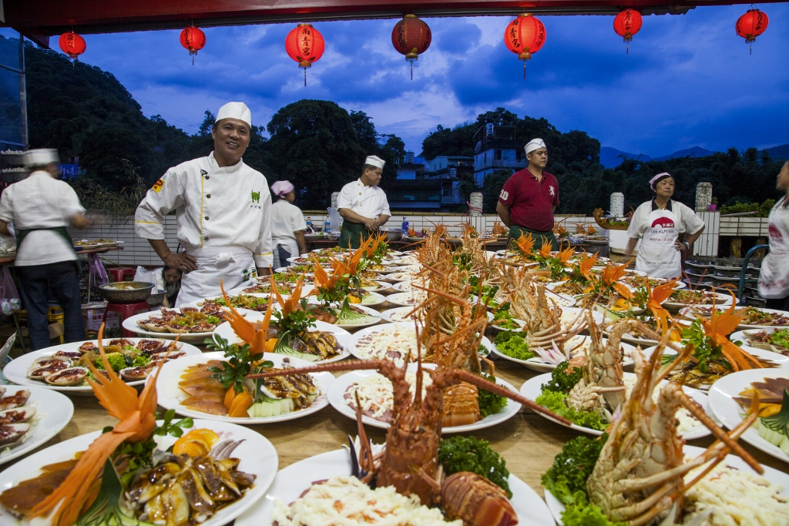

Slide 3
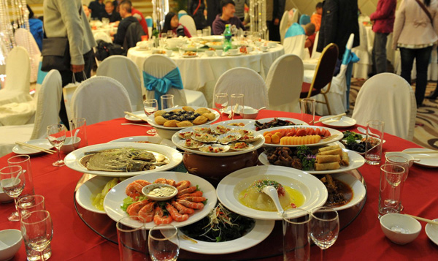
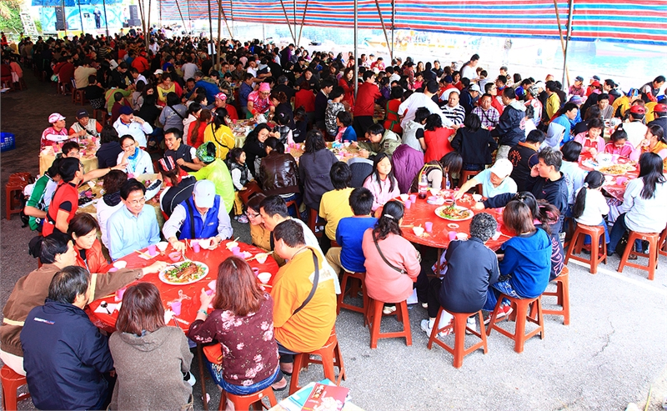

Slide 4
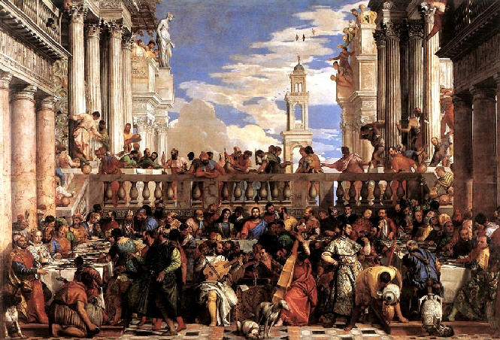
Wedding at Cana 迦南婚筵

Slide 5
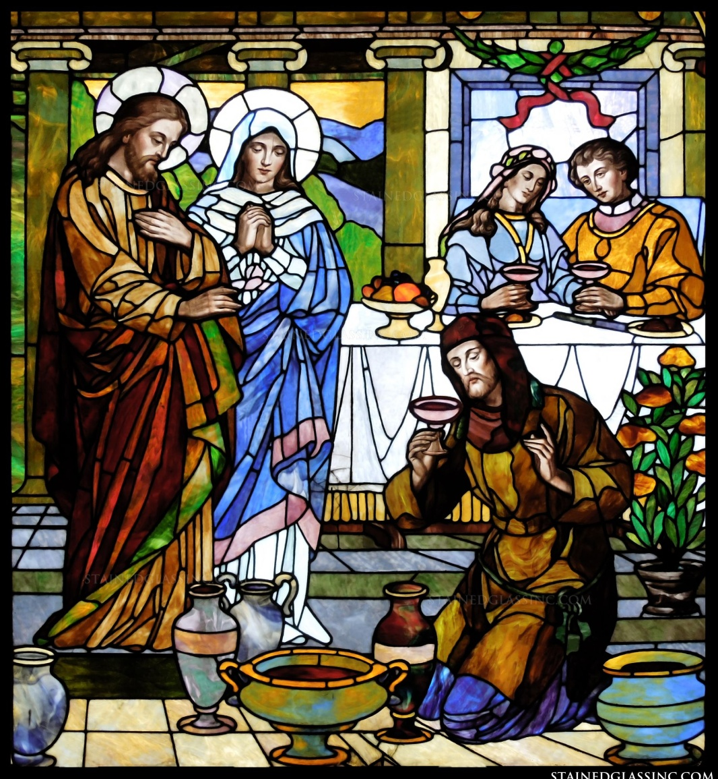
They have no more wine.
他們沒有酒了！

Slide 6
³ 酒用盡了，耶穌的母親對他說：他們沒有酒了。⁴ 耶穌說：母親，我與你有什麼相干？我的時候還沒有到。
³ When the wine was gone, Jesus’ mother said to him, “They have no more wine.” ⁴ “Woman, why do you involve me?” Jesus replied. “My hour has not yet come.”

Slide 7
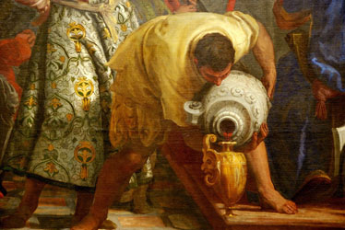
Do whatever he tells you.
他告訴你們什麼，你們就做什麼。

Slide 8
¹你們做兒女的，要在主裡聽從父母，這是理所當然的。² 要孝敬父母，使你得福，在世長壽。 (弗6:1-2)
¹ Children, obey your parents in the Lord, for this is right. ² “Honor your father and mother”—which is the first commandment with a (Eph. 6:1-2)

Slide 9
³ 這是第一條帶應許的誡命。
⁴ 你們做父親的，不要惹兒女的氣，只要照著主的教訓和警戒養育他們。(弗6:3-4)
³ “so that it may go well with you and that you may enjoy long life on the earth.” 4 Fathers, do not exasperate your children; instead, bring them up in the training and instruction of the Lord.
(Eph. 6:3-4)

