Slide 1

復活的力量 The Power of Resurrection

Slide 2


Slide 3
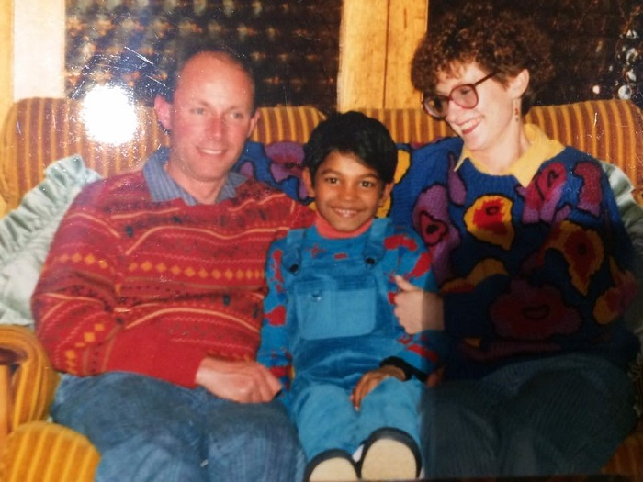

Slide 4
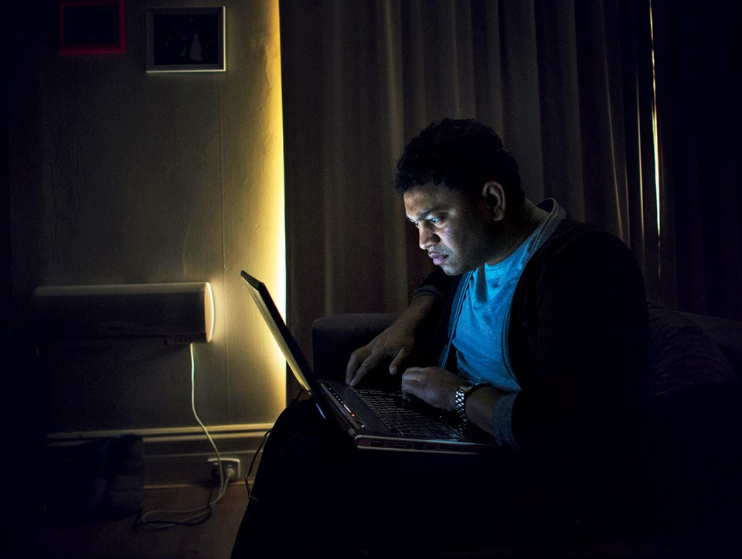

Slide 5
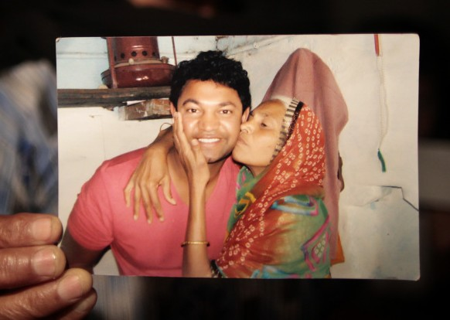

Slide 6
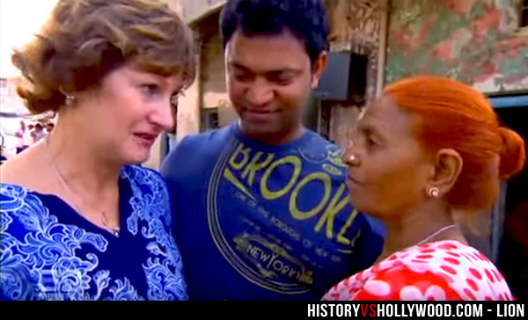

Slide 7
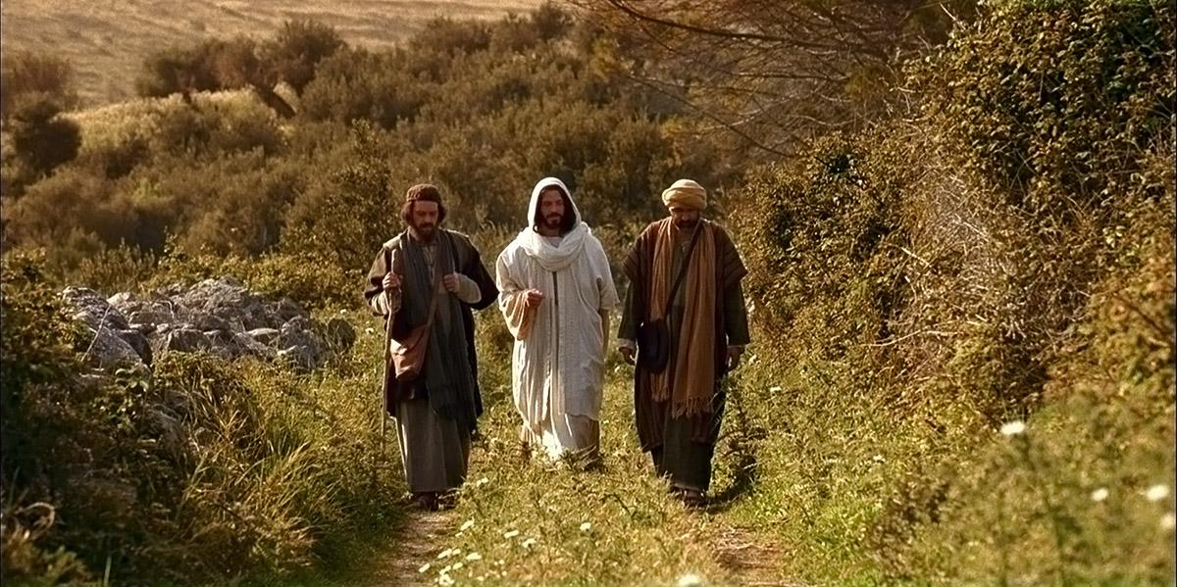
往以馬杵斯的路上
on the way to Emmaus

Slide 8

如果基督沒有復活，我們所傳的就是枉然，你們的信也是枉然！
And if Christ has not been raised, our preaching is useless and so is your faith.

Slide 9
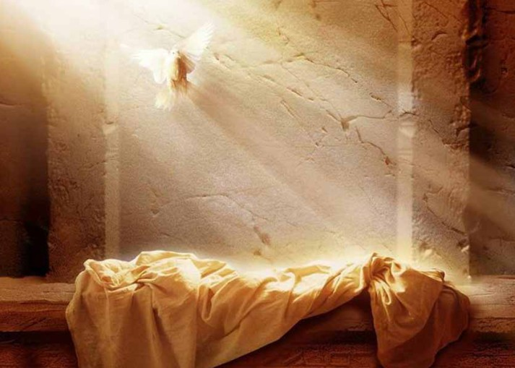
復活的力量遠超過
你的想像!
The power of resurrection is far more than your imagination.

