Slide 1
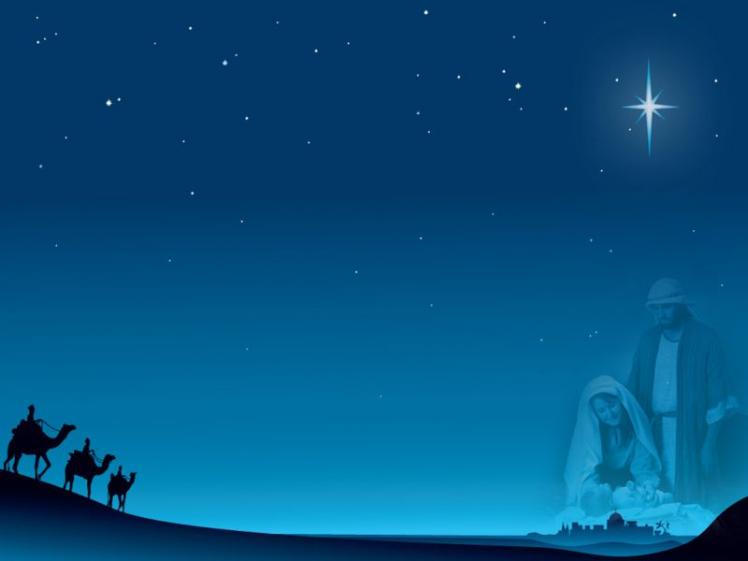
An extra baby Jesus
多一個耶穌

Slide 2
Since we were kids, we have heard the Christmas story many times, even performing the story in skits during Christmas. In the two Christmas accounts from Matthew and Luke, there are some basic differences between the characters, plots, and messages.

Slide 3
For example, only the Gospel of Matthew records the star from the East, the Magi and the gifts, and Herod and his cruelty. The Gospel of Luke records the Roman emperor ordering his subjects to return to their hometown to register for a census, Joseph and pregnant Mary not finding an inn to stay in Bethlehem, the baby Jesus being born and placed in a manger, the angels giving good news to shepherds, and so on.

Slide 4
The two Christmas stories have different explanations for why Jesus was born in Bethlehem and why he settled in Nazareth. The Gospel of Matthew says that Joseph and his family lived in Bethlehem. They escaped from king Herod, fled to Egypt, and settled in Nazareth after returning. The Gospel of Luke says that Joseph already lived in Nazareth. Because Caesar Augustus issued a census, everyone had to return their home town to register.

Slide 5
Obviously there are two different versions of the Christmas story. The Christmas skits used to mix the two versions of the story. Frankly, it is a mixed version with Joseph, Mary, the Magi, the shepherds, animals and flying angels joined together.

Slide 6
I believe that the Crystal Cathedral will not attract so many viewers to buy tickets every year. I explain the background of the two Christmas stories, so we may have another reason to talk about another Christmas story--there are actually many Christmas stories, and one of them is this.

Slide 7
About a week before Christmas, a mother bought a Nativity set from a local dollar store. When she unpacked it, she found two figures of the Baby Jesus. “Someone must have packed this wrong,” she said, and then realized that if she had two of the baby Jesus, one of the sets down at the store was missing a baby Jesus.

Slide 8
This mother decided to return to the store. But then Dad explained that there was probably thousands of that particular Nativity set scattered all over the country. It was probably miss-packed at the plant somewhere in Asia, which meant the Baby Jesus could be missing from a set in Florida or Texas or California.

Slide 9
But Mom insisted. She took the two kids and returned to the store where she told the manager that they had an extra Jesus. The manager tried to tell her the same thing Dad had said but again Mom insisted and finally the manager agreed to post a sign with the remaining sets which read: “If you’re missing Baby Jesus, call this number.”

Slide 10
All week long Mom kind of hovered around the phone. Every time it rang she got excited because she wanted to give that Baby Jesus to its rightful owner. Every time the phone rang, Mom would say, “I’ll bet that’s about Jesus.” But it never was.

Slide 11
Dad suggested that they just put the extra Jesus back in the box and forget about it.
Mom said “Surely someone will call. We’ll just keep the two Babies together in the manger until someone does.”

Slide 12
When no call had come by 5:00 p.m.
on Christmas Eve, Mom insisted that Dad “just run down to the store” to see if there were any of the Nativity sets left. “You can see them right through the window,” she said. “If they are all gone,
I am sure someone is bound to call tonight.”

Slide 13
Dad was not pleased.
“Run down to the store? Are you nuts? It’s 15 below zero out there!” The kids, brother and sister, both piped up and said, “Daddy, we’ll go with you!”
So they all got bundled up and headed out the front door.

Slide 14
When they got close to the store, brother ran ahead and pressed his nose up to the store window. “They’re all gone, Daddy,” he shouted. “Every set must have been sold. Hooray! The mystery will be solved tonight!”
Dad who was still about a half a block away, heard the news and immediately turned on his heel and headed back home.

Slide 15
When they got back to the house, they noticed Mom was gone and so was the extra Baby Jesus.
“Someone must have called, and she went out to deliver the Baby,” Dad reasoned. “You kids get ready for bed while I wrap the Christmas presents.”

Slide 16
Then the phone rang. Dad yelled, “Answer the phone! It must be the store manager. Tell him we found the home for Jesus.” But it was Mom. She called with instructions for the family to come to 205 Chestnut St. immediately, and bring three blankets, a box of cookies, and some milk.

Slide 17
Dad complied with the instruction but murmured, “Now what’s she gotten us into? 205 Chestnut. That’s half way across town. Why can’t we all just get on with Christmas?” When they got to the house at 205 Chestnut St., they noticed it was the darkest one on the block.

Slide 18
Only one tiny light burned in the living room. The minute they set foot on the porch, the door opened and Mom said, “They’re here! Oh thank God you got here! You kids take those blankets into the living room and wrap up the little ones on the couch. I’ll take the milk and cookies.”

Slide 19
“Would you mind telling me what is going on?” Dad asked. Mom said, “There is no heat in this house, and this young mother doesn’t know what to do. And these poor kids are facing a very cold Christmas, so don't you complain. I told her you could fix the oil furnace.” The children’s mother explained that she’d been doing all right until the furnace broke down.

Slide 20
I’ve been doing cleaning at the dollar store,” she said. “I saw your number every day there, on those Nativity set boxes. When the furnace went out, that number kept going through my mind. It said on the box that if a person was missing Jesus, they should call that number. I figured that maybe you would help me.

Slide 21
So I stopped at the store tonight and
I called. “I am missing heat. I have no money to fix that furnace.”
“Not a problem,” said Dad.
“You’ve come to the right place. Shouldn’t be too hard to fix the furnace. I’ll look it over, see what it needs.”

Slide 22
Mom came into the living room carrying a plate of cookies and warm milk. Meanwhile, Dad got the oil burner working but said, “You need more oil. Let me make a few phone calls tonight and get you some oil.”
Everything was done according to plan.

Slide 23
As Mom and Dad and two kids were ready to say goodbye, they noticed that extra Baby Jesus figurine was lying in the center of the table.
It was the only sign of Christmas in the house. But that was enough to make the tiny house look like a manger.

Slide 24
Brothers and sisters, nobody ever did call about the missing Baby Jesus in the Nativity set. But you know it wasn’t a packing mistake at all. An extra Jesus – that’s almost the only appropriate way to pack the Nativity set! That night, the Word became flesh and dwelt among the people once again.

Slide 25
That night, the Baby Jesus found his rightful manger in the family who needed him most. For this Christmas, you and I need to do one thing. We need to check the Nativity sets here in this church and in our homes, and see if there is an extra Jesus! I bet there is! And so we are compelled to find an appropriate Manger for this extra Jesus.

Slide 26
We still have plenty of time to handle our own extra Jesus in Christmas season. Before you set out to do that, let’s pray that:
Glory to God in the highest heaven, and on earth peace among those who he favors!

