Slide 1
相遇之後

Slide 2
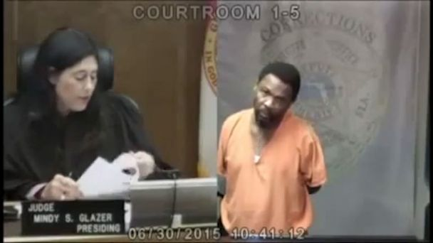
Mindy Glazer
Arthur Booth

Slide 3
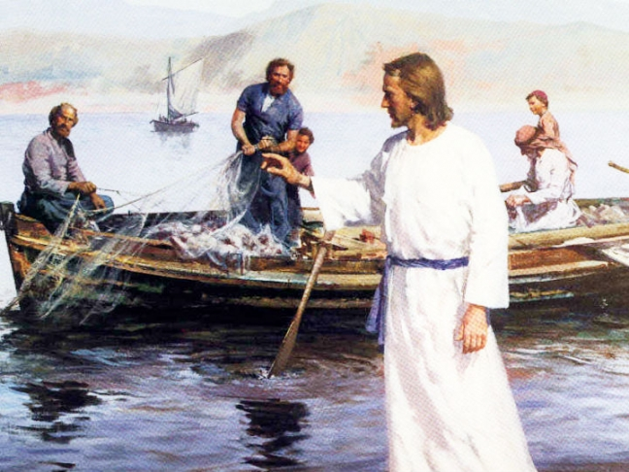

Slide 4
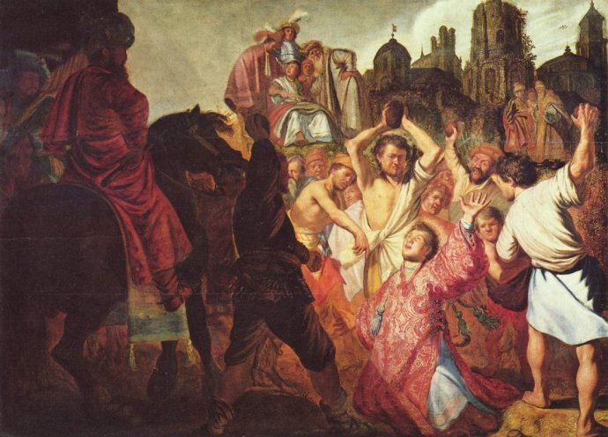

Slide 5
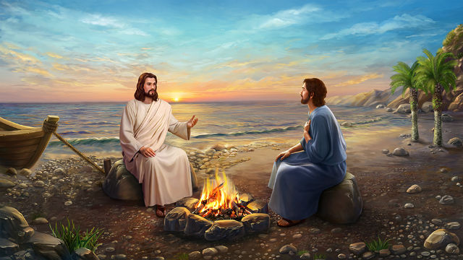
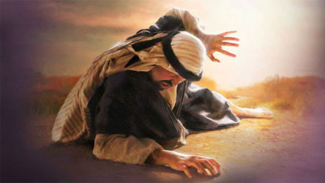

Slide 6
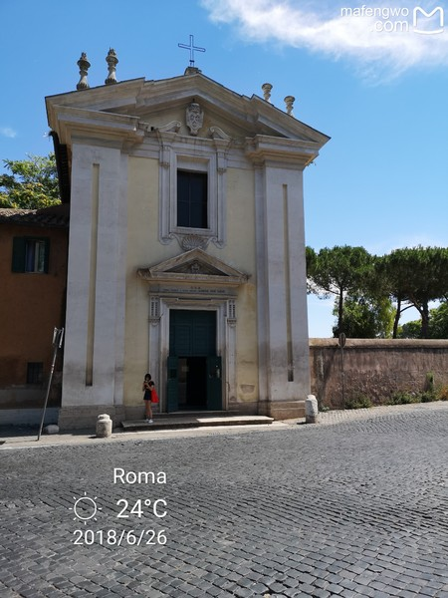
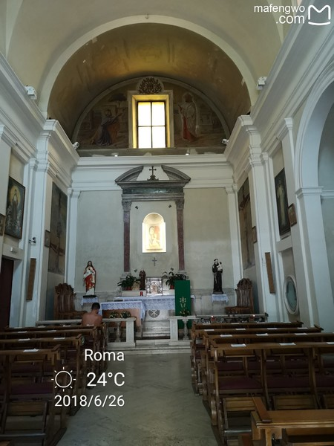
St Mary in Palmis
Lord, where are you going？

Slide 7
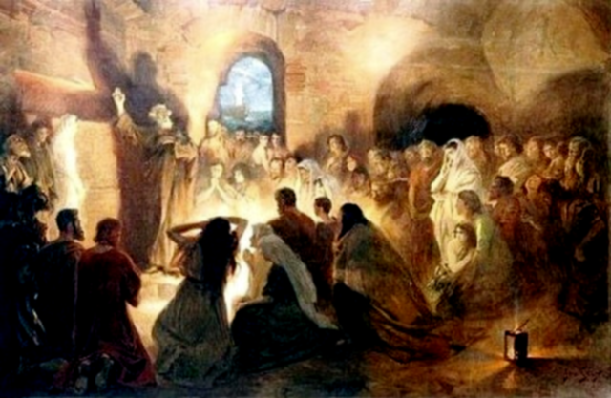
復活的主與你
相遇的故事

Slide 8
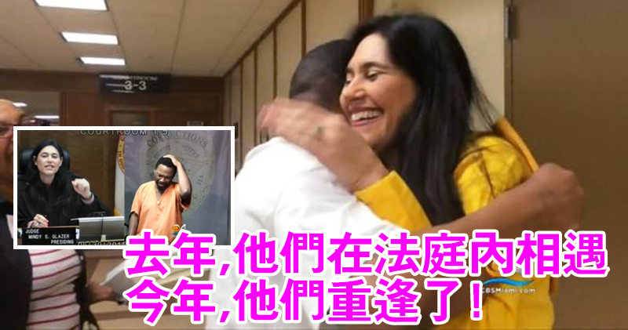
意外的相遇能帶來改變嗎？
意外的相遇能帶來改變嗎？

Slide 9
Judge Greets Classmate Lea ... r Recognizing Him in Cour

